Slide 1

Sharing Smiles and
Promoting Vaccine Awareness
Rotary Clubs of Kansas
Notes:
A new statewide program developed for all the Rotary Clubs in Kansas (and the Oklahoma panhandle).

Slide 2
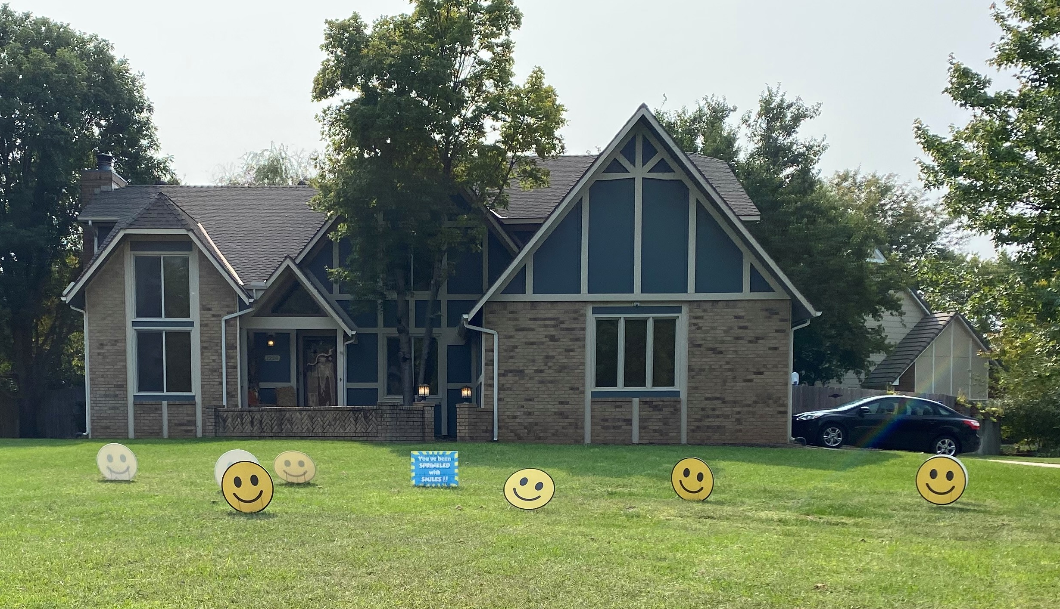
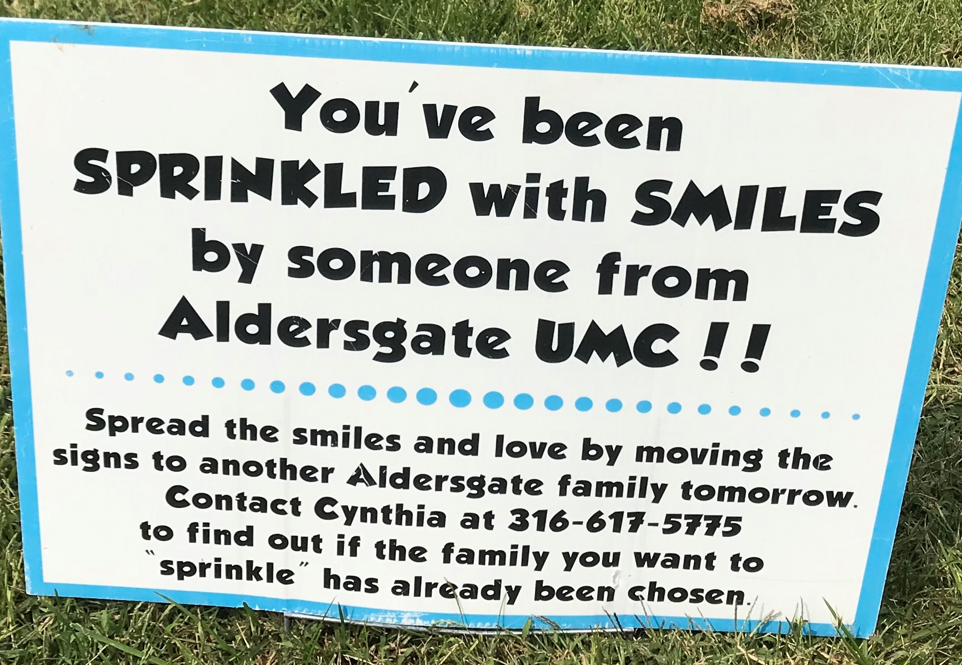
The Inspiration
Notes:
On the way to pick up her sister, Rotarian DeAnn Sullivan saw this in the yard of one of her neighbors. It made her smile and curious! So they stopped to see what was up and took some pictures.

Slide 3
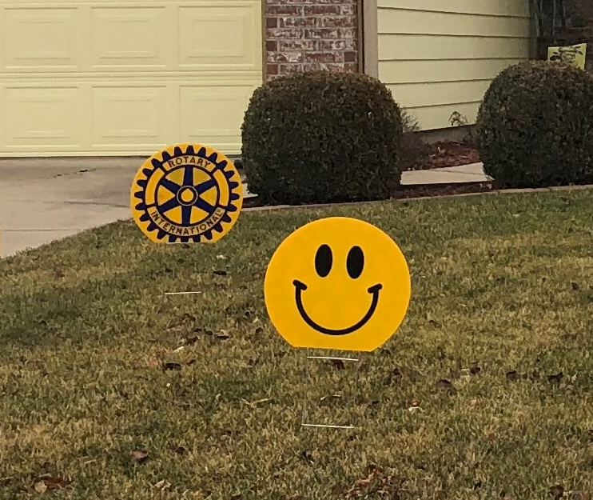
A Rotary Version?
What if we put the Rotary Wheel on the back of the Smiley?
Notes:
Then they started thinking about how Rotary might be able to do something similar. In fact, since the Smileys were round… we could put a Rotary wheel on the back and promote Rotary as we made people smile.

Slide 4
Just for Fun!
Surprise members with a life event (new baby, anniversary, birthday, etc.)
Connect with members who are ill or who haven’t been attending meetings.
Honor first responders – police, fire, teachers, nurses, etc.
Use as a fundraiser. Members could pay to have them put in someone else’s yard for a birthday; or ask for payment to have them moved.
During a Rotary project draw attention while it’s underway, like a playground map project.
Notes:
The more they talked about it with others, the more ideas came for how to use the signs.
One Rotarian had just delivered a baby - how fun it would have been to have them in her yard when she came home from the hospital.
Or perhaps our new club officers.
Some of our members have been homebound during the pandemic – wouldn’t it brighten their day. And their neighbors!
Some members just hadn’t been coming to meetings – perhaps it would help reconnect.
More ideas came from other Rotarians, such as a potential fundraiser, similar to when you get flamingoes put in your yard and you pay to have them removed or moved.

Slide 5
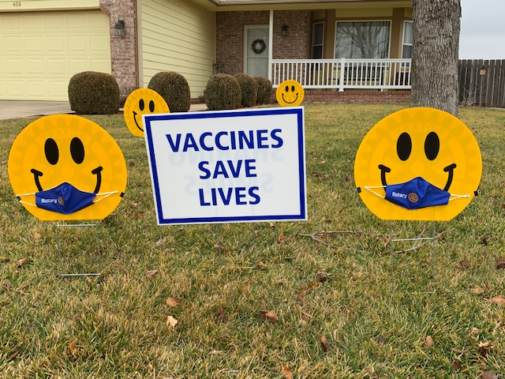
Vaccine Awareness
Notes:
The first club to actually pursue the idea was the Derby club. They ordered powder-coated metal signs! But the cost was over $300 and the delivery interval 8-10 weeks. So DeAnn started exploring options and found a company to make them from corrugated plastic.
About that time, members of our District leadership team participated in a meeting led by the Kansas Leadership Center asking for ideas for promoting vaccine awareness and adoption. That’s when the idea to add a sign came up – and a couple of masks to put on smileys – to draw attention to it. This allowed us to apply for (and we got) a grant to help pay for the signs.
We discussed the wording on the sign and instead of “get vaccinated and wear your mask”, we went for simpler wording that supports Rotary’s long term efforts toward vaccinations. And the masks are a subtle touch. (They do kind of look like a mustache unless you use pins to open them up a bit. ☺)

Slide 6
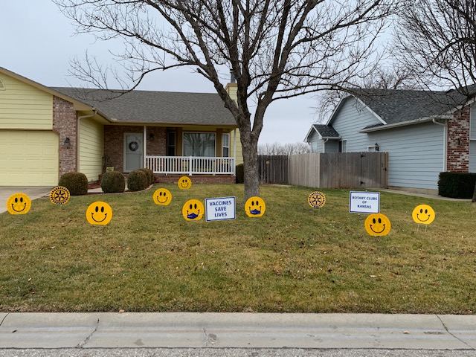
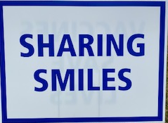



Flexible
Set Up
Simple to Implement
Notes:
We partner on PETS and other projects with District 5710 and they chose to join in. They’re paying for their kits from their Public Image budget. When we realized we covered all the KS clubs except the 12 in Southeast KS, we didn’t want to leave them out. So we reached out and they bought kits as well.
A Smiley “kit” includes 10 round smiley/wheel signs, 2 rectangles, 12 metal stakes for them, and 2 Rotary masks equipped with binder clips! There is also a sample press release included and a flyer with suggestions for implementing the project – a summary of what I’m sharing with you in these slides.
By placing a single order for 120 “kits”, our volume discount made this a very affordable project. If a club ordered just one set – it would cost over $500! Ten sets would provide a volume discount bringing it to $900 – or $90 per set. So with 120 sets – “It was beneficial to all concerned!”
This should be a simple project to implement. Each club should identify someone to store them when they’re not out and keep track of them when they are. And perhaps a couple of people to help put them out, move them and take them down.
The signs are such you can choose what to use and how to use them. Sharing Smiles is on the other side of the Vaccine sign. The Rotary logo on the other side of the Rotary Clubs of Kansas sign.

Slide 7
People of Action
Service (club, community)
Rotary publicity (community wide)
Member engagement (COVID and beyond)
Customize your press release and share your Rotary efforts.
Send photos of how your club is using them to DeAnn.Sullivan@att.net
Notes:
We all look forward to not needing the vaccine sign. And even now you may have times you just want to focus on Sharing Smiles.
Our only request is that you use them as you serve your club and community; and share any creative ways you come up with.
The signs are being delivered to the clubs during February. Let’s start thinking about how to have some fun with them. Each of you write down 3 ideas and we’ll then compare notes. (Brainstorm ideas with the members and identify a point of contact to store and keep track of the signs, if possible.)
Customize your sample press release and let your community know what Rotary is doing and why!
Please send photos of how your club is using them to our district Trainer, DeAnn Sullivan, at deann.Sullivan@att.net. She’ll put them on the new Sharing Smiles page on our district website.
Have fun!!

