Slide 1

District #5680 Conference
Liberal, KS
October 21-23rd, 2022
Part three of three
Presenter Name

Slide 2
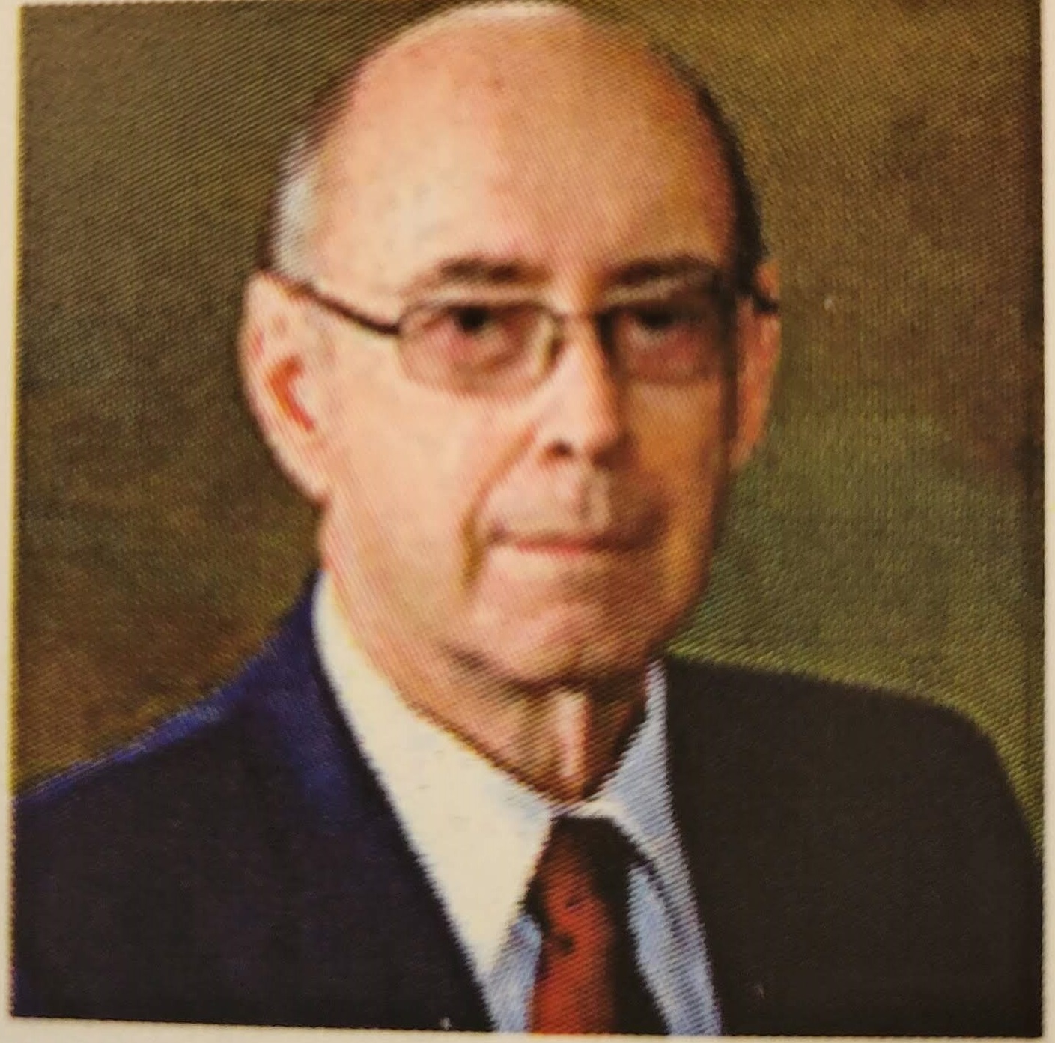
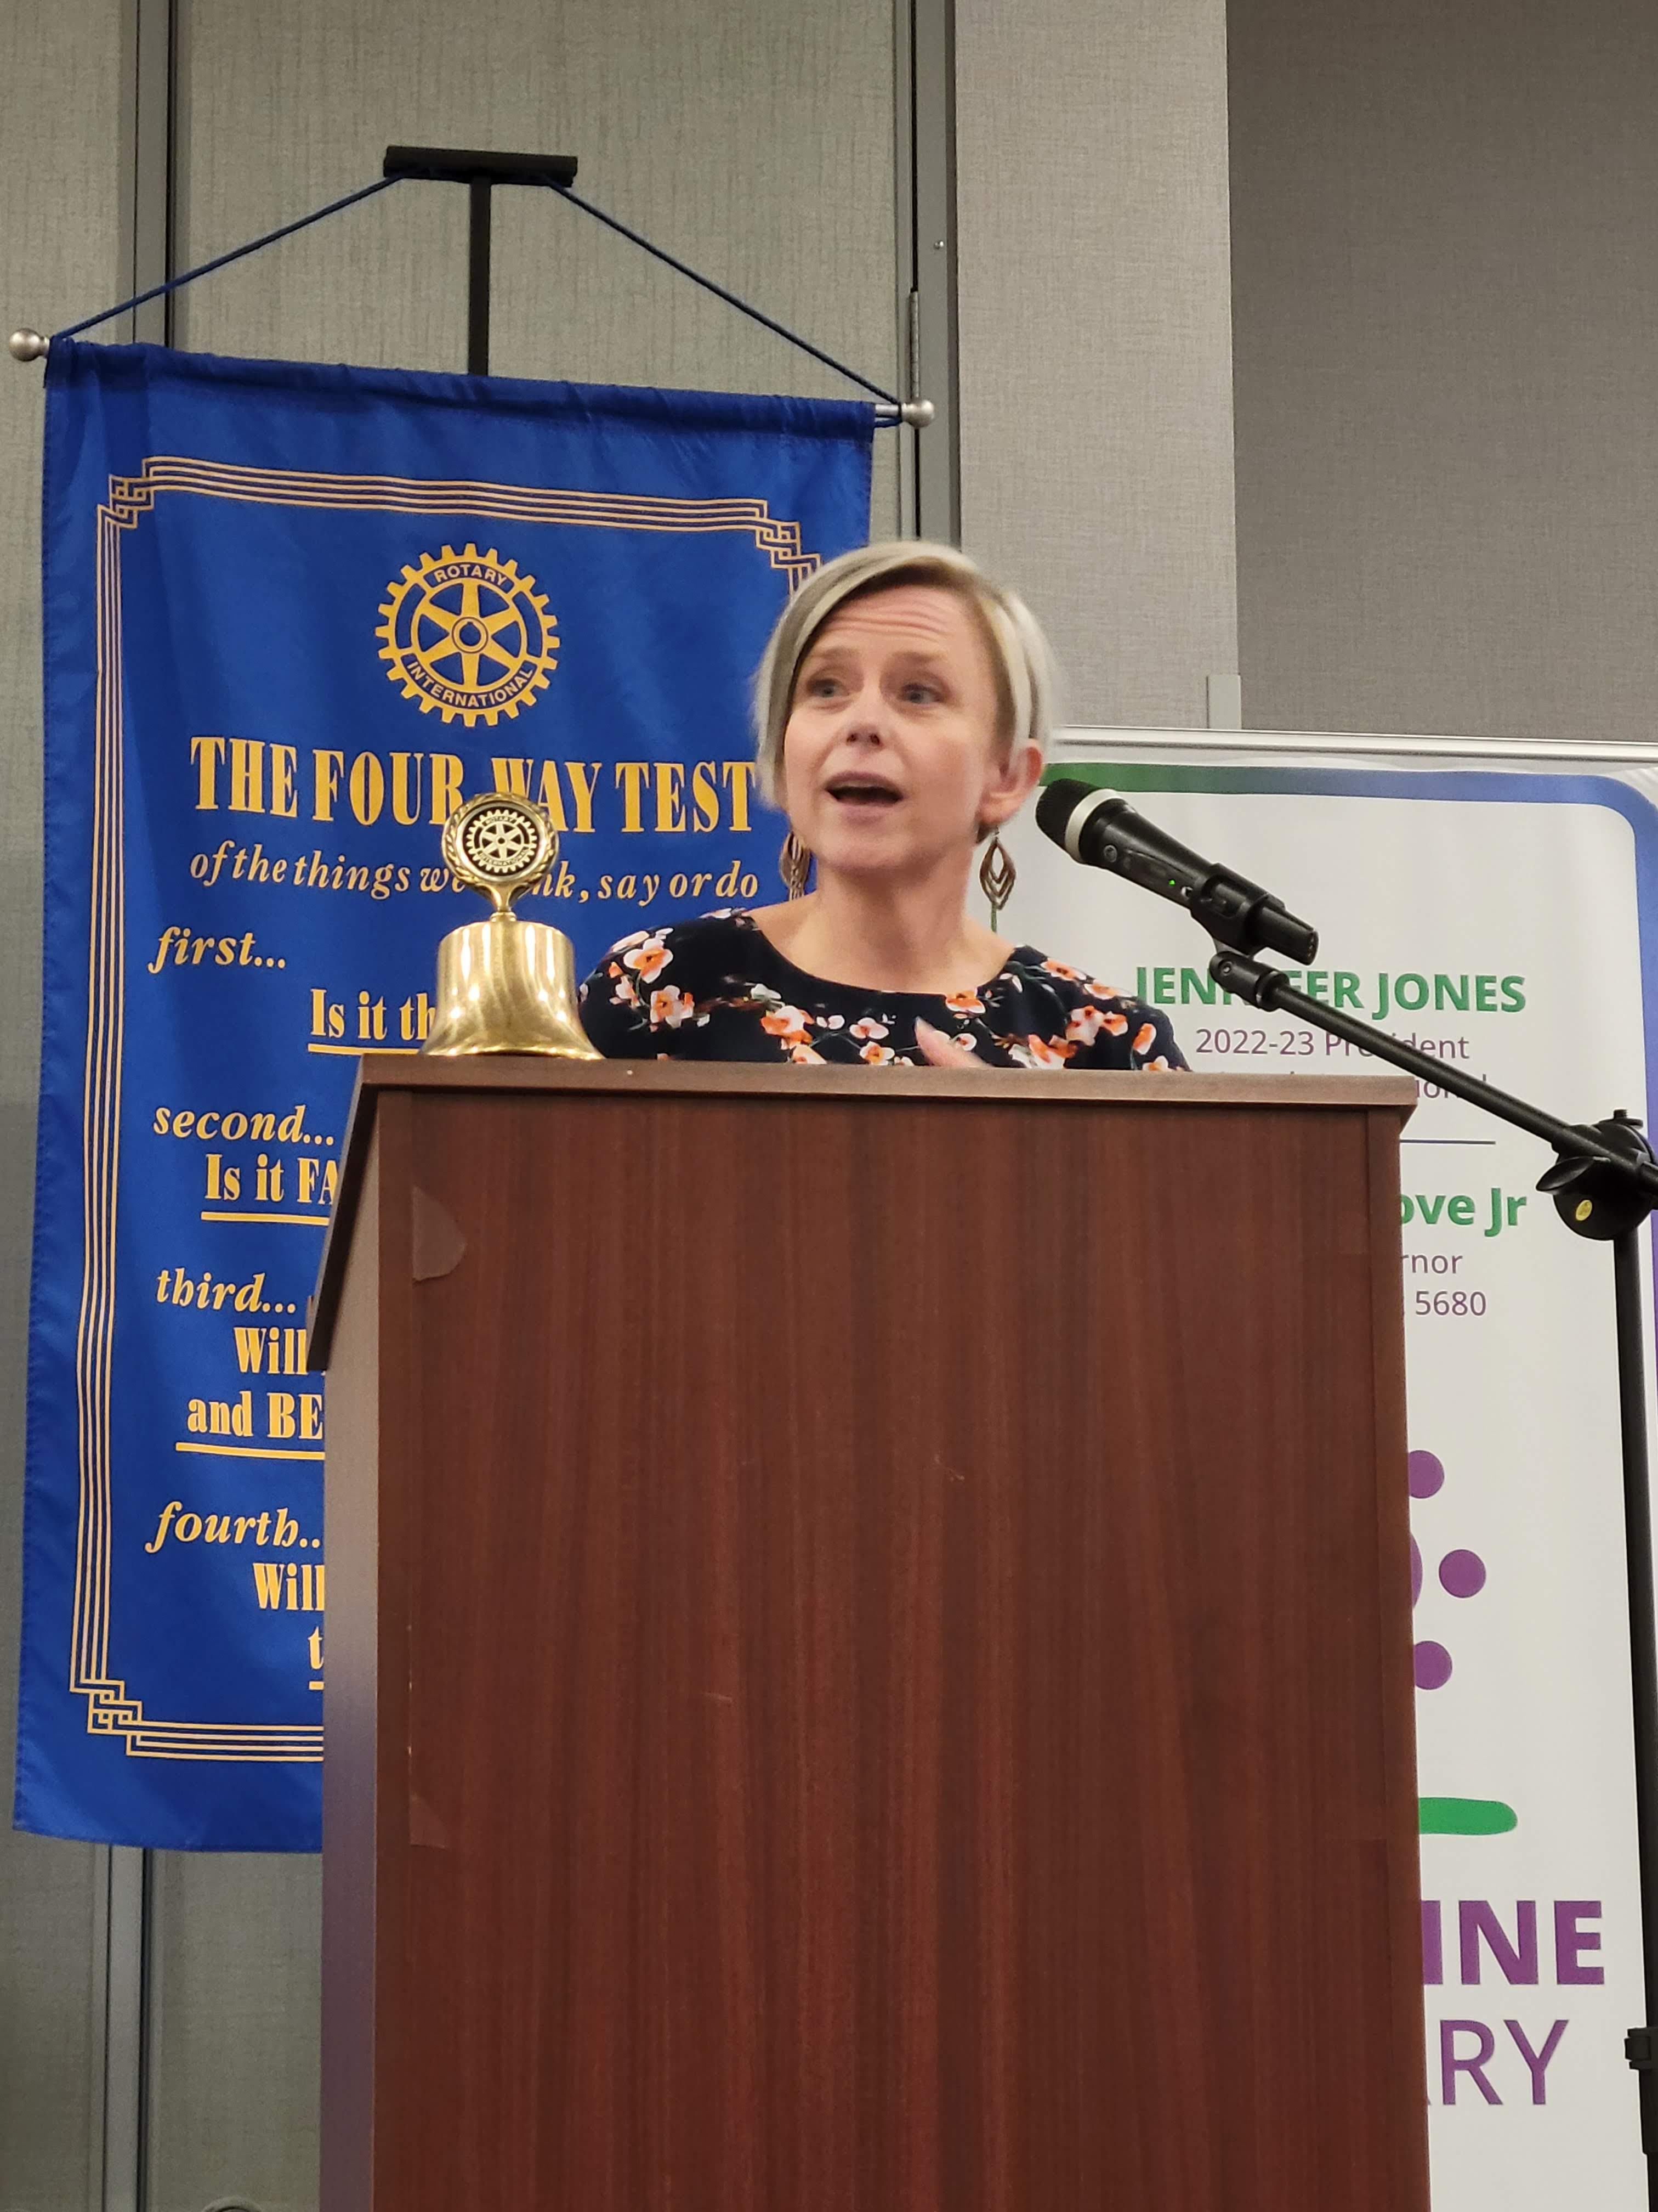
William “Ed” Thurman, Jr. - Lexington, KY
The International President’s Representative!
Saturday’s Conference was filled with Guest Speakers, Awards, Project & Entertainment!
Michelle McCormick
Dir. Of Victim Services
Kansas Attorney General’s Office
Human Trafficking
Drug Smuggling in Kansas

Slide 3
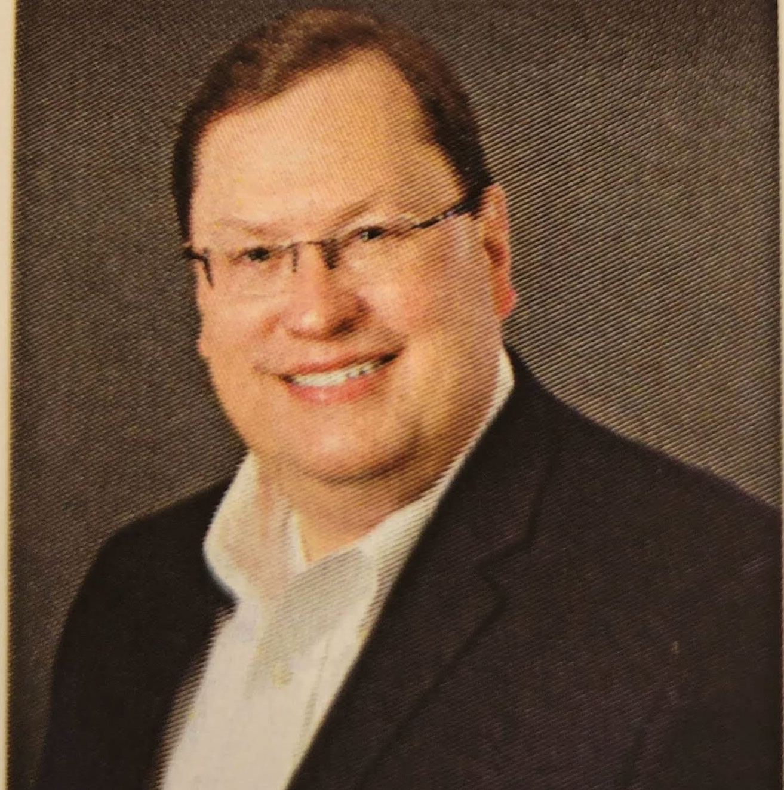
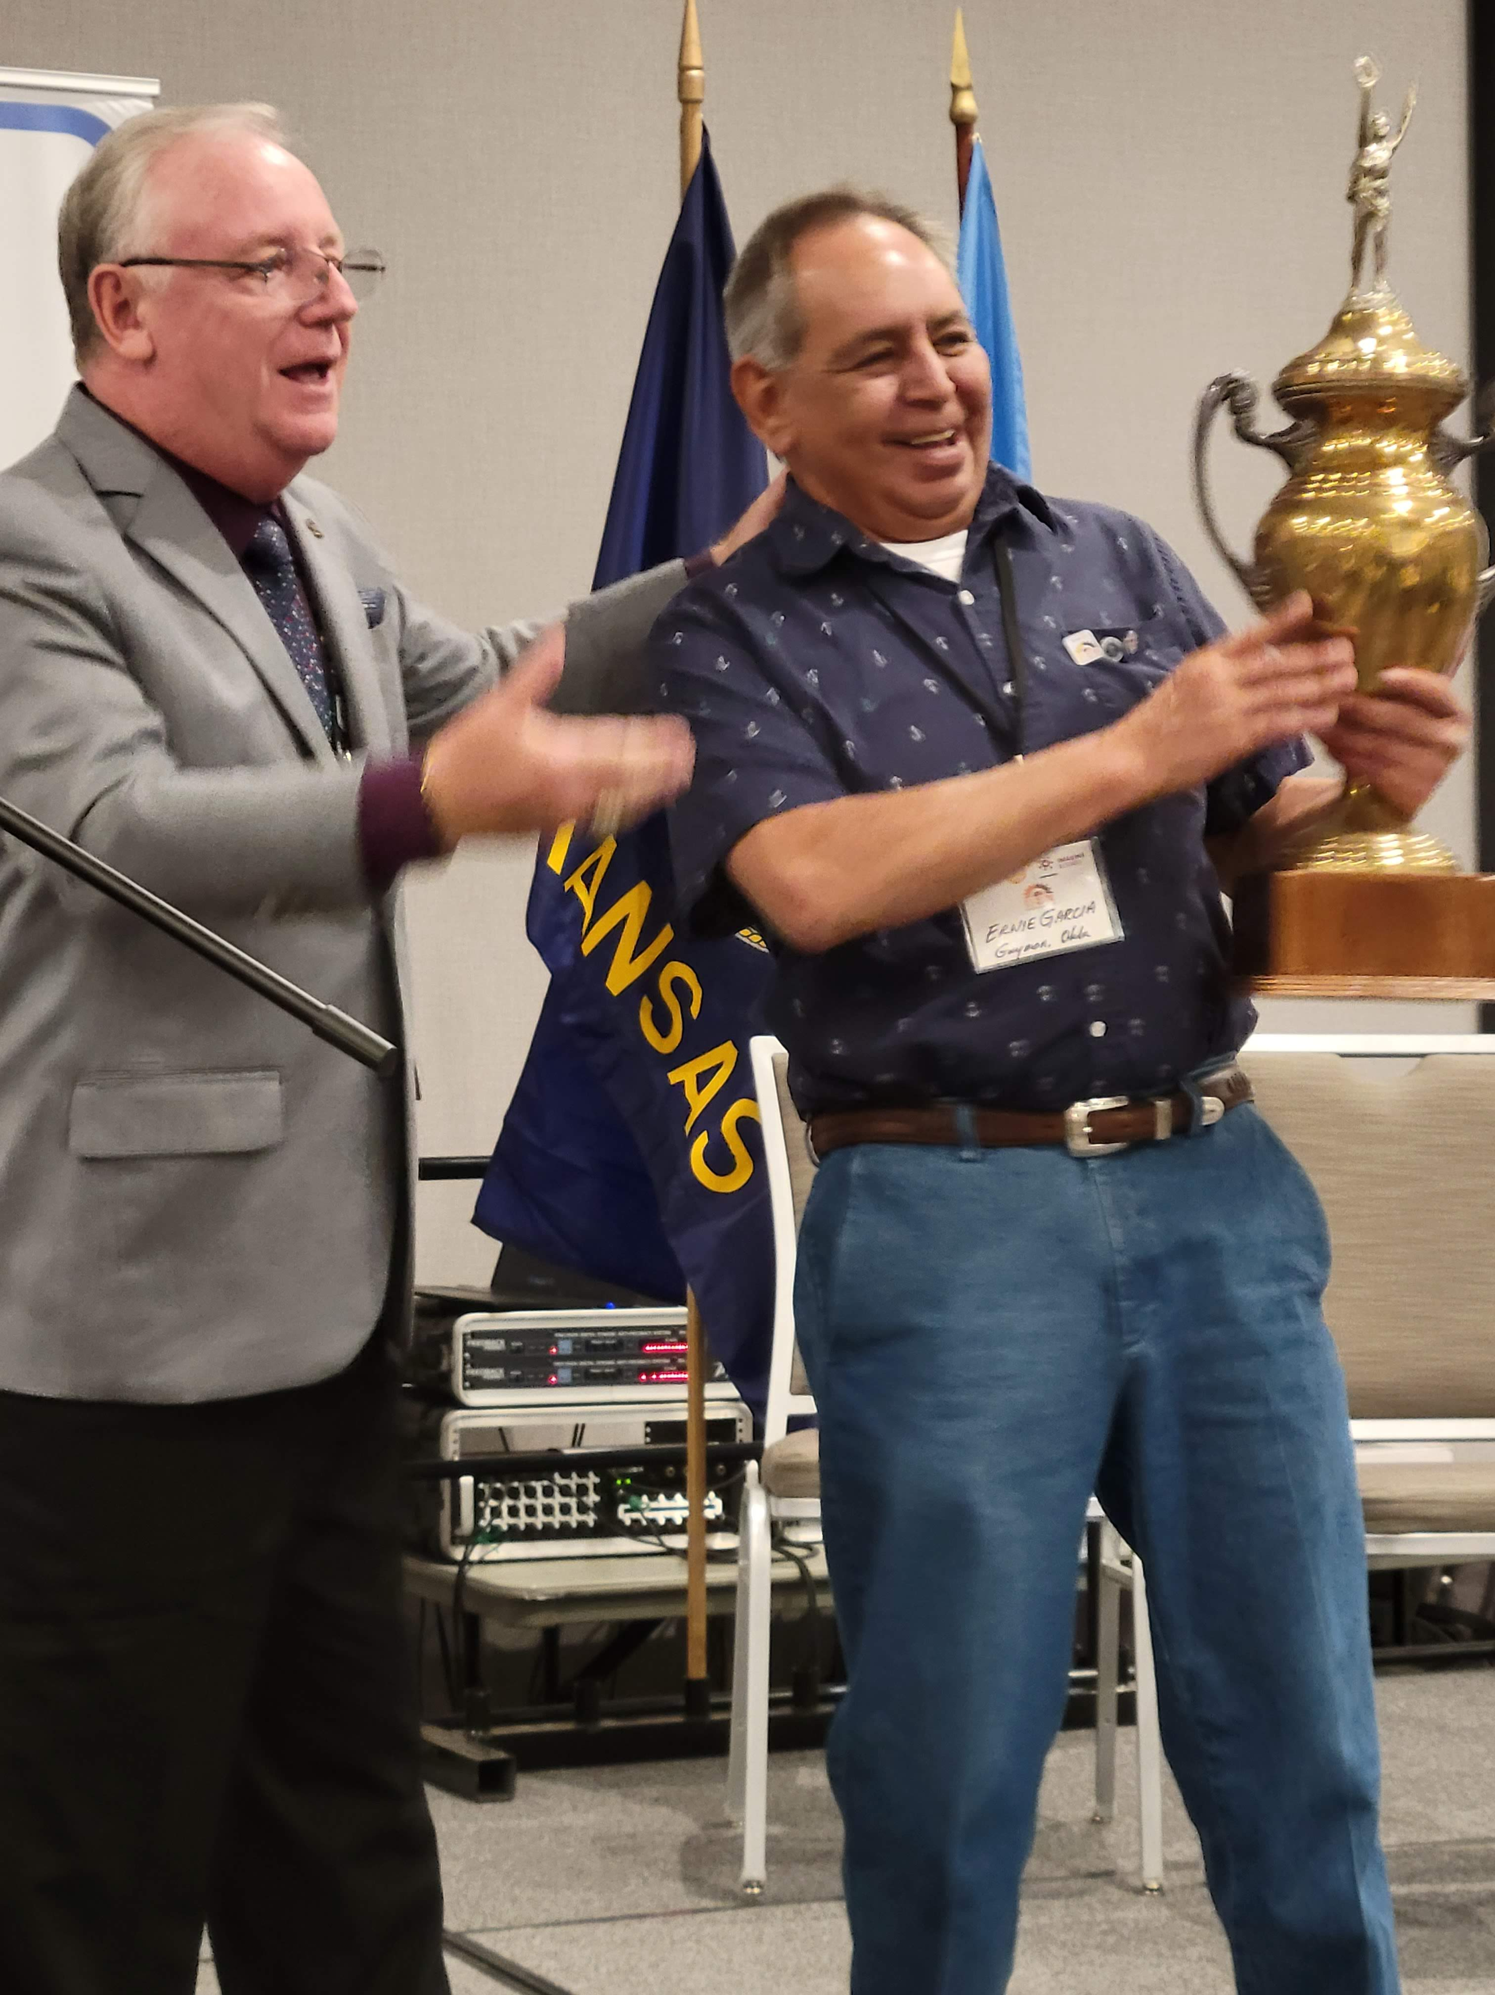
Tom Gump – Rotary International’s
Membership Growth Committee 2022 -25
Guest Speakers & Awards
District #5680’s
Rotary Club of the Year
Presented to
Earnie Garcia, President
Guymon, OK

Slide 4
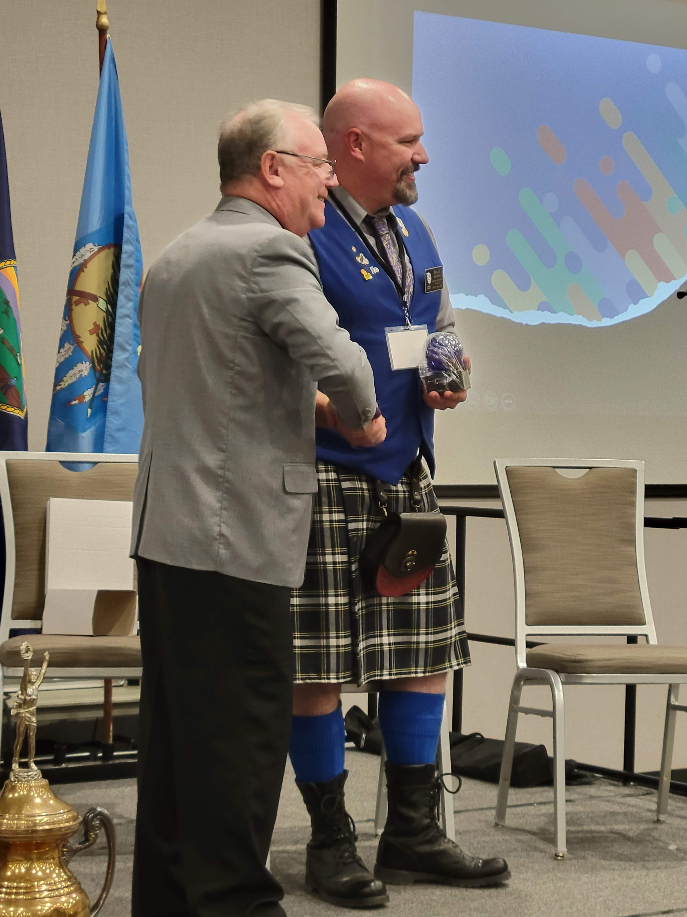
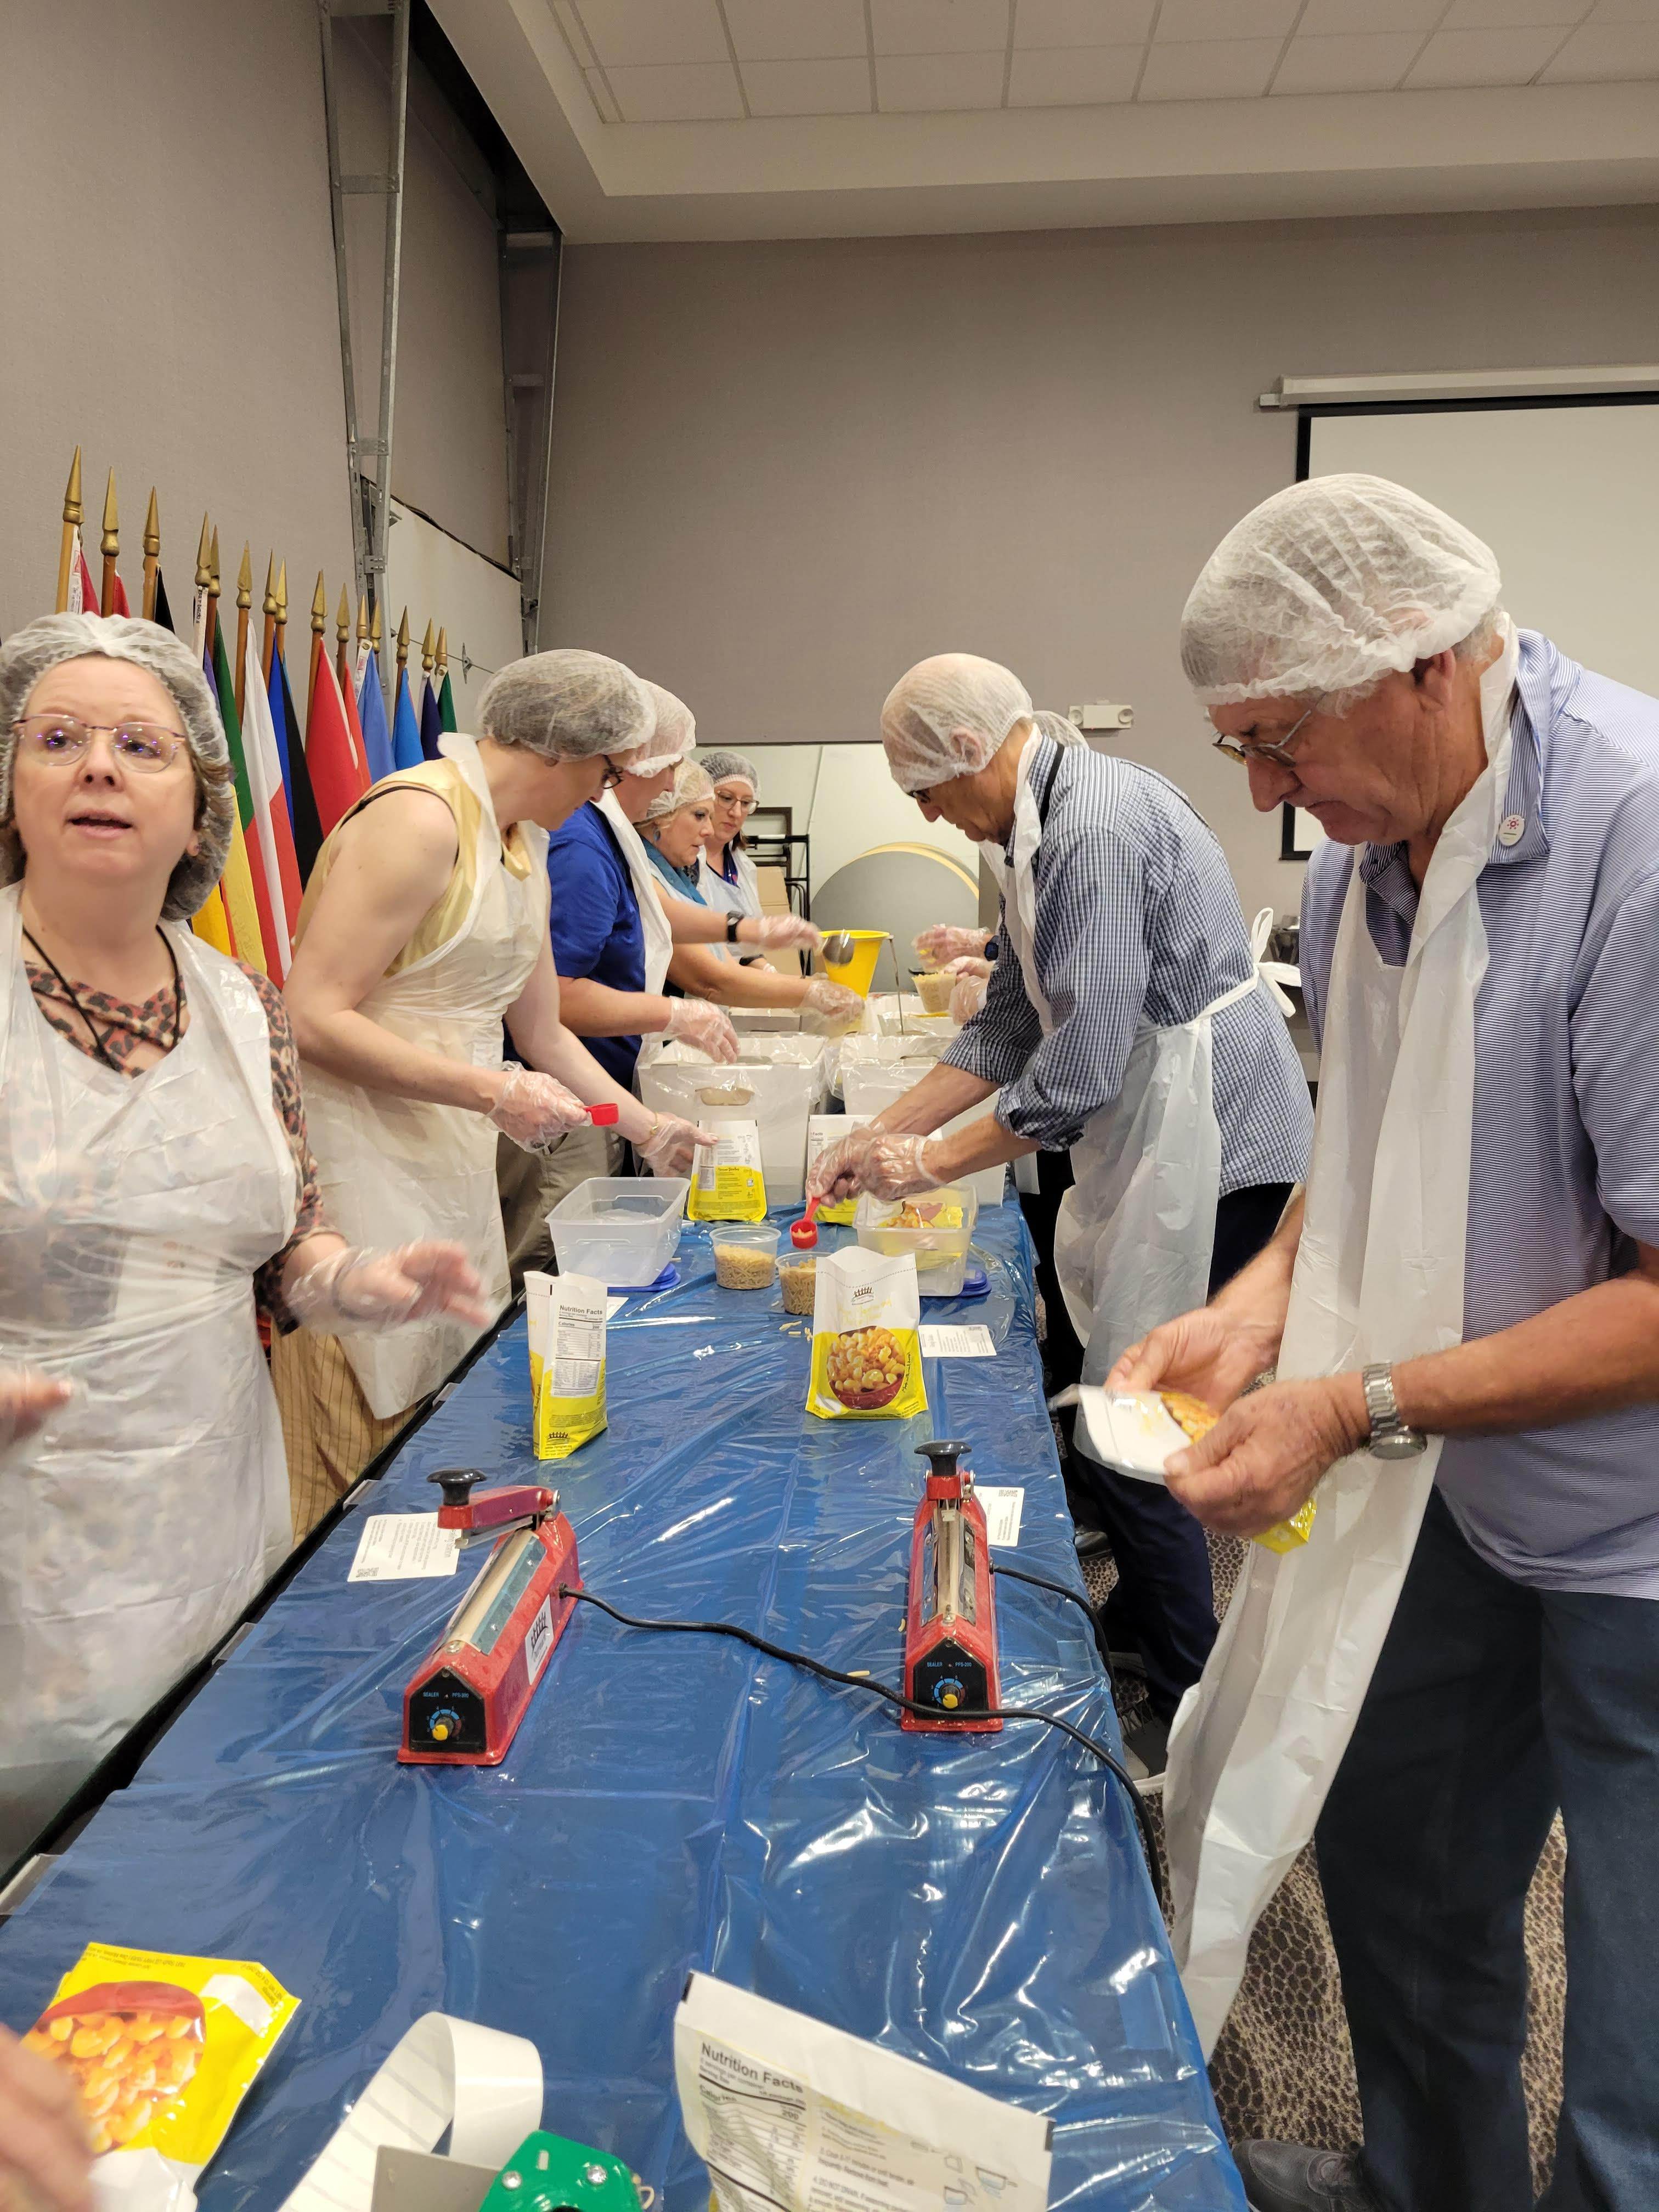
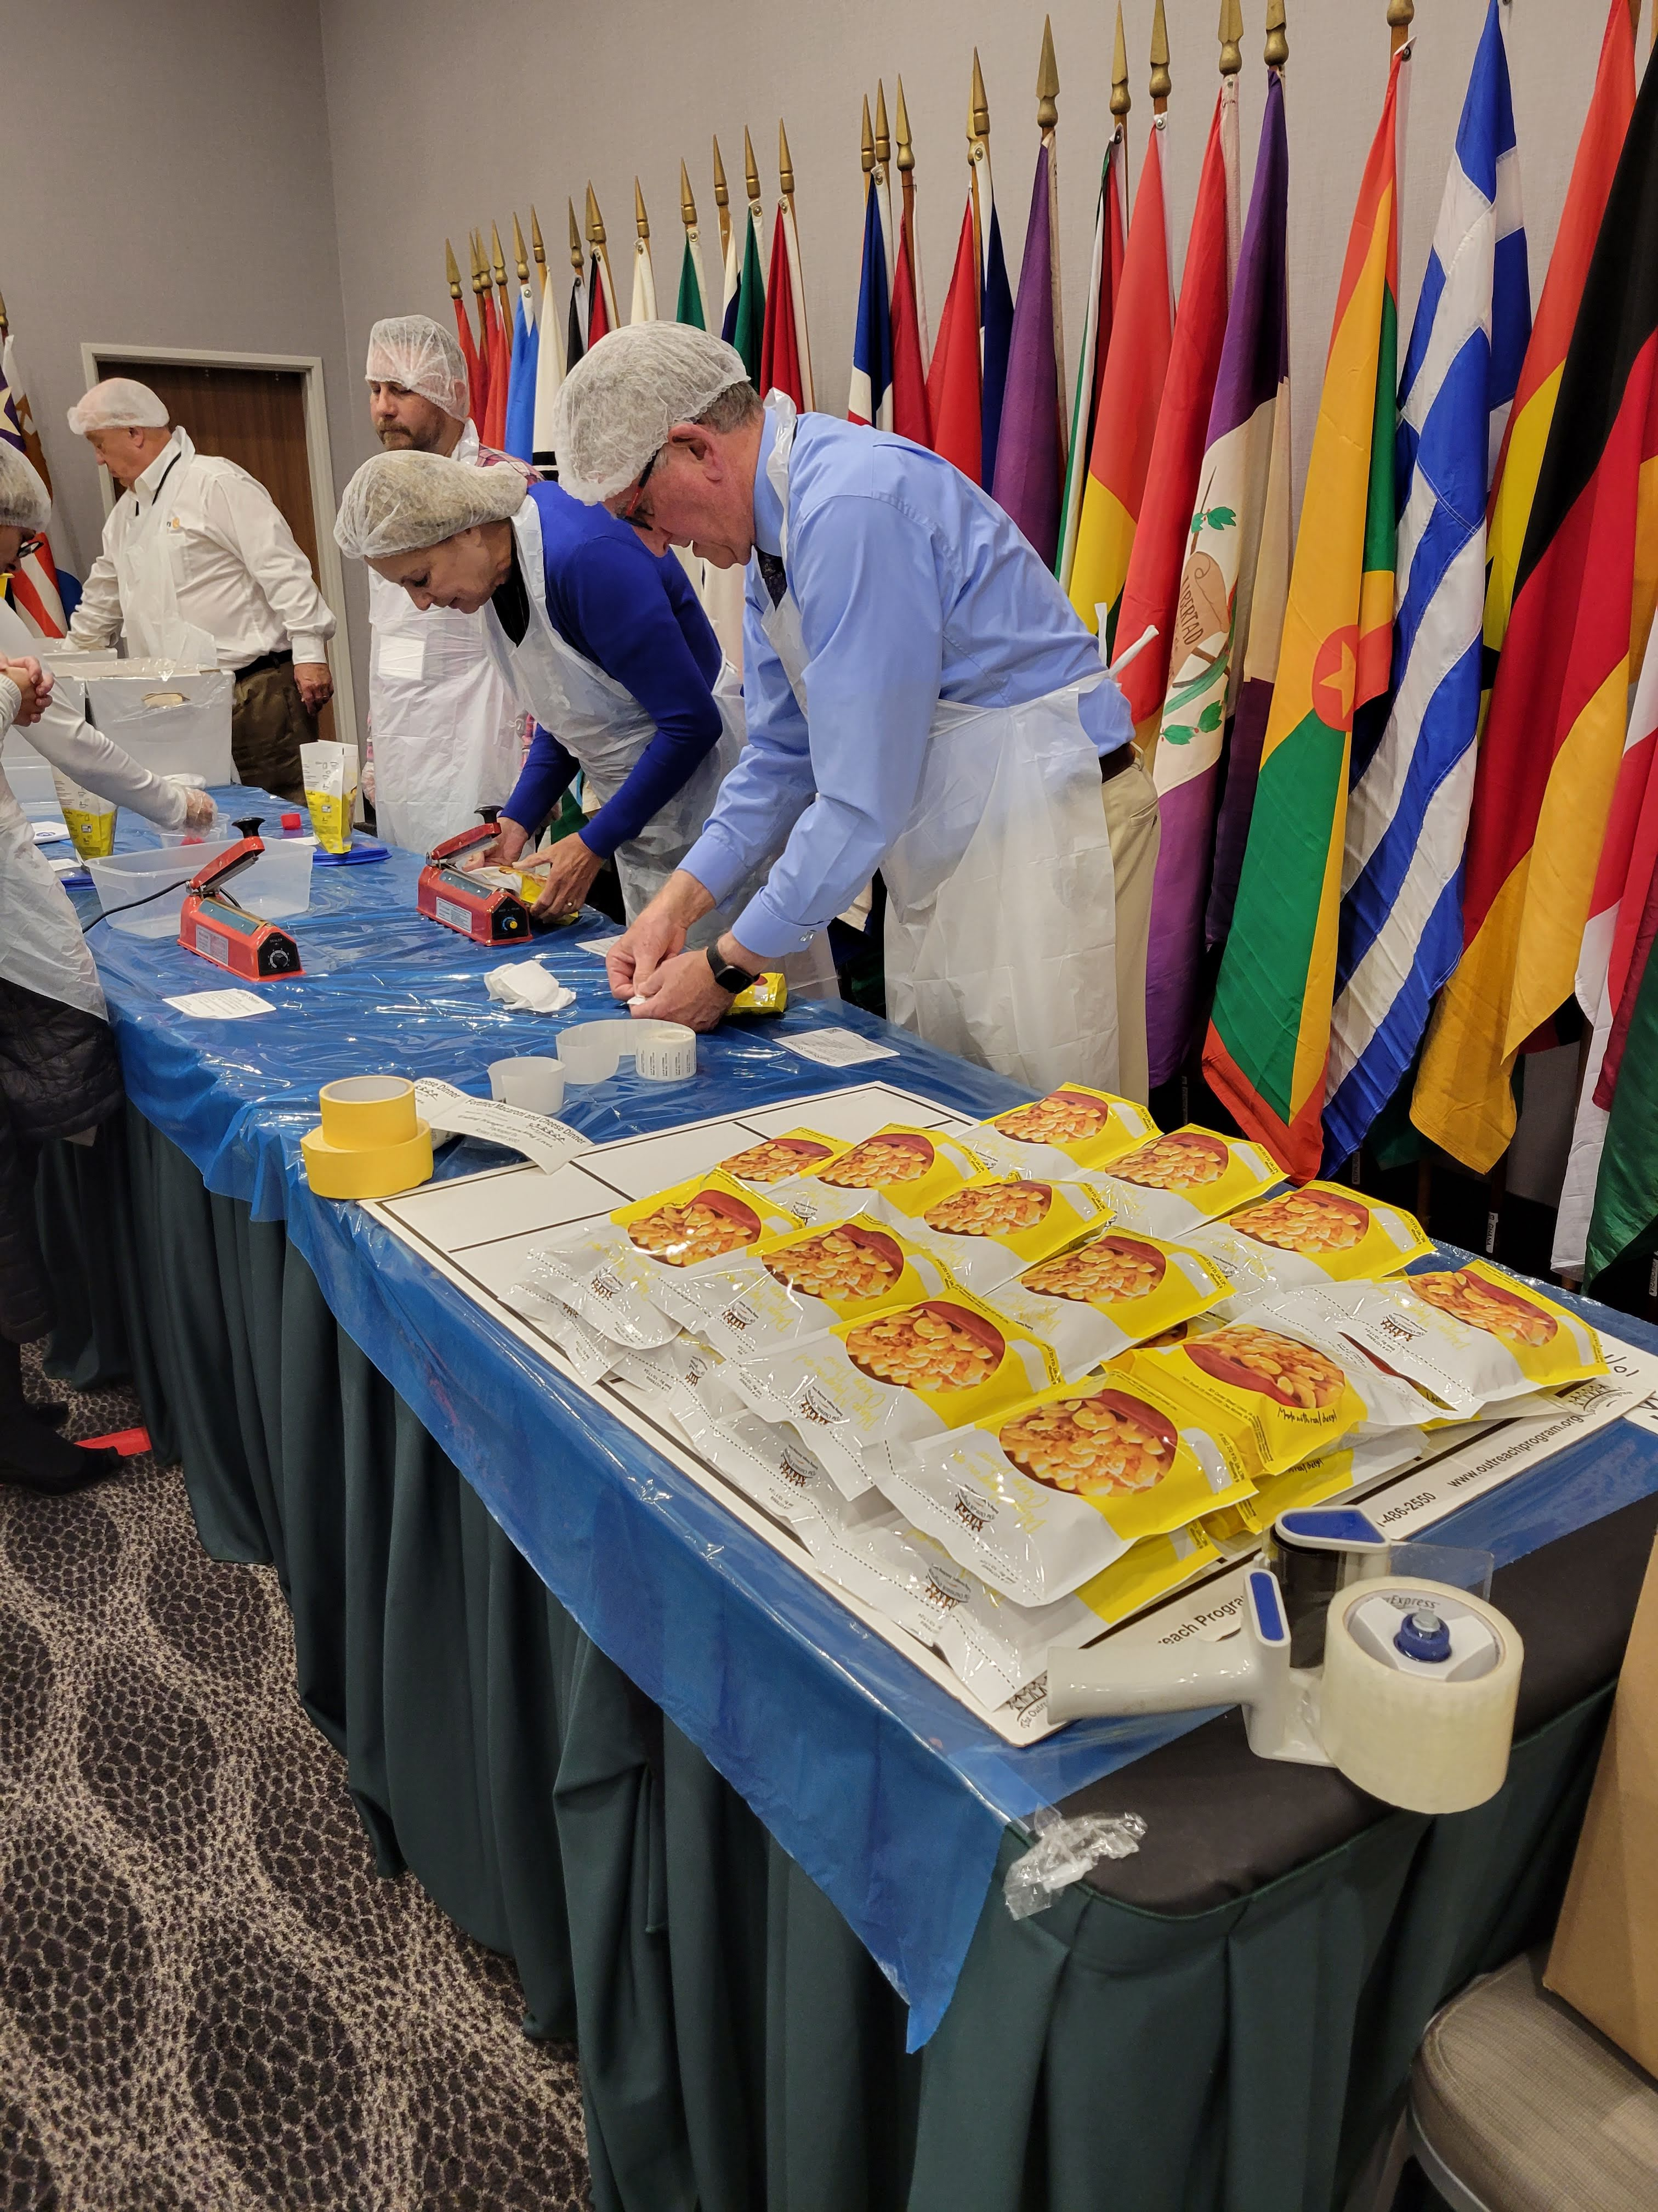
Then…. Isaac McNary,
the Scottish guy…. Organized
a great Service Project .. Packing Lunches!

Slide 5
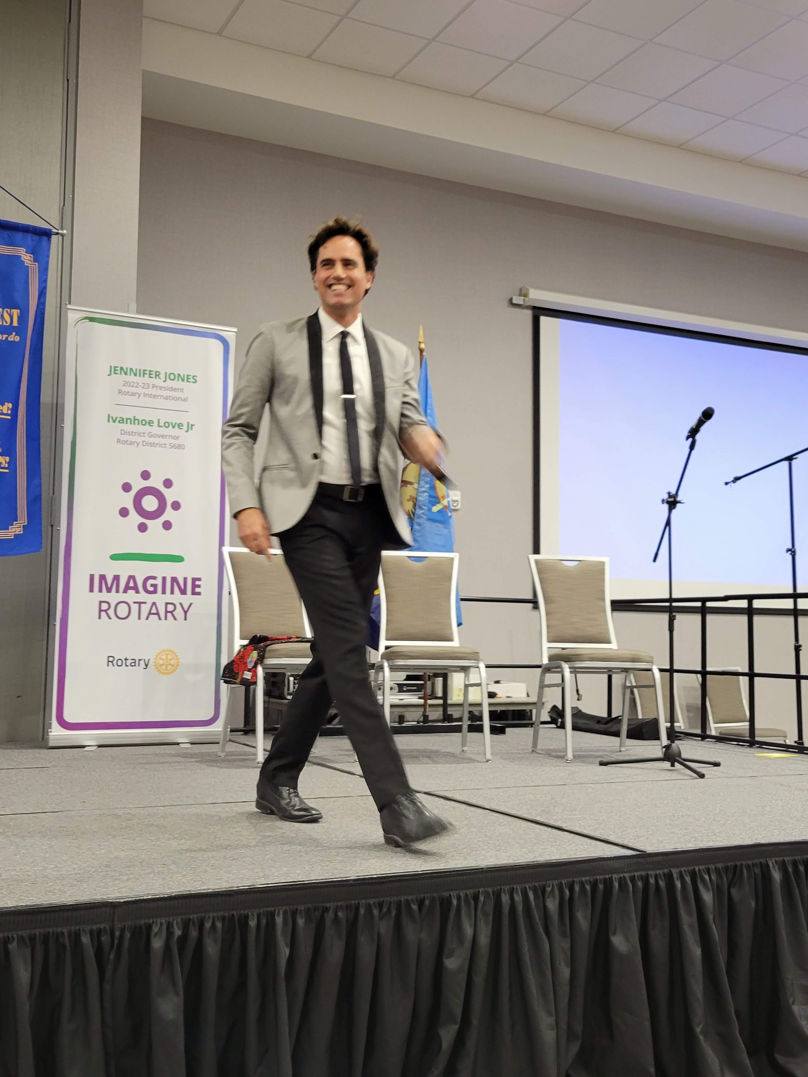
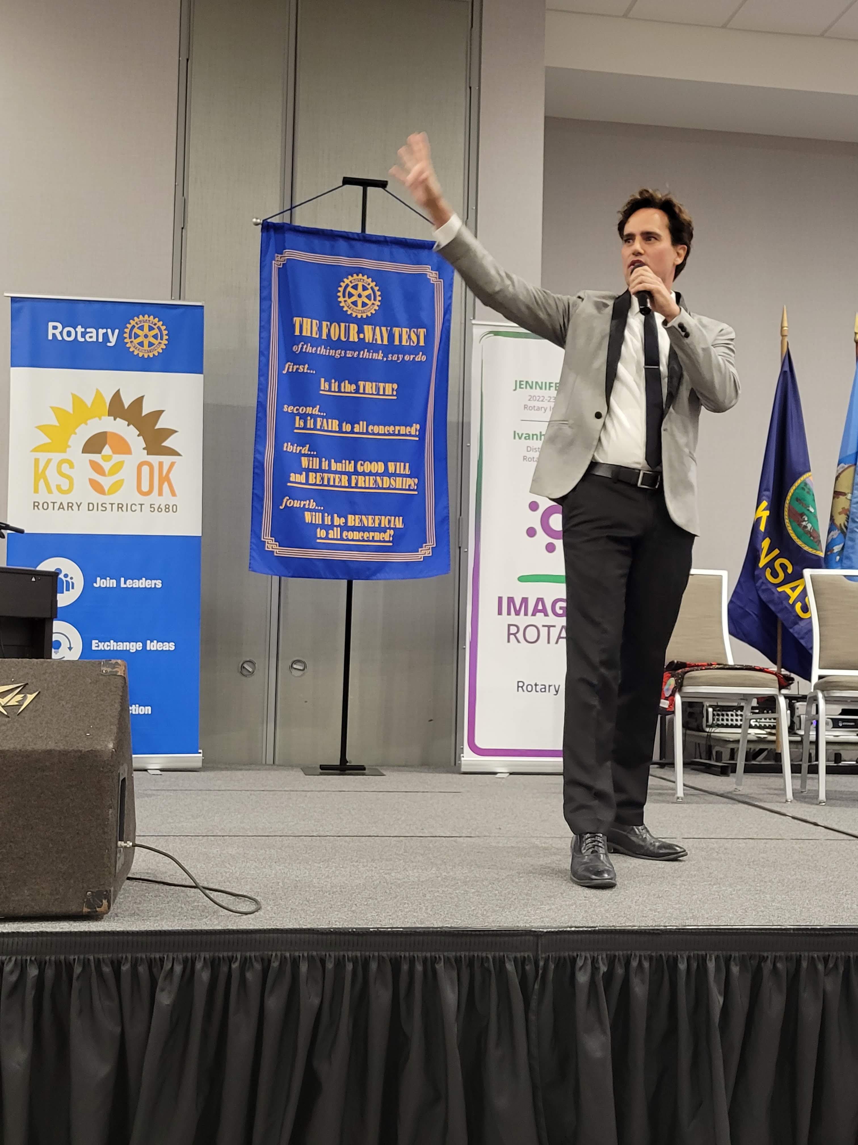
Topping Off Saturday Evening’s dinner
with Broadway Entertainment….
David Burnham!
Come On Get Happy...... It's going to be a great Rotary Day!
Learn More about David @ Davidburnham.com

Slide 6
Seven
Areas of focus
We direct our efforts to enhance our local and global impact. Our most successful and sustainable projects and activities tend to fall within the following areas:
Promoting peace
Fighting disease - # 1 is Polio
Providing clean water
Saving mothers and children
Supporting education
Growing local economies
Protecting the environment

Slide 7
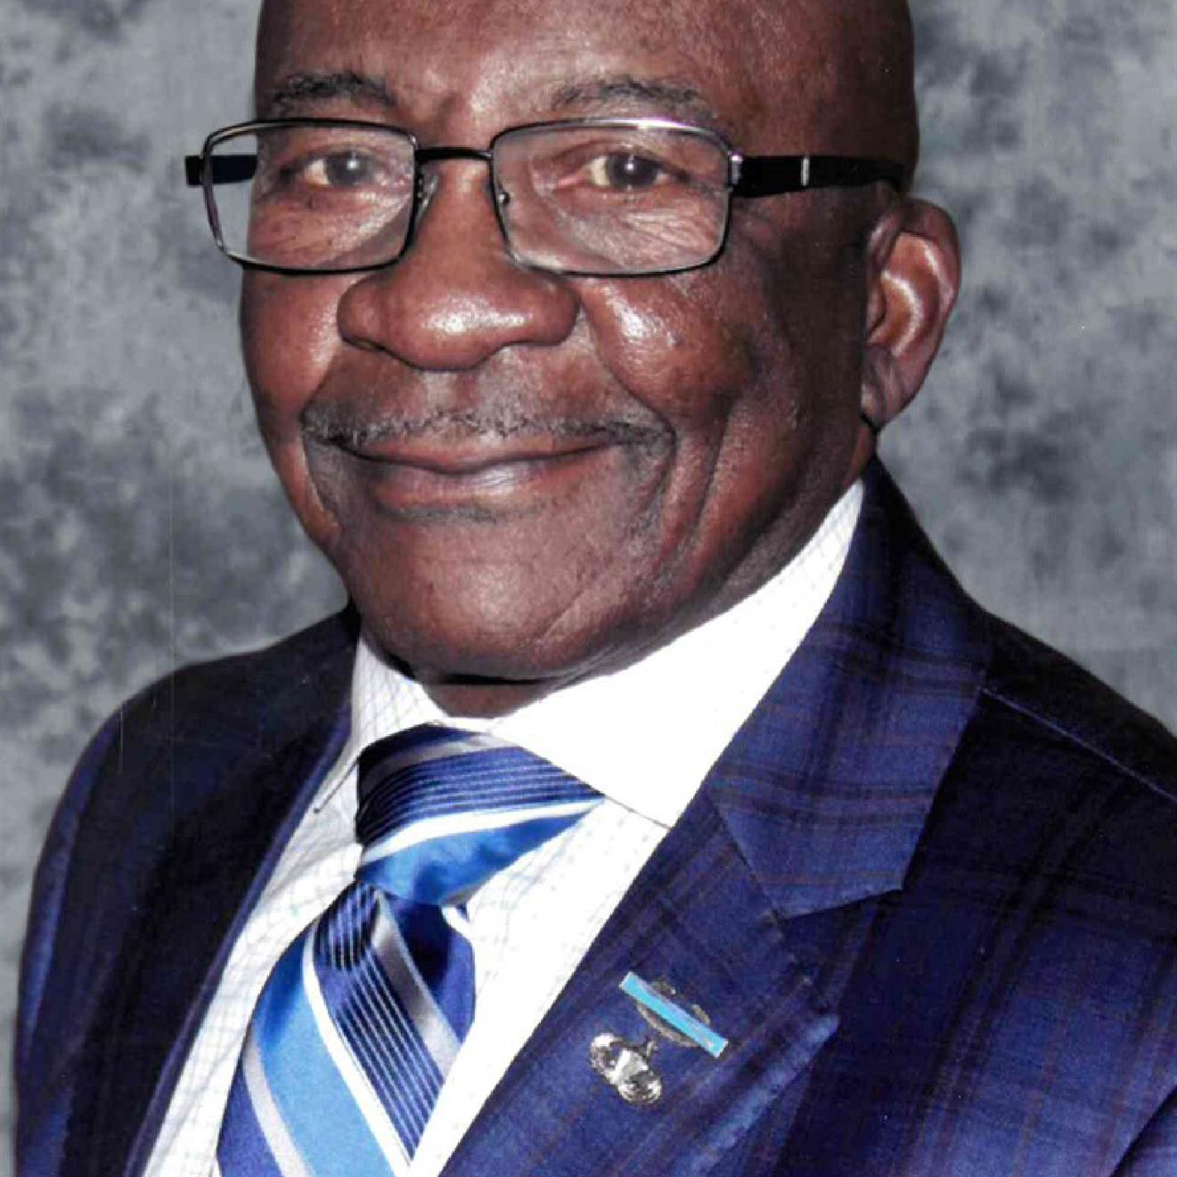
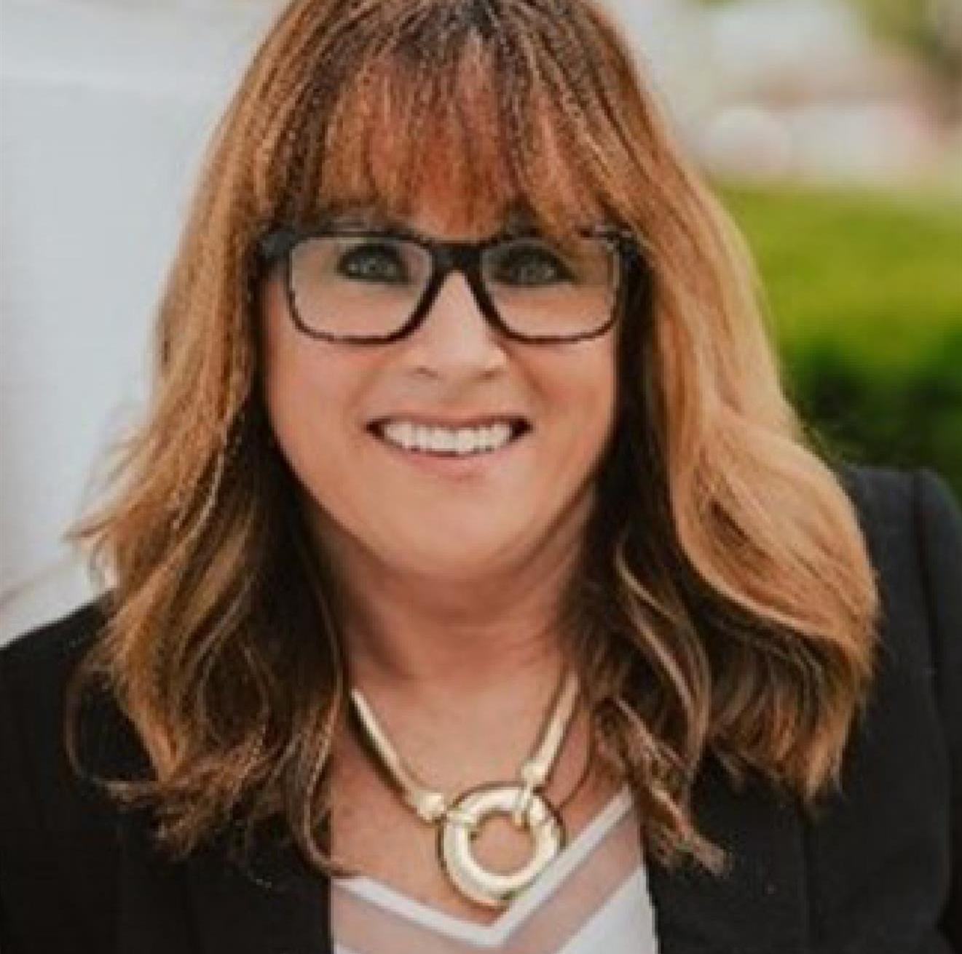

Thank you
SEE YOU
@ District Conference 2023 - 2024
Russell, KS
Gloria Homeier, DG Elect
Dates & Details @ https://rotary5680.org/

