Slide 1
District #5680 Conference Liberal, KS October 21-23rd, 2022 Part two of three
Presenter Name

Slide 2
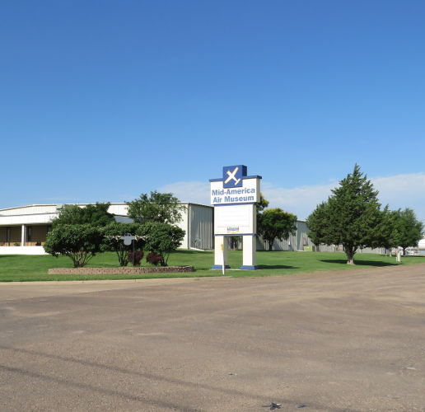
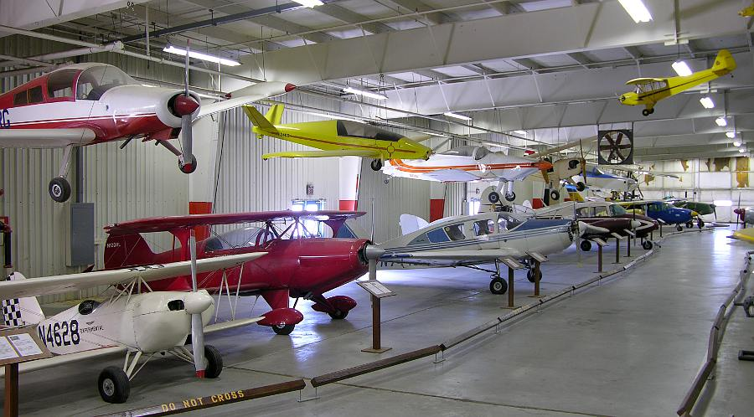
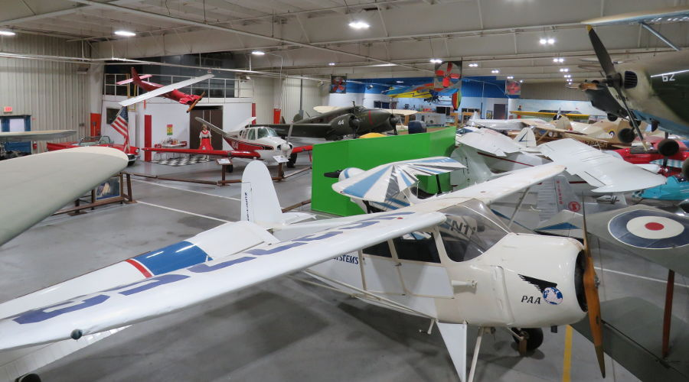
And then… there were Tours…..
Over 110 planes – 52 were donated by Colonel tom Thomas, Jr. from his collection!
War Planes - Smallest Military Planes
Distance Record Planes
Personal Presidential Planes

Slide 3
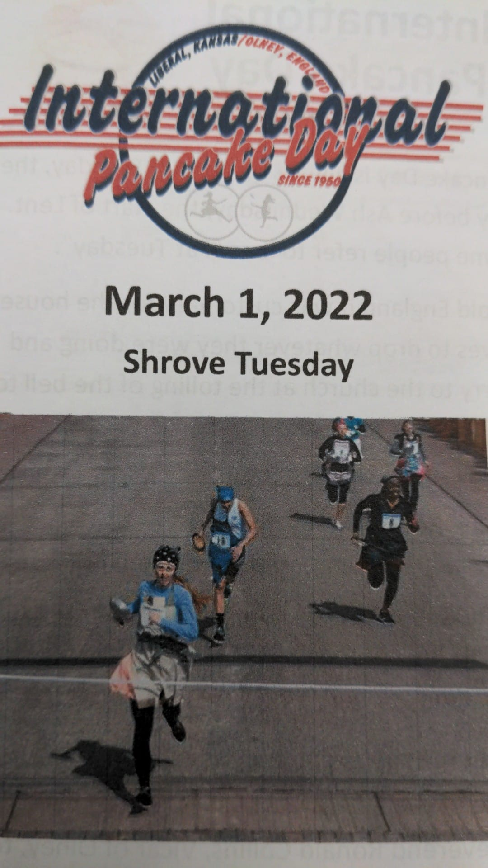
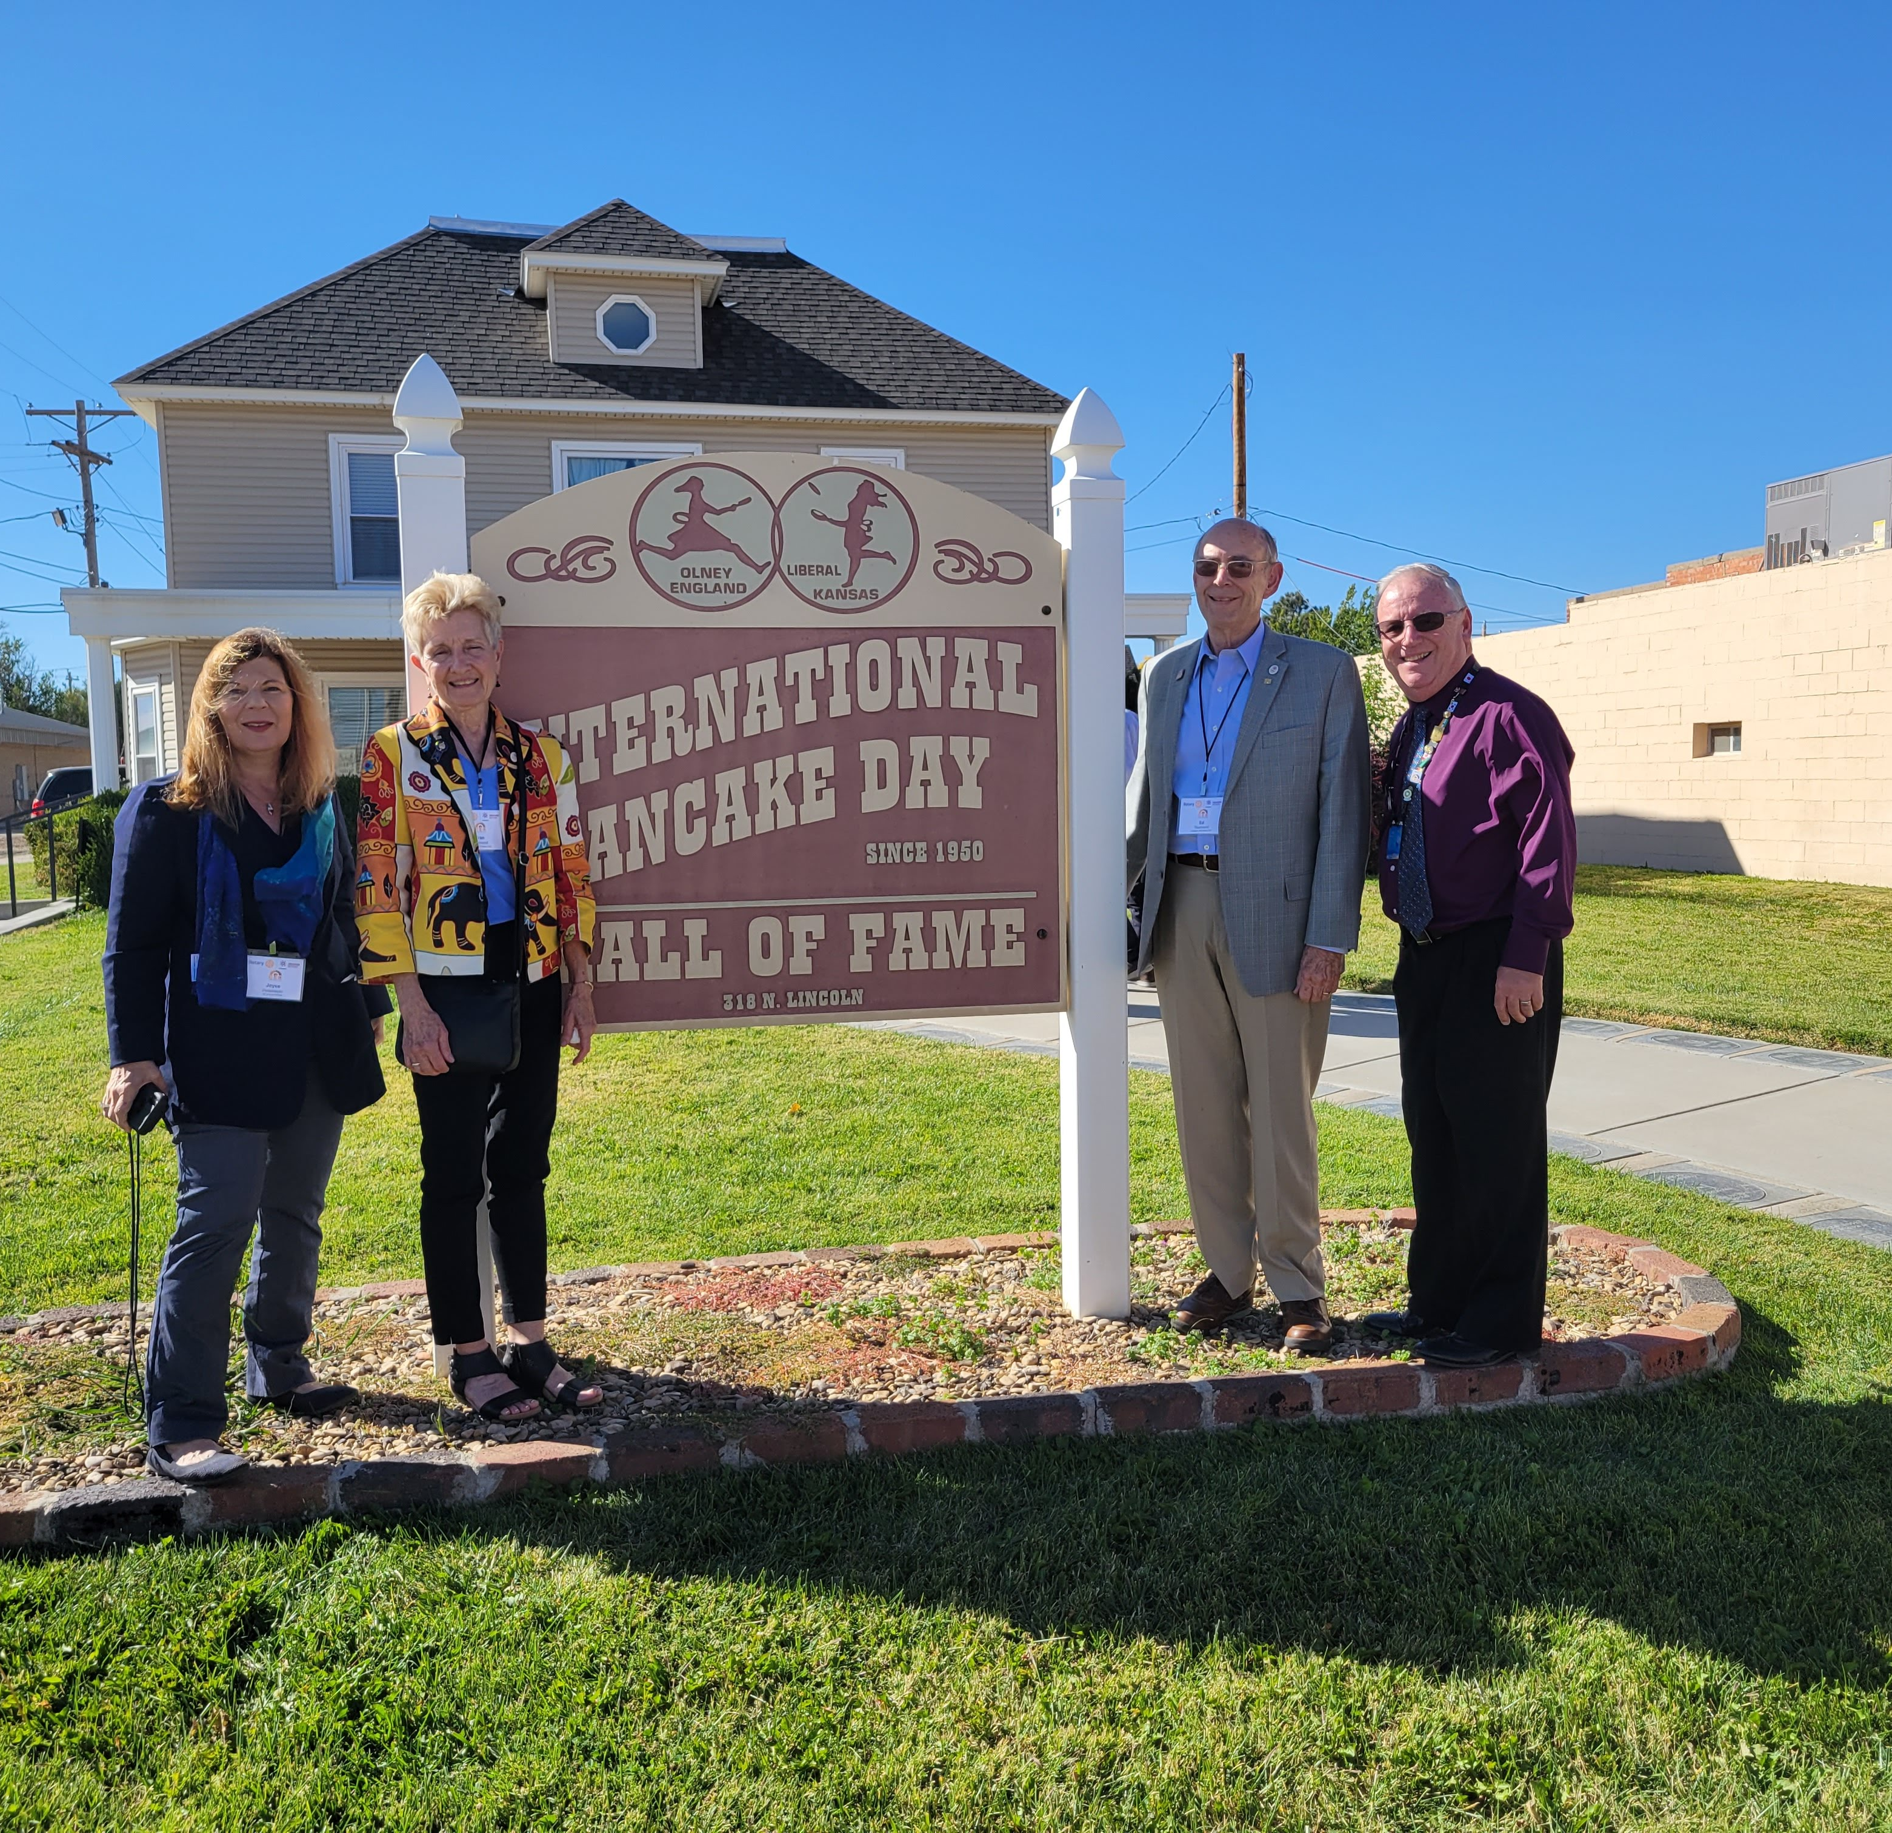
From Planes …to Pancakes
In Liberal, Kansas, the day before Lent means just one thing – it’s Pancake Day
The friendly little competition between Liberal, Kansas, and Olney, England, with women running 415 yards down the streets of each town flipping pancakes, has been going on for more than 70 years now. It is still the only race of its kind on the planet.
Save the Date! 74th Annual International Pancake Day is February 21, 2023!

Slide 4
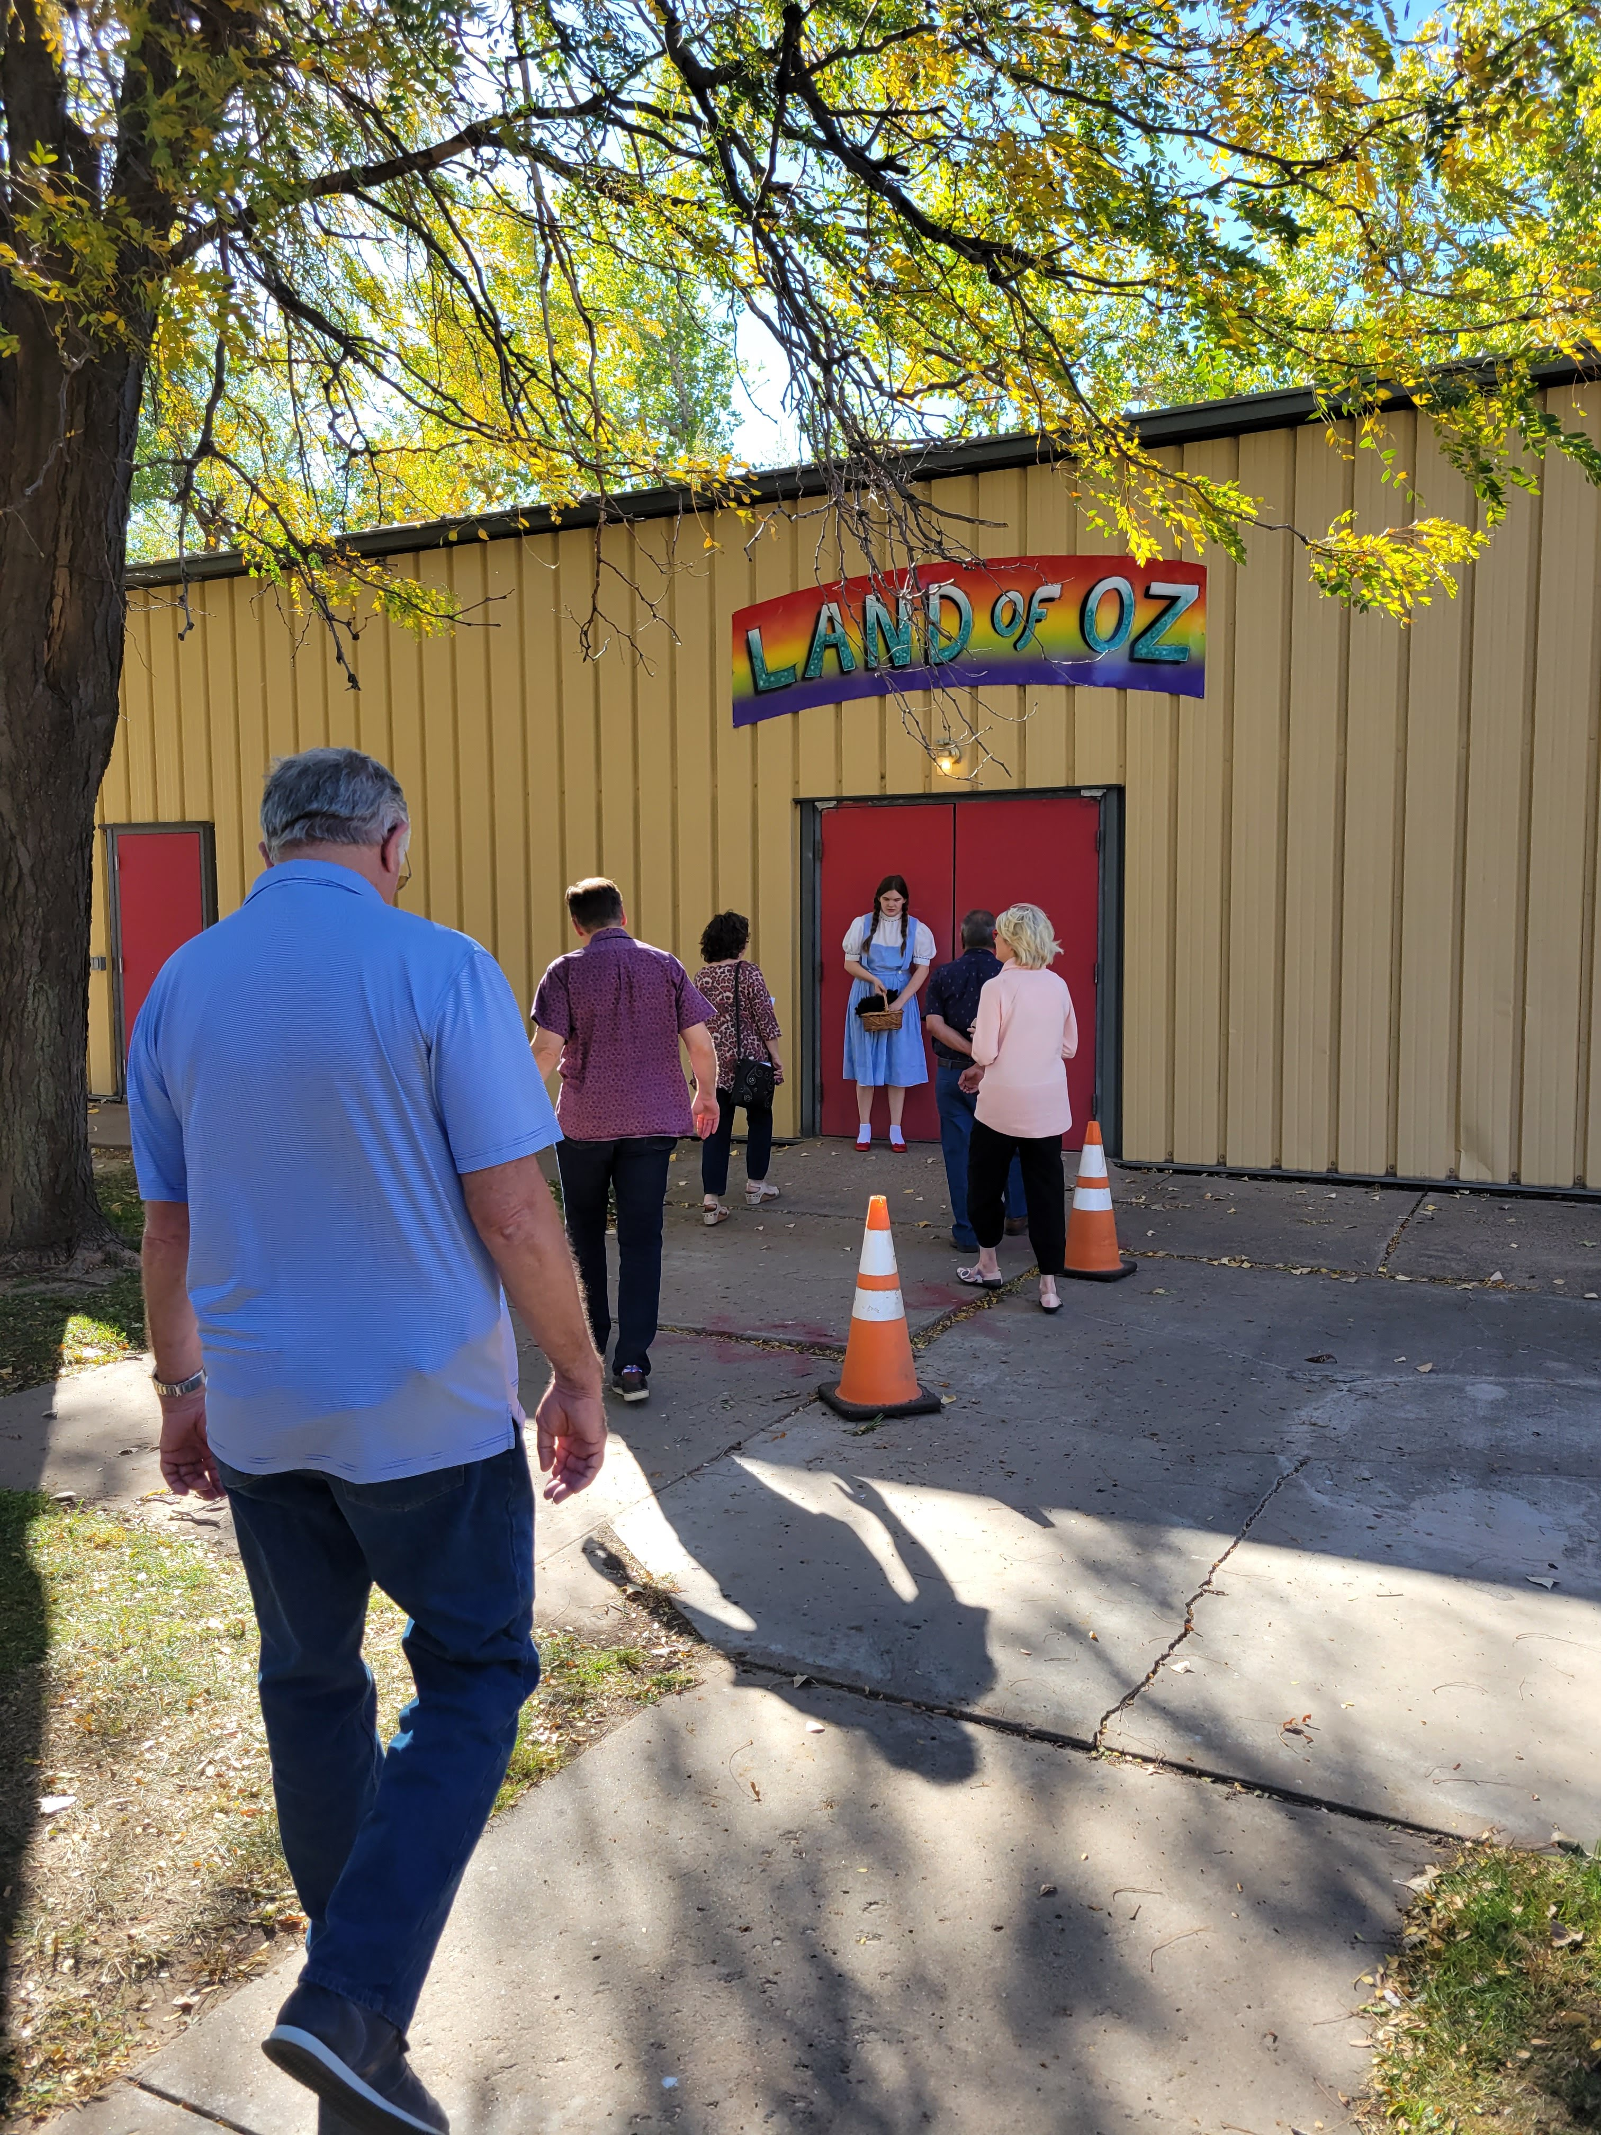
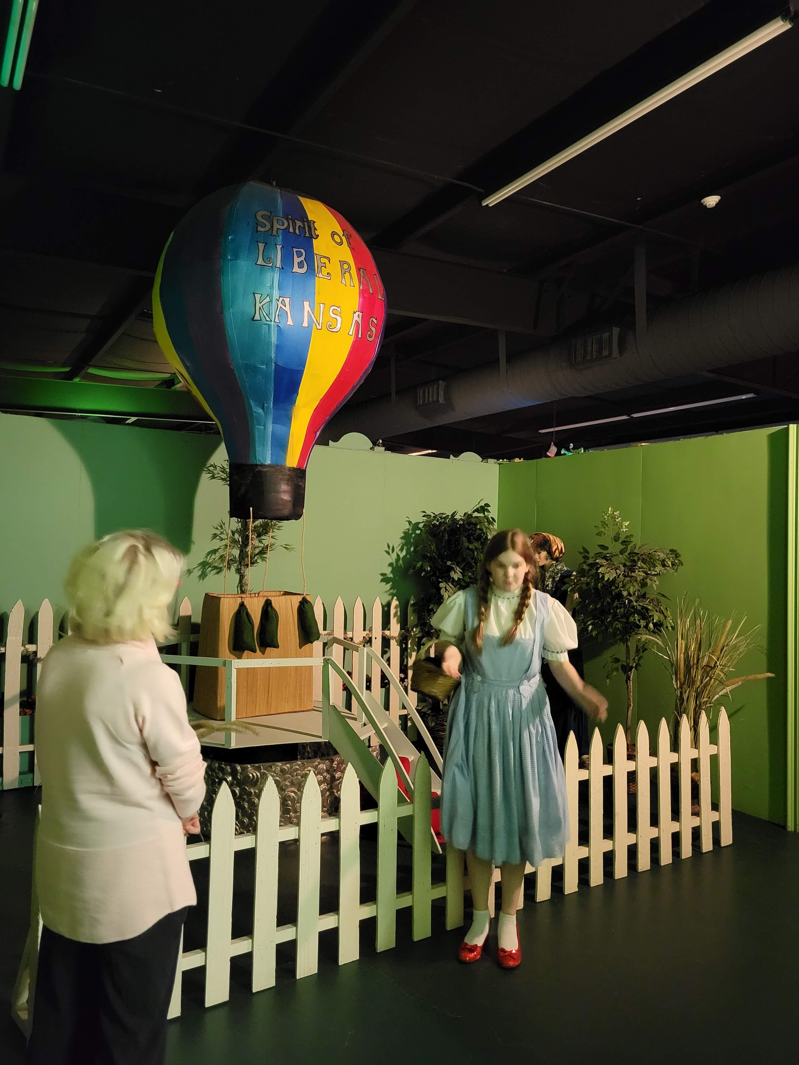
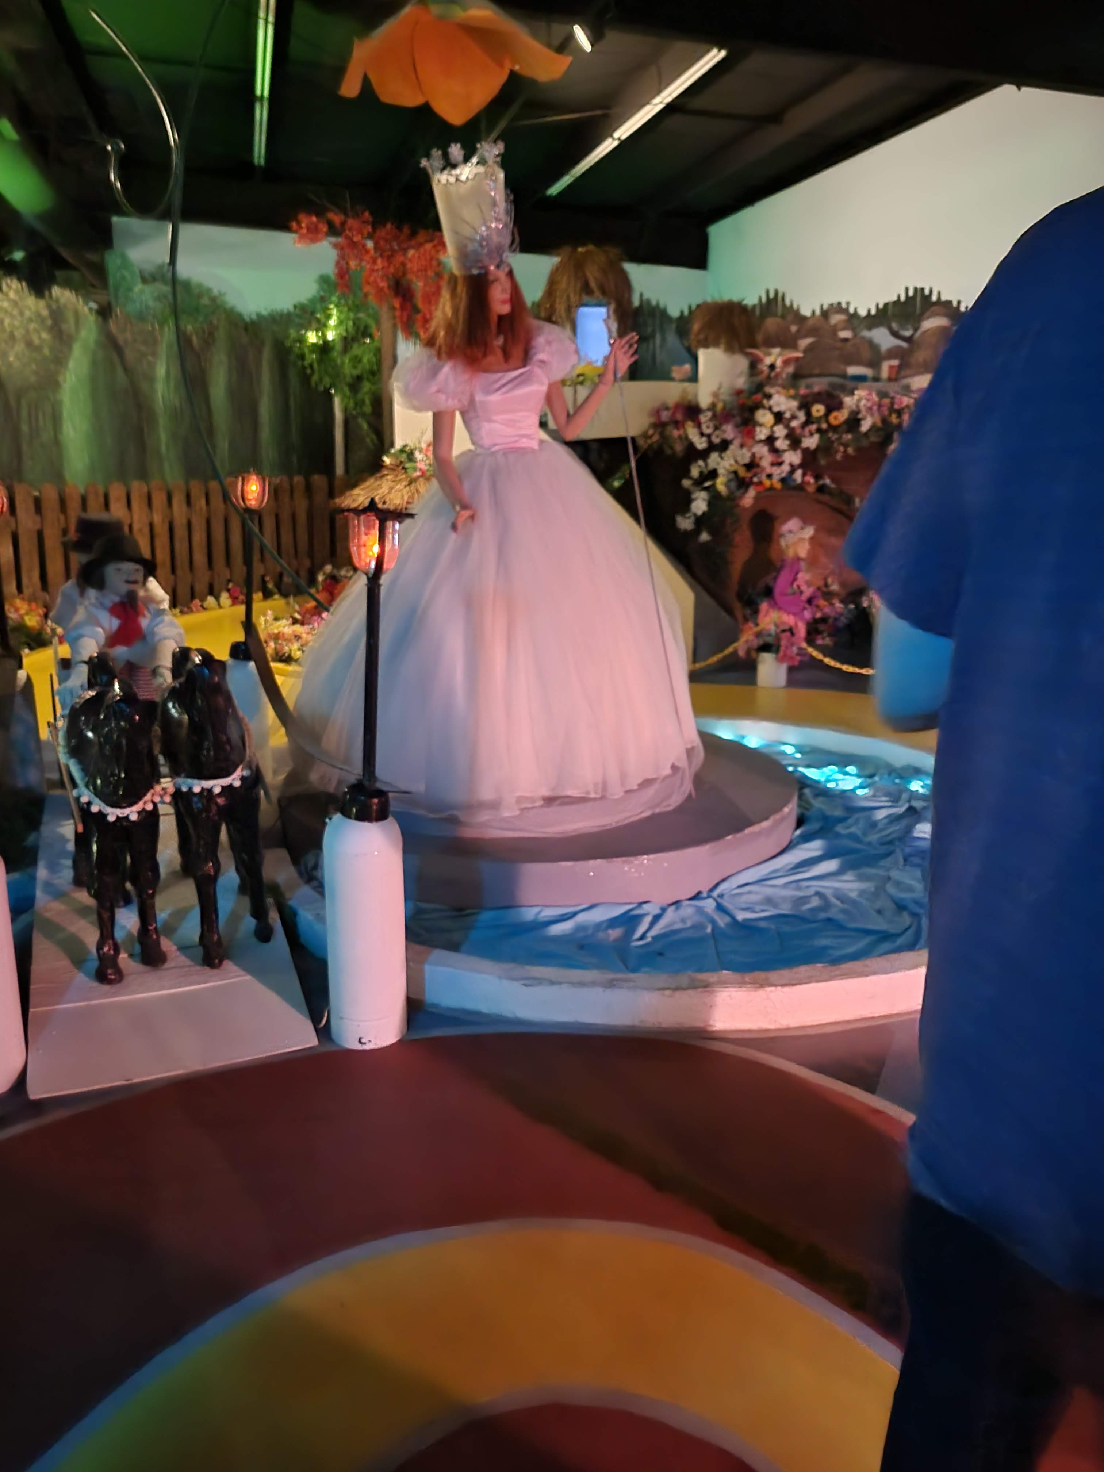
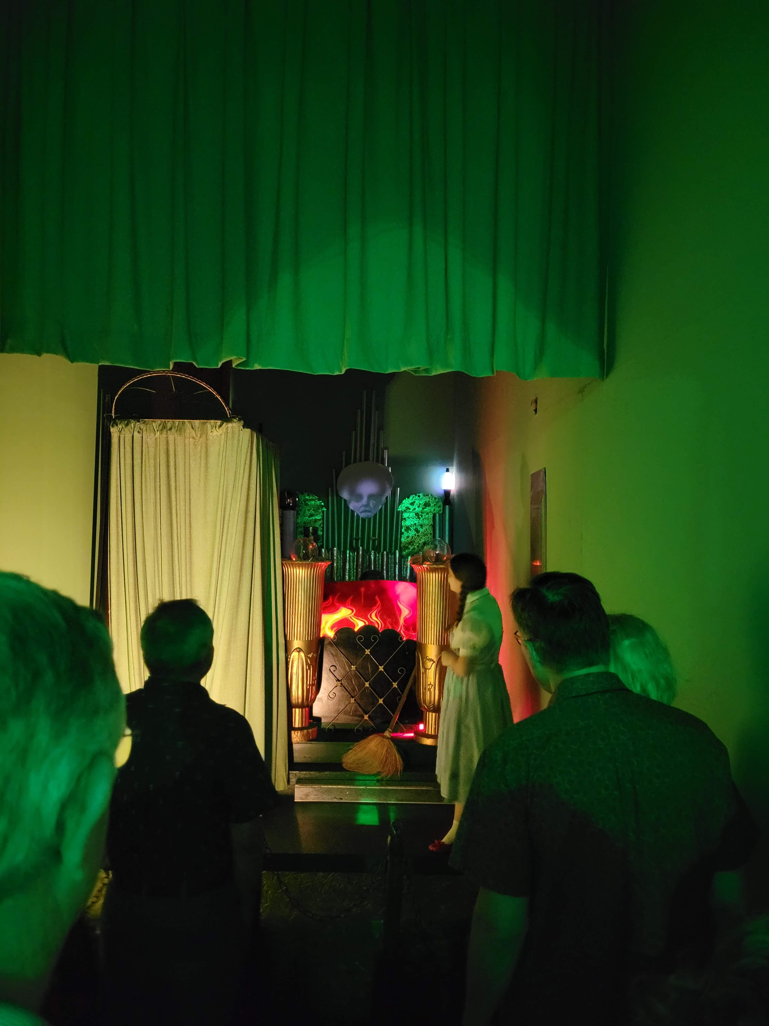
We entered the land of “OZ”
Dorothy was our guide on the
Yellow Brick Road to meet the Wizard!

