Slide 1

Membership
Title Page Option
Notes:
Welcome!

Slide 2

Jenalea Randall
Hold on!
Jenalea.Randall@icloud.com
785-213-2515
District 5710 Governor Nominee Designee, 2024
District 5710 Membership Chair, 2020-2023
Rotary Club of Topeka South, joined Aug. 2009
Previous offices:
President, 2019-2020
First and second vice president
Club Membership chair
Club Social chair
Club Service chair
  Resources available on Rotary.org
  The Value We Offer
  In-Depth Assessment Tools
  Actions for Today
  Opportunities from 2020
Notes:
I’m Jenalea Randall, DMC for 5710
Hold on friends! Make sure that coffee cup is filled – this is going to go fast!!
In 20 minutes we will discuss resources available to you, reflect on the value we offer members and potential members, discuss benefits in-depth assessment tools, as well as actions to take today. And if time allows, we will talk about opportunities before us.

Slide 3
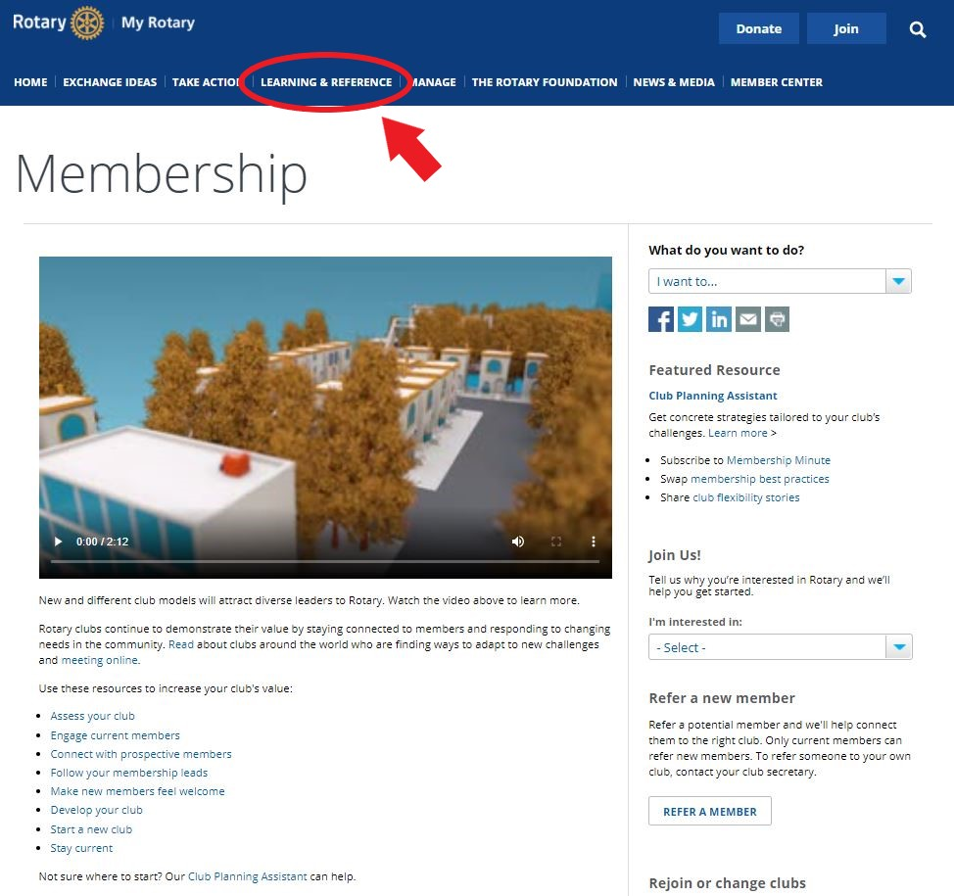
Resources
Rotary.org
District Membership Chair
Assistant Governor
www.Rotary5710.org
www.Rotary5680.org
Notes:
Rotary.org: Load of information available on Rotary.org under My Rotary, Learning by Topic. It’s worth a visit. Whatever the topic – club assessment, engagement members, connecting with prospects, making new members feel welcome, etc…there is a PDF, Learning Center class or worksheet to help!
District Membership Chair & Assistant Governors: We are happy to discuss topics customized to your club.
District website: www.Rotary5710.org and www.Rotary5680.org
Today, in our short 20 minutes, we are going to focus on reenergizing and rebuilding Rotary membership during this difficult time.

Slide 4
subhead
&
Re-energize
Re-build
Notes:
Recently I read a story about a service club in Texas. This club sounded like many Rotary clubs. Older membership, had to stop meeting and service projects because of COVID. They had a rich and lengthy history in their community, but decided to close…because of COVID. Their final act of service was to donate the $80,000 in their coffers to local charities.
We do not want this to happen to one single Rotary club! As COVID continues, community spread numbers bounce up and down, vaccinations catch up to the spread, it will be important for each of us to remind our members of the value of Rotary delivers to them personally, professional as well as to the community and the world.

Slide 5
What is Our Value?
Has your club lost members?
Are they just waiting the pandemic out and will back with the club 100 percent, when it is safe?
Do they just want to be heard?
Will job losses or employer budget cuts cause members to leave?
Are you worried that Rotary may not be as important or relevant in their lives?
What will keep Rotarians in Rotary?
Notes:
Have you lost members?, Are you worried that Rotary may not be as important or relevant in their lives?, Will job losses or employer budget cuts cause members to leave?, Do they just want to be heard?, Are they just waiting the pandemic out and will back with us 100 percent, when it is safe?
I’m preaching to the choir here, because all of us are fully, 1000 percent committed to our clubs, district, to Rotary. But for those members who have only been attending virtual meetings – if that – we may need to get back to asking ourselves, what value are we offering members?
To regain/keep our relevancy and maintain/increase membership we must be clear about the value we provide, not necessarily to service, but to members and then showcase that value …and they will show it to potential members.
Membership does not stand alone. It is one of the three legs of the metaphoric stool. Our value is dependent on our club culture, service and members. Happy engaged members are our best membership committee. When they are serving, attending and being involved they naturally share that passion with their networks.

Slide 6

subhead
Comradery:
The Heart of Rotary
Notes:
Definition: A feeling of friendliness, goodwill, and familiarity among the people in a group.
The heart of Rotary is that it brings people together. When we come together (for service, club meetings, socials, etc..), we are socializing, creating friendships, building goodwill, creating memories.
When I reflect on my club…my first thoughts go to the people. Working with them, learning with them, serving my community with them. Drinking coffee with them…because we meet SO EARLY on Friday mornings! One of my favorite memories is when we demoed a building that eventually became a day center for survivors of human trafficking.
Sadly the pandemic has taken this from us over the past year. It is up to us to make sure we bring this back in perhaps new ways, or old ways that are refreshed.

Slide 7
In-Depth Review
Club Health Check
Topics:
  Club Experience
  Service and Socials
  Members
  Image
  Business and Operations
Membership Assessment Tools
6 tools available in the PDF
Help reveal opportunities to add value to your club’s experience/culture
  Representing Community’s Professions
  Diversifying the Club
  Improving Member Retention
Notes:
RI suggests doing this on a regular basis. Doing one now may be even more valuable. They may help you answer/learn: What made them happy before the pandemic may or may not be what keeps them in the club.
Why did members join in the first place? What kind of value were they looking for? Then, once you've answered that, you can continue to create programming that will create that kind of value for them. Why have they stayed, what will help them to remain a member?
Again, Happy engaged members are our best membership committee. When they are serving, attending and being involved they naturally share that passion with their networks.
Both of these tools take time and dedication and are worth it, but you may be wondering what can you do now to reenergize and rebuild?

Slide 8
Actions for Today
Fireside Chats Don’t Justify, Listen
Board Buddies Communication
Ask specific questions:
  What do they miss?
  What are they looking forward to?
  How comfortable are they meeting in person again?
  How do they want the club to resume – hybrid, slowly, all-in?
Notes:
Immediate actions to learn more from and connect with members:
Fireside chats – An oldie but a goodie!
Board Buddies – Assign each of your board members (and possibly committee chairs) to an equal number of club members and ask them to maintain regular contact to foster engagement.
Stay connected! Communication will continue to be paramount.
Don’t Justify, Listen! – I hope that most are giving each other and clubs grace during this difficult time, but let’s listen to our club members. Hear what they say and don’t justify. Provide facts, but don’t argue. Hear them.
Ask specific questions:
What do they miss?
What are they looking forward to?
How comfortable are they meeting in person again?
How do they want the club to resume – hybrid, slowly, all-in?

Slide 9
Test the Waters
Service
Membership Engagement
  Choose a local charity and ask all members to highlight it using their social channels.
  Coordinate with local hospitals or nursing homes for members to send cards or letters.
  Start a gift card drive
  Outdoor projects back again!
  Board Buddies
  Outdoor socials
  Chain Letters - Start a good old-fashioned-chain letter to engage members.
  Pen Pals - Develop a relationship with another club near or far to start “Rotary Pen Pals.”
Notes:
Service:
Choose a local charity and ask all members to highlight it using their social channels. Choose a new charity each week! This is a great way to leverage the influence of Rotarian leaders to elevate causes that matter to your local community (and it might even sprout a future project collaboration!).
Coordinate with local hospitals or nursing homes for members to send cards or letters to combat loneliness from isolation in facilities that have limited visitors.
Start a gift card drive. Ask members to purchase gifts cards (bonus points if it’s a local small business) and then mail them along with a note from the Rotarian to organizations that would be able to put them to good use.
Outdoor projects back again!
Member Engagement:
Board Buddies
Outdoor socials – movie parties? Picnics? Member musicians?
Chain Letters - Start a good old-fashioned-chain letter to engage members.
Pen Pals - Develop a relationship with another club near or far to start “Rotary Pen Pals. Invite the partnering club to share mailing addresses for their members and then assign each one to a member of your own club to start exchanging letters.

Slide 10

subhead
With Adversity comes
Opportunity
Notes:
A past president said to a current president: This is a new club. Never in the history of our club has this happened – meetings suspended. Service suspended. Social interactions suspended. What will the club be?

