Slide 1


Slide 2

ROTARY’S VISION
TOGETHER, we see a world where PEOPLE unite and take action to CREATE lasting CHANGE — across the globe,
in our communities,
and in ourselves.

Slide 3

Increase
our impact
Expand
our reach
Enhance
participant
engagement
Increase
our ability
to adapt
Notes:
Increase our impact
Expand our reach
Enhance participant engagement, and
Increase our ability to adapt

Slide 4

From Priority to Action
Utilize the Action Plan as a framework for making strategic decisions for your club, enhancing your club and participant experience, elevating your club’s presence in your community, addressing regional and local challenges, and identifying new opportunities to drive impact.

Slide 5

ACTION PLAN PRIORITY 1:
INCREASE OUR IMPACT

Slide 6

Eradicate polio and leverage the legacy
Focus our programs and offerings
Improve our ability to achieve and measure impact
Notes:
Rotary staff and members at all levels are working together to develop practices and tools for measuring and sharing Rotary’s positive, long-term change. And we’re measuring our impact more deliberately because we know that current and potential partners, program participants, and, increasingly, donors want to see clear, tangible proof of our impact — especially for our humanitarian projects.
We want to ensure that we’re using our resources for programs that have the potential for the greatest impact and that align with our Action Plan or organizational strategy. Every club and district, along with all of their members and participants, can significantly increase their impact by increasing their focus. We’re developing an evaluation process that will help us make objective recommendations about what we should continue doing, start doing, or stop doing.
We’re implementing Programs of Scale, a grant model that was developed to provide measurable and sustainable solutions to issues that affect many people in a large geographic area. Programs of Scale also provides us with a new framework for thinking about how we bring about change in the world.

Slide 7

IMPACT IS THE POSITIVE LONG-TERM CHANGE RESULTING FROM OUR ACTIONS.
DEVELOP A STRATEGY FOR EDUCATING MEMBERS on the importance of impactful service projects.
CONDUCT A COMMUNITY ASSESSMENT both before and after implementing a project.
FOCUS YOUR EFFORTS on those that can make a real impact on your community.
CELEBRATE SUCCESSES by sharing with other clubs and on Rotary Showcase and publicizing the project’s impact within the community.
Notes:
This work is underway. Check the Action Plan page at rotary.org/actionplan for resources and news. But also remember that the best way to learn is by doing. Identify a project you can use to explore and practice measurement.
I will support you in focusing your efforts by reviewing your activities and determining which ones can be streamlined or eliminated so your club can spend more time on making a bigger and more lasting impact. I encourage you to connect with other clubs that are also engaged in assessment to get a sense of collective effort.
There’s a Programs of Scale page at rotary.org/programsofscale that has resources that can help you find new ways to develop service projects. I also encourage you to apply similar principles to your own projects and grants.

Slide 8

ACTION PLAN PRIORITY 2:
EXPAND OUR REACH

Slide 9

Grow and diversify our membership and participation
Create new ways for participants to experience Rotary
Increase club flexibility and appeal
Build understanding of impact and brand
Notes:
We’re committed to embracing and exemplifying diversity, equity, and inclusion (DEI) in everything we do at Rotary. We have revised our DEI statement, which now reflects our stronger-than-ever commitment to being an organization that values, respects, and welcomes everyone who interacts with us. Now we’re developing a comprehensive plan of action with achievable, measurable, and meaningful DEI outcomes for Rotary.
I strongly encourage you to read and follow Rotary’s new DEI Code of Conduct, which points the way to creating more just, open, and welcoming communities or all people.
We’re piloting and evaluating new products and participant models so that people can join us and take action, no matter where they live. We also see great potential in existing programs, including Rotary Action Groups, Rotary Community Corps, Rotary Fellowships, and others.

Slide 10

USE ROTARY’S MEMBERSHIP TOOLS to do a club assessment and learn how to make it more attractive to members of your community.
COLLABORATE with other groups in your community through service projects or social events.
TELL COMPELLING STORIES about how your club is making a difference.
USE THE ROTARY BRAND CENTER to ensure that your club’s messaging is consistent with Rotary’s brand standards.
Notes:
You should visit our DEI page at rotary.org/dei to learn more about how to make their club more inclusive.
We’re eager to hear about the ways you’re engaging people beyond traditional membership. I invite you to share those ideas through the My Rotary Action Plan page.

Slide 11

ACTION PLAN PRIORITY 3:
ENHANCE PARTICIPANT
ENGAGEMENT

Slide 12

Support clubs to better engage their members
Improve understanding and support of individual participants
Offer new opportunities for personal and professional connection
Provide learning opportunities for leadership development and skill building
Notes:
We’re tearing down the walls between “us” and “them” and thinking about “participants” — a word that encompasses all Rotary members and others who get involved in Rotary activities, like family members, partners, and alumni. And we’re making participants central to what we do, which means we’re being proactive, asking people how they want to engage with us, and making sure they know that we value their participation.
We’re looking at ways to measure member engagement and satisfaction so we can better understand what people are getting from Rotary. We know that when our members don’t find their experiences to be personally or professionally relevant, they go elsewhere. The information we collect will assist clubs, districts, and Rotary International in determining how we can deliver greater value and give people more reasons to stay in Rotary.

Slide 13

IMPLEMENT A NEW MEMBER ORIENTATION PROGRAM to support new members.
USE THE MEMBER SATISFACTION SURVEY to learn what’s important to your members in their club experience and how they want to grow and develop through Rotary.
MAKE MEMBERS FEEL VALUED by keeping them informed and seeking their input in making decisions.
USE ROTARY’S LEARNING CENTER to help members develop leadership skills.
Notes:
Start surveying members to learn what’s important to them in their club experience and how they want to grow and develop through Rotary. And make it clear that you’re ready to listen: Be proactive in asking members if they feel engaged enough and listened to and if Rotary is meeting their expectations.

Slide 14

ACTION PLAN PRIORITY 4:
INCREASE OUR ABILITY
TO ADAPT

Slide 15

Build a culture of research, innovation, and willingness to take risks
Streamline governance, structure, and processes
Foster more diverse perspectives in decision-making.
Notes:
We’re improving our operations to become more agile and more responsive. We’re using change management strategies throughout Rotary, from the Secretariat to the club level. Governance models, committee structures, business processes — we’re reviewing everything.
Having fewer administrative layers will address the disconnects between clubs, districts, zones, and headquarters. And it will give us a clearer picture of support and resources you need to stay ahead of change.

Slide 16
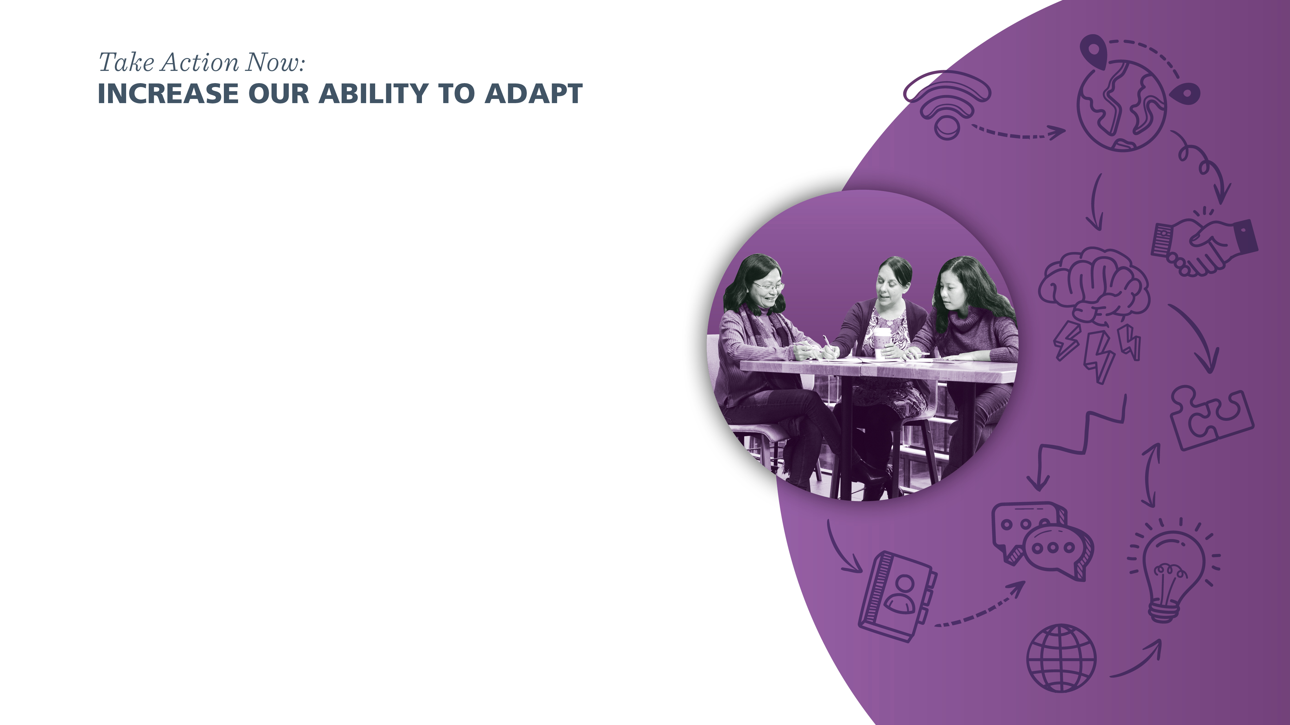
HOLD BRAINSTORMING SESSIONS with club members to gather innovative ideas to make your club more relevant.
IDENTIFY INCOMING LEADERS early so that they have time to prepare for their future roles.
REVIEW CLUB BY-LAWS, ROLES, AND PROCESSES for ways to be more efficient and effective.
SET 3-YEAR GOALS and establish a continuity plan to ensure cohesive efforts and joint success.
Notes:
Change is coming. We’ll all be encouraged to do things differently. But new approaches to our organizing principles won’t threaten our sense of who we are. Together, we can get Rotary ready for another century of service.

Slide 17
rotary.org/actionplan

Slide 18


