Slide 1



We will begin this session in a few minutes
Please write your name, title, club and district in your screen name. such as
Jane Jones, PE, Anytown, 0000
“The servant-leader is servant first… It begins with the natural feeling that one wants to serve, to serve first. Then conscious choice brings one to aspire to lead. That person is sharply different from one who is leader first.”
- Robert K. Greenleaf

Slide 2

Fill your Heartland PETS glass with your favorite beverage and get to know your fellow PEs

Slide 3

VIRTUAL SOCIAL
This is your time for a virtual social. Visit one or more of the breakout rooms; drop-in and drop-out as you want.
BEER COFFEE
WINE SPIRIT
SOFT DRINKS WATER
Get to know your fellow PEs, enjoy some networking time, share what your club is doing, discuss your goals and plans, or tell jokes.
Just like a live social hour - roam around, talk with different people, and have a little fun!

Slide 4


RAISE OUR GLASSES
to Rotary,
to Rotarians,
to District 5710,
to District 5680,
to Your Clubs,
and to YOU,
the PEs, as you

Slide 5
Once Upon a Time
Once Upon a Time - Bing video

Slide 6
WELCOME
PRESIDENTS-ELECT of D5680 & D5710
VIRTUAL
PETS
President-Elect Training Seminar
2021
PETS
Friday, March 26
4:30 p.m. – 7:00 p.m.

Slide 7

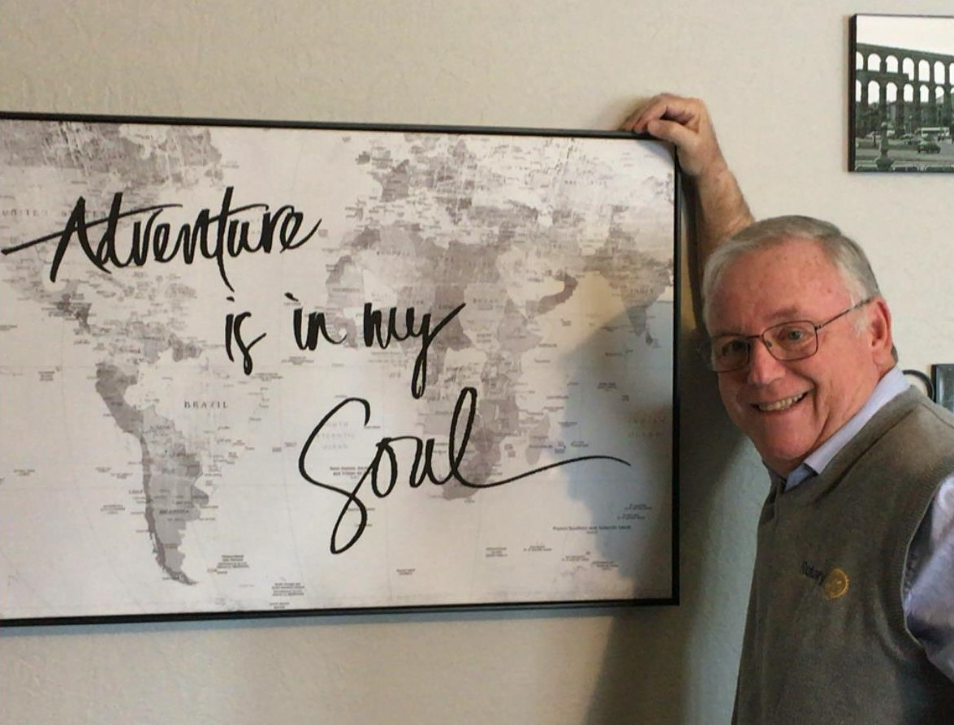
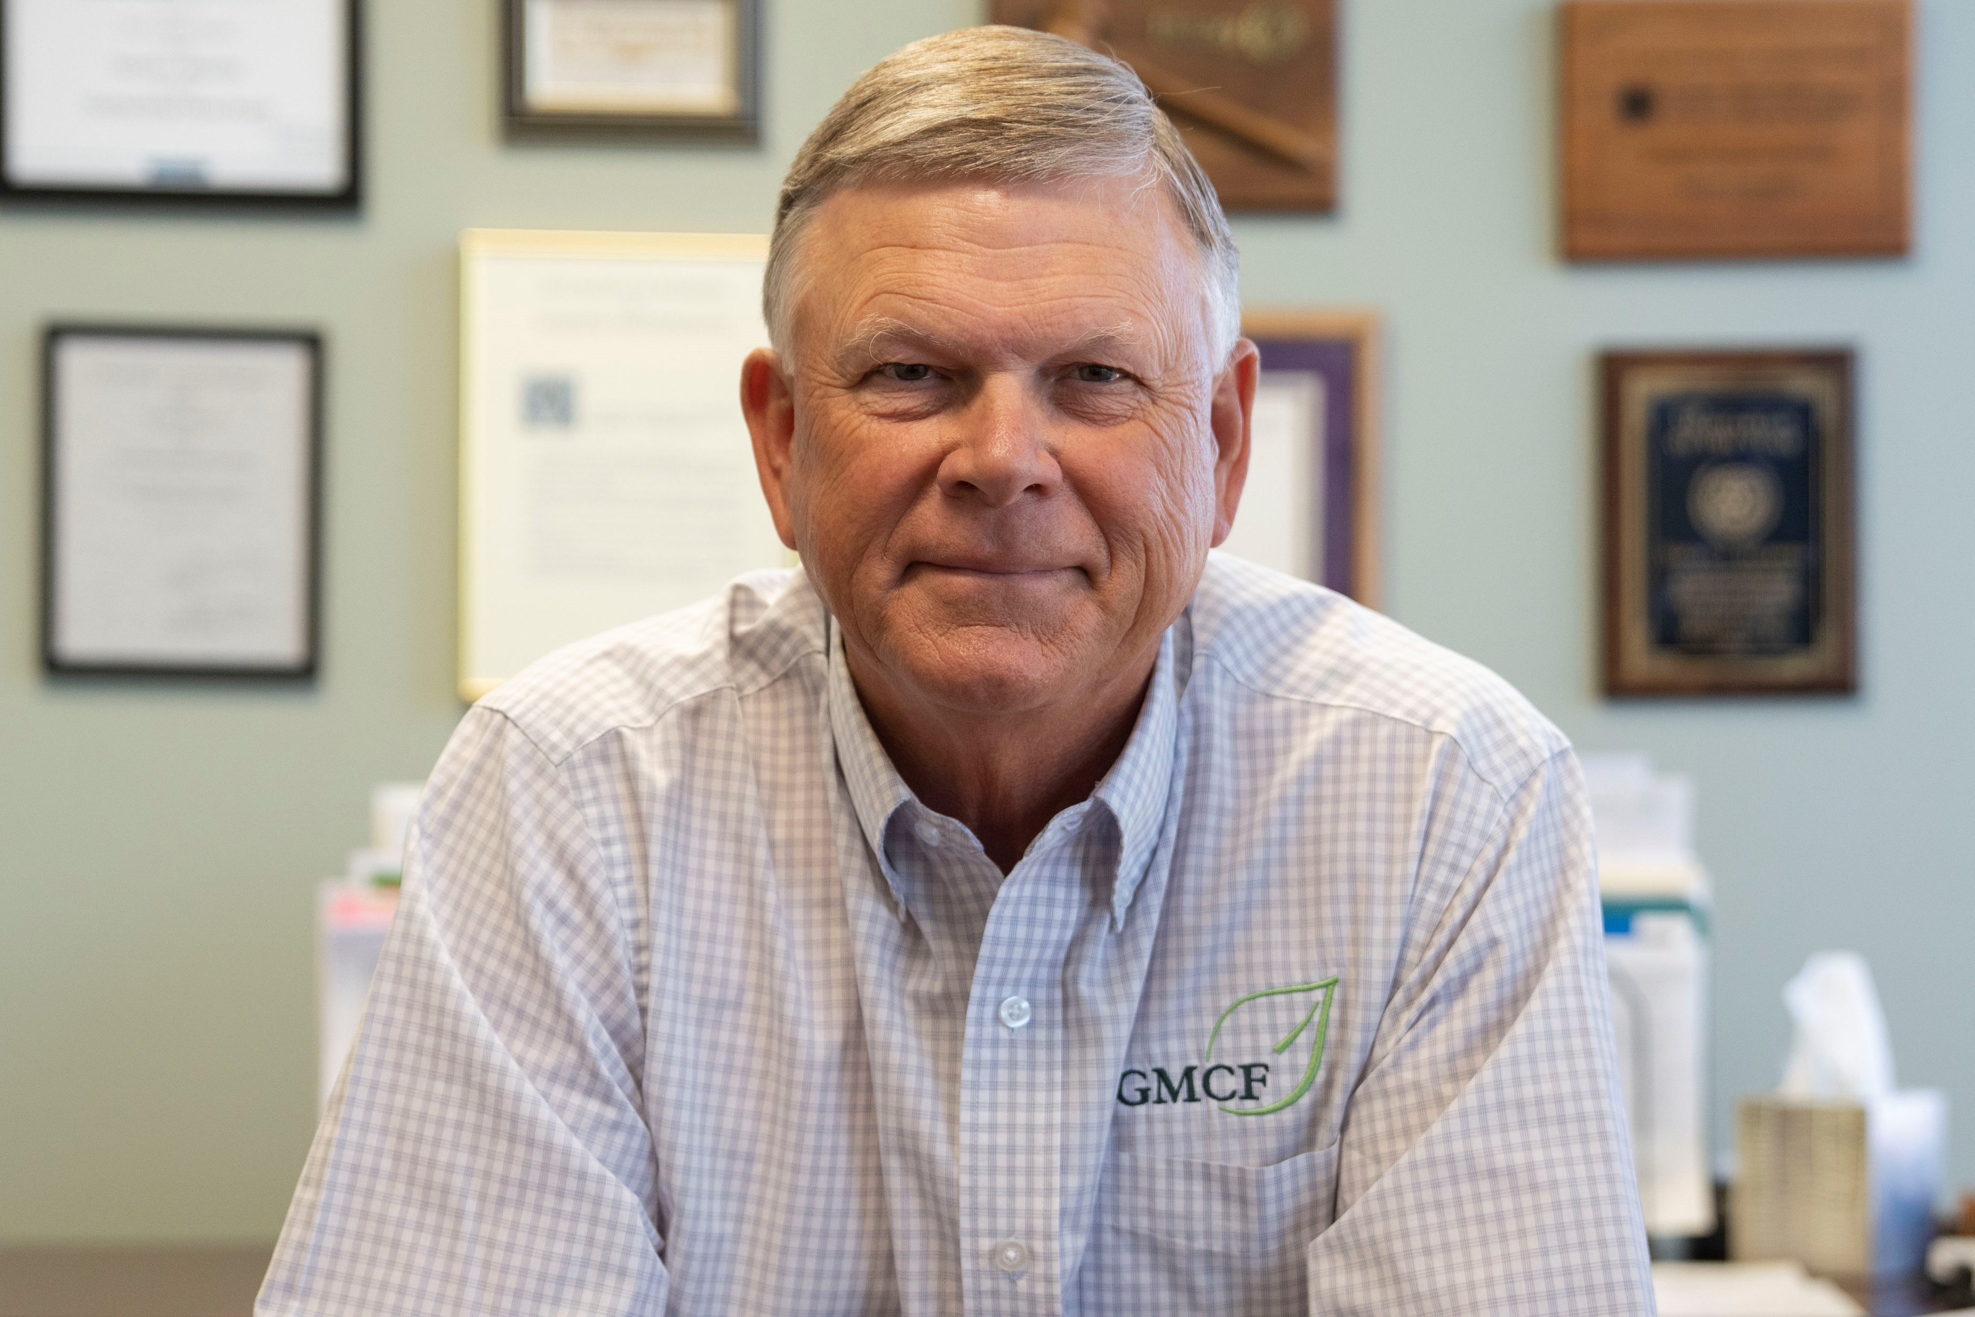
Fred Heismeyer
District 5680
Governor - elect
Vern Henricks
District 5710
Governor - elect

Slide 8






Before We Start
Rename yourself
with first and last name,
title, Club
Please MUTE when
not talking
Turn your
camera on
Use the chat to communicate
questions and comments
Raise hand to contribute
or comment

Slide 9
The question we have been asking you, is now the question we encourage you to ask your fellow Rotarians:
ARE YOU READY to
Make a World of Difference and

Slide 10
EXERCISE
Poll Question:
What makes your club fun?
Great meals
Getting to see my friends
Doing good in my community
Silly jokes that Rotarians tell
Great service projects
Can’t really say

Slide 11

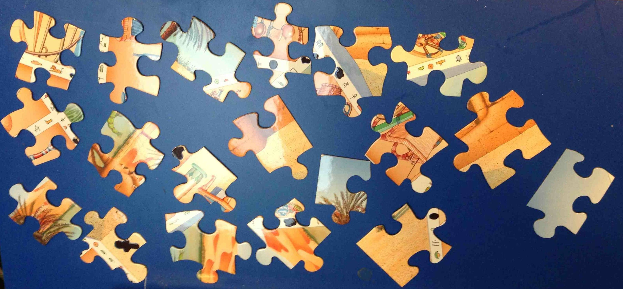
Pieces of

Slide 12
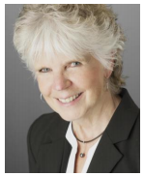
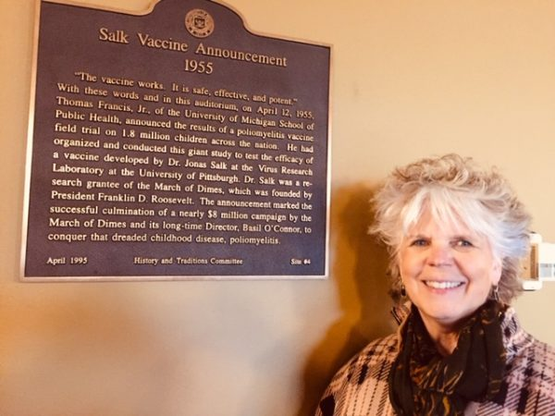
ANN LEE HUSSEY
A lifetime passion for ridding the world of Polio:
A PERSONAL STORY

Slide 13
EXERCISE
In the chat box,
write one word,
and only one word,
that best describes
your leadership style?

Slide 14
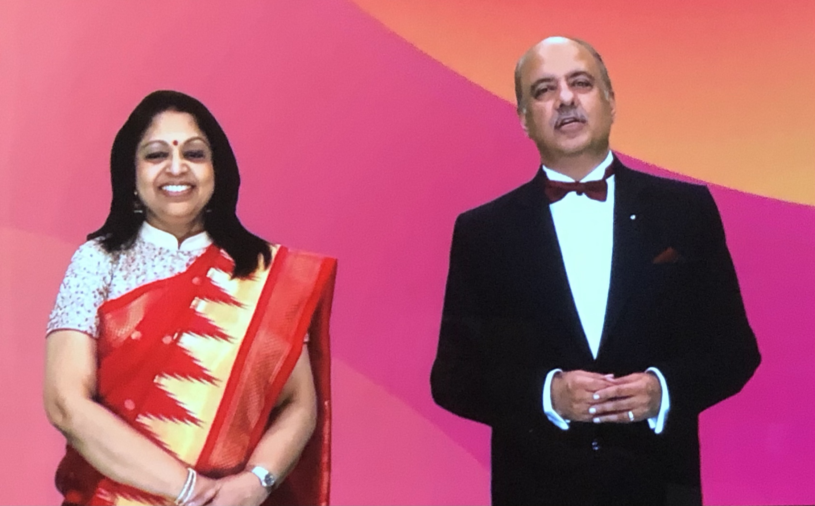
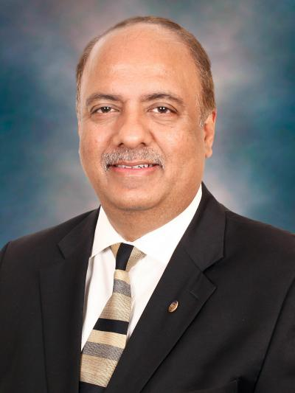
RI PRESIDENT-ELECT
SHEKHAR and RASHI MEHTA
Not just a leader in Rotary, but a true example of a
SERVANT LEADER

Slide 15
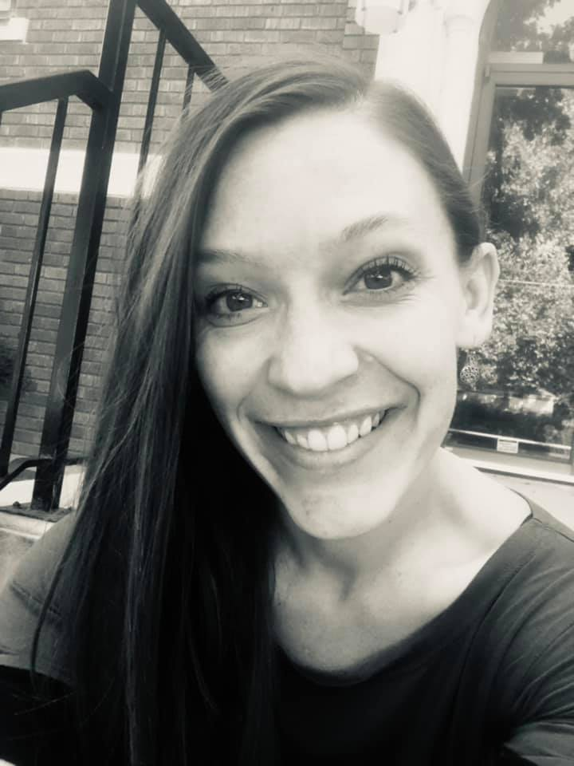


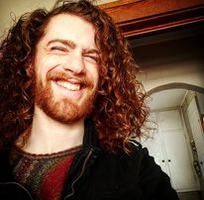
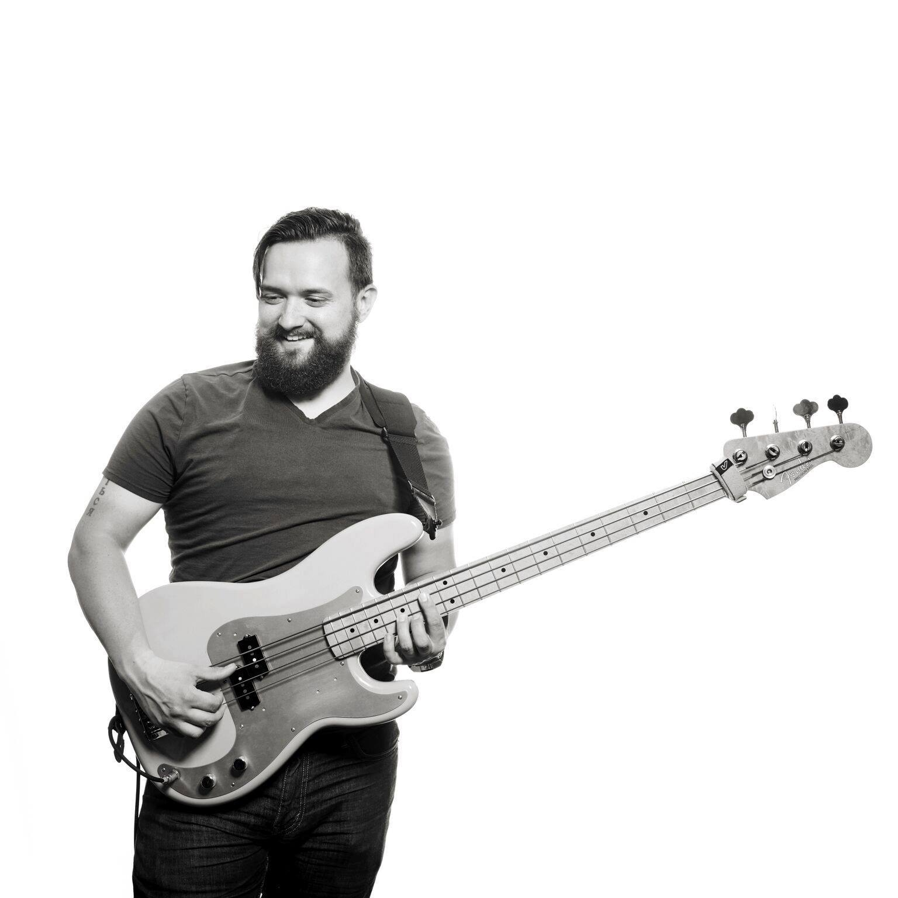

Slide 16


PIECES
of
ROTARY

Slide 17
Tomorrow will be filled with
tips, hints, strategies
and of course, some fun!
GUEST SPEAKERS
Suzie Howe, RI Director
Rob Pennington
TOPICS
Re-energizing your membership
Public Image
Being an Effective President
RI Foundation
Virtual Fundraising
TIME WITH YOUR DGE
Tomorrow’s session is 8:00 a.m. – 12:00 p.m.
NOTE: District 5680 PEs,
please plan to be on through 12:30 p.m.

Slide 18
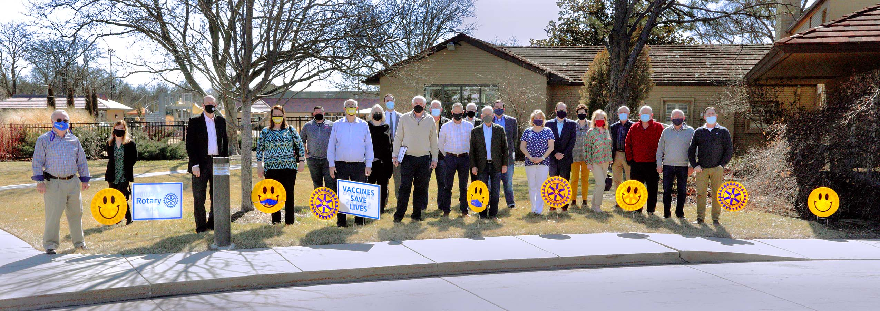
#Rotarysharingsmiles
Make sure your club is using the smile kits
Use the hashtag to spread the word
Take pictures and share them with both districts
Like and share on your personal social media sites

Slide 19

RE
SO
UR
CE
s
District 5680 website – www.rotary5680.org
District 5710 website – www.rotary5710.org
D5680 RYLA –
Campus Activities - Leadership - Southwestern College (sckans.edu)
RI website – www.Rotary.org
Heartland PETS – www.heartlandpets.org
My Rotary Log-in:
Learning Center Individual Profile
Giving History Rotary Club Central

Slide 20
Attention: D5680 PEs
Learning opportunities for your club’s officers and chairs
Zoom meeting: Saturday, April 3
10:30 a.m. – 12:00 p.m.
OPEN TO ALL ROTARIANS
LEARN DETAILS ABOUT
District Grant Process: 10:30 a.m. – 11:00 a.m.
Youth Programs: 11:00 a.m. – 11:30 a.m.
Strategic Engagement: 11:30 a.m. – 12:00 p.m.
INVITE YOUR 2021-22 CLUB OFFICERS/CHAIRS

Slide 21

Pieces of

Slide 22
THANK YOU
PRESIDENTS-ELECT of D5680 & D5710
VIRTUAL
PETS
President-Elect Training Seminar
2021
See you tomorrow for our next session of PETS 2021
Saturday, March 27
8:00 a.m. – 12:00 p.m.

Slide 23
We will begin this session in a few minutes
Please write your name, title, club and district in your screen name. such as
Jane Jones, PE, Anytown, 0000
“Words may inspire but only action creates change.”
- Simon Sinek

Slide 24
Rotary Minute: What have you learned from being a Rotarian?
Rotary Minute: What have you learned from being a Rotarian? - Bing video

Slide 25
WELCOME BACK
PRESIDENTS-ELECT of D5680 & D5710
VIRTUAL
PETS
President-Elect Training Seminar
2021
PETS
Saturday, March 27
8:00 a.m. – 12:00 p.m.

Slide 26
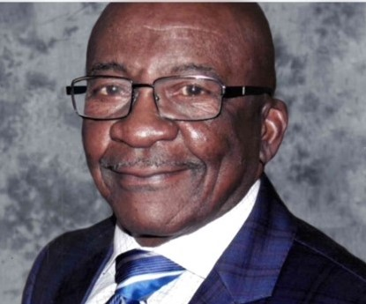
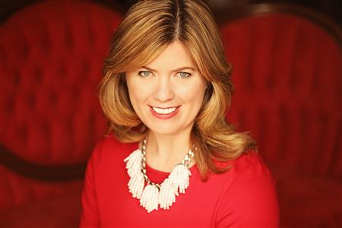
Ivanhoe Love
District 5680
Governor - nominee
Stephanie Meyer
District 5710
Governor - nominee

Slide 27
Before We Start
Rename yourself
with first and last name,
title, Club
Please MUTE when
not talking
Turn your
camera on
Use the chat to communicate
questions and comments
Raise hand to contribute
or comment

Slide 28
For the last time during
PETS 2021, we ask you and encourage you to ask the Rotarians in your club:
ARE YOU READY to
Make a World of Difference and

Slide 29
EXERCISE
Poll Question:
What will you call success?
Create a better awareness of Rotary beyond the club level
Add value to our community’s efforts to help the needy
See increase engagement from members
Make it through the year
Have Rotary on social media
Increase membership in the club

Slide 30
Pieces of

Slide 31
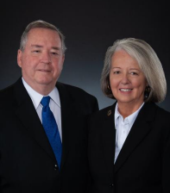
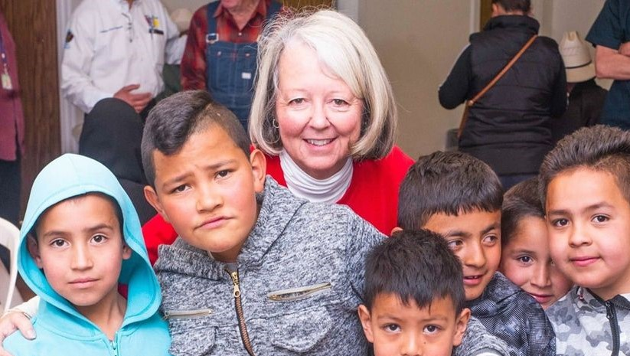
RI Director, Suzi Howe
Our voice to Rotary International

Slide 32
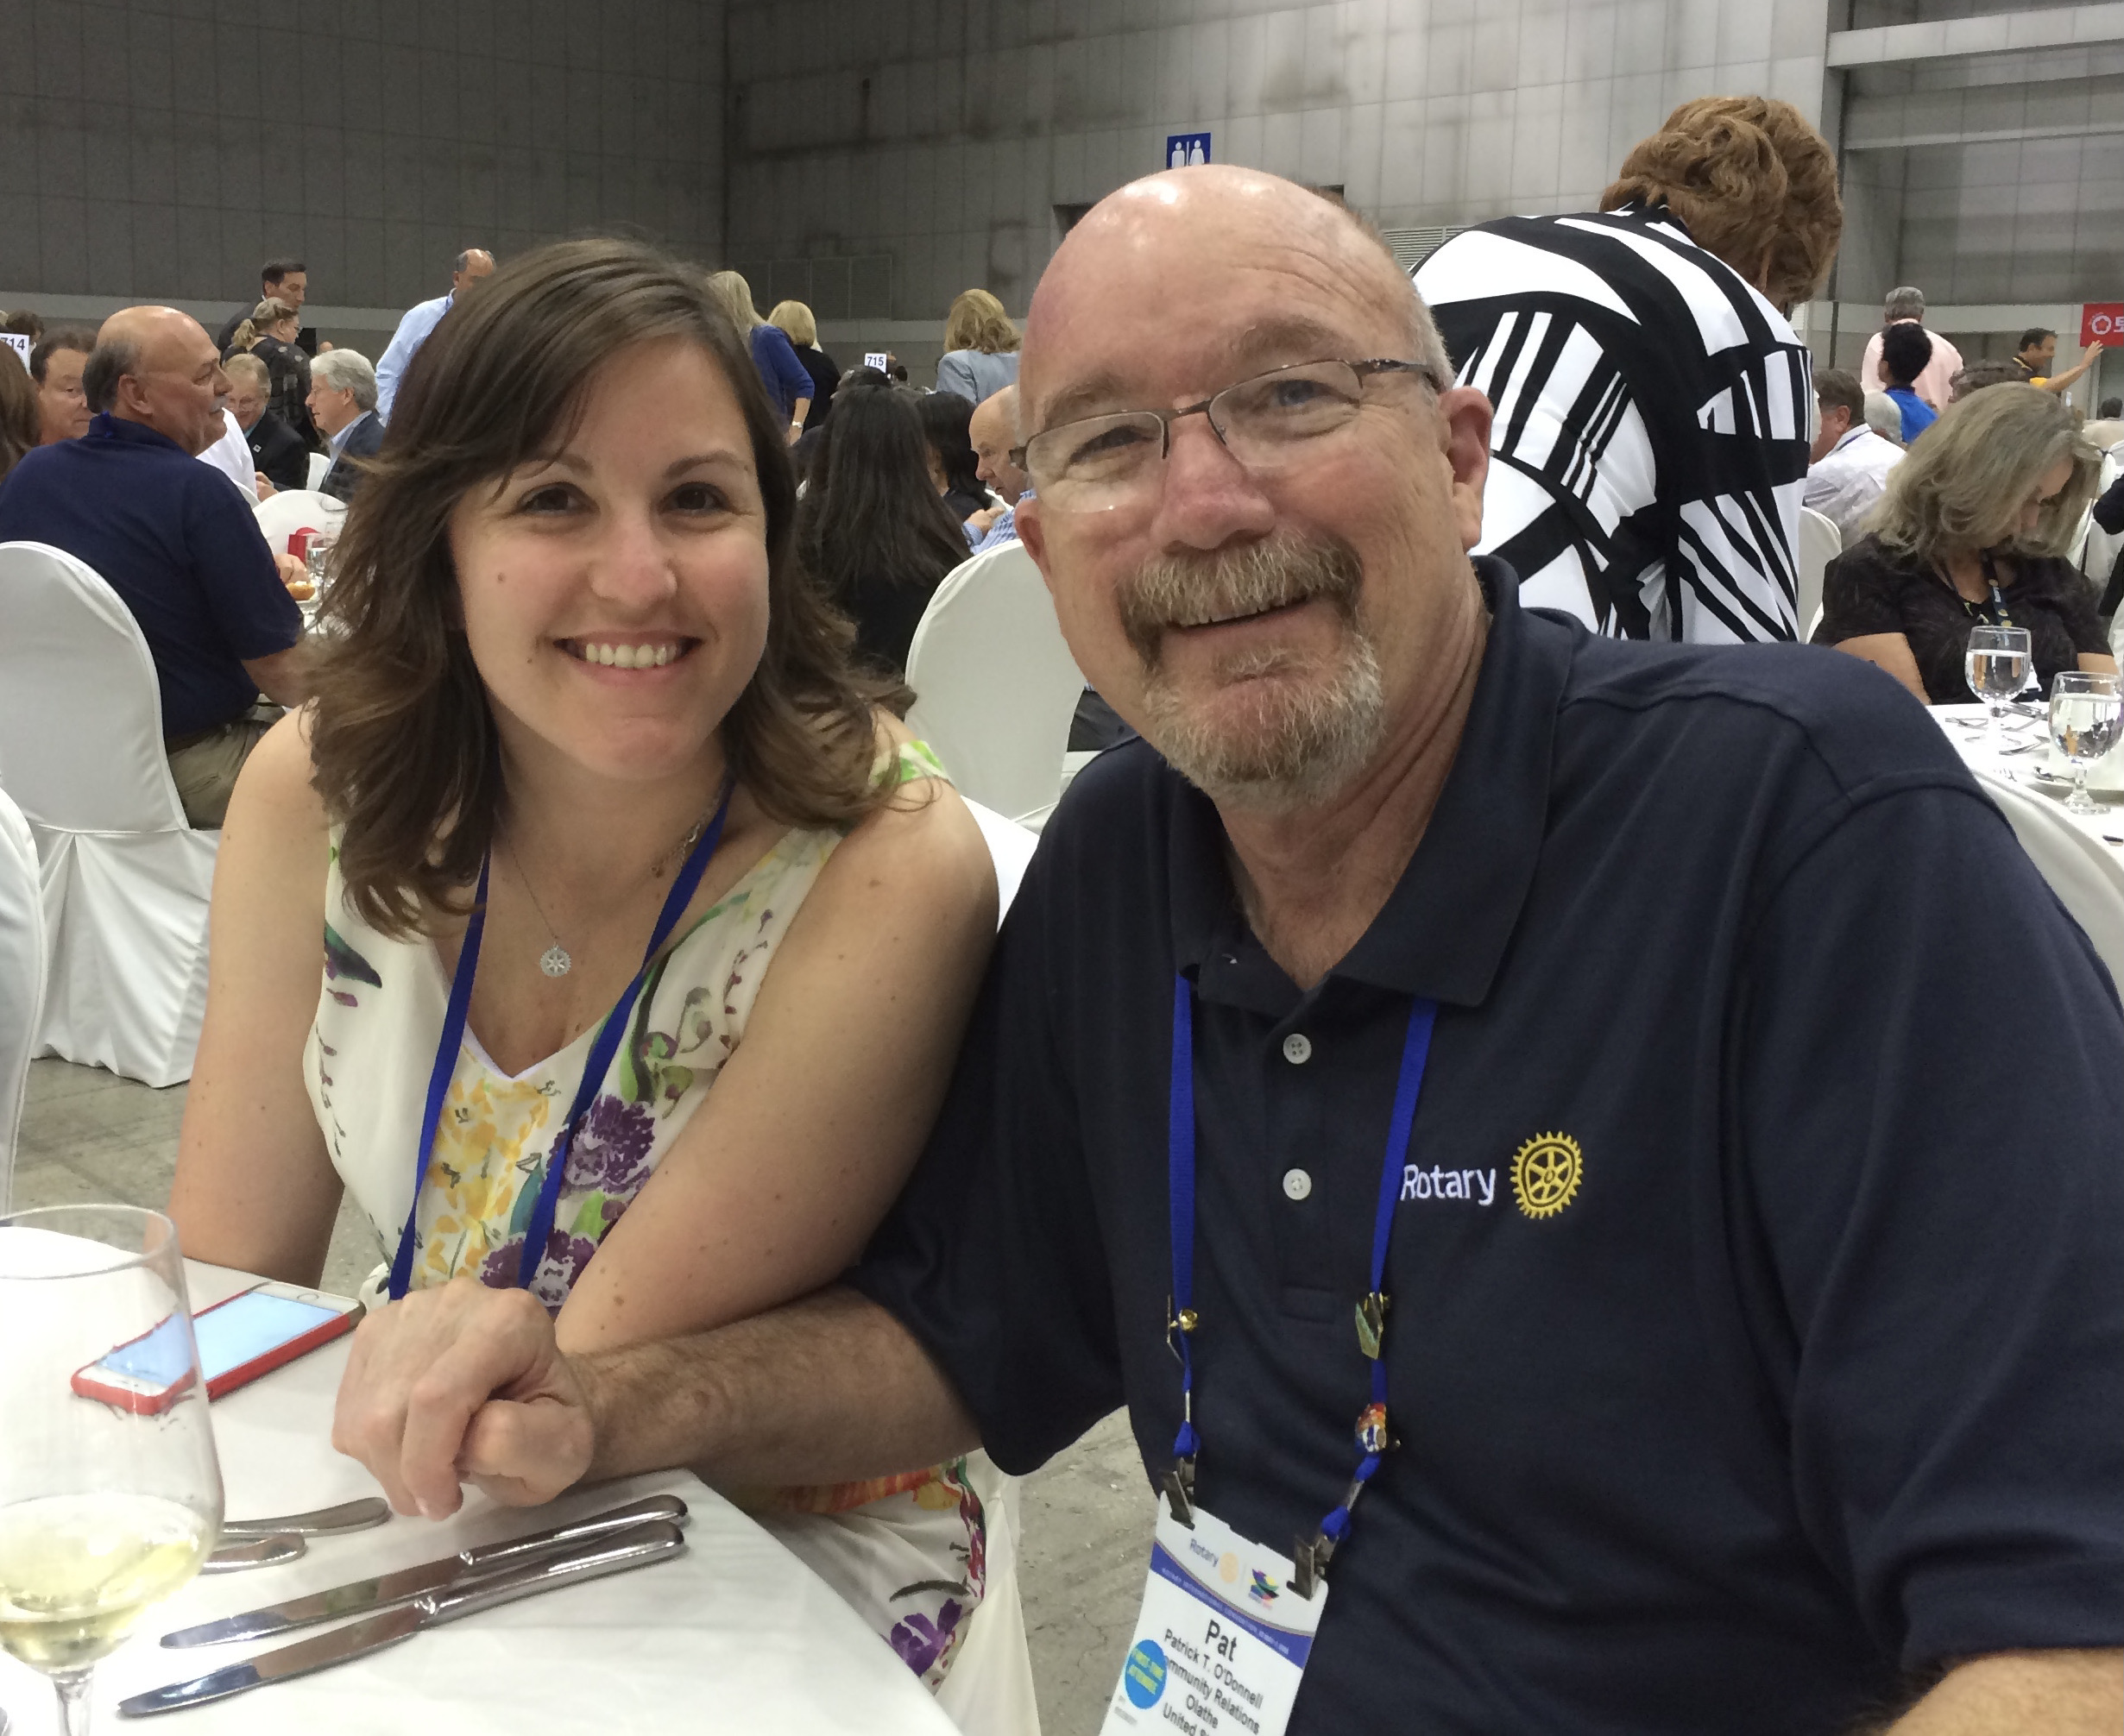
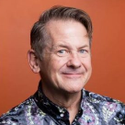
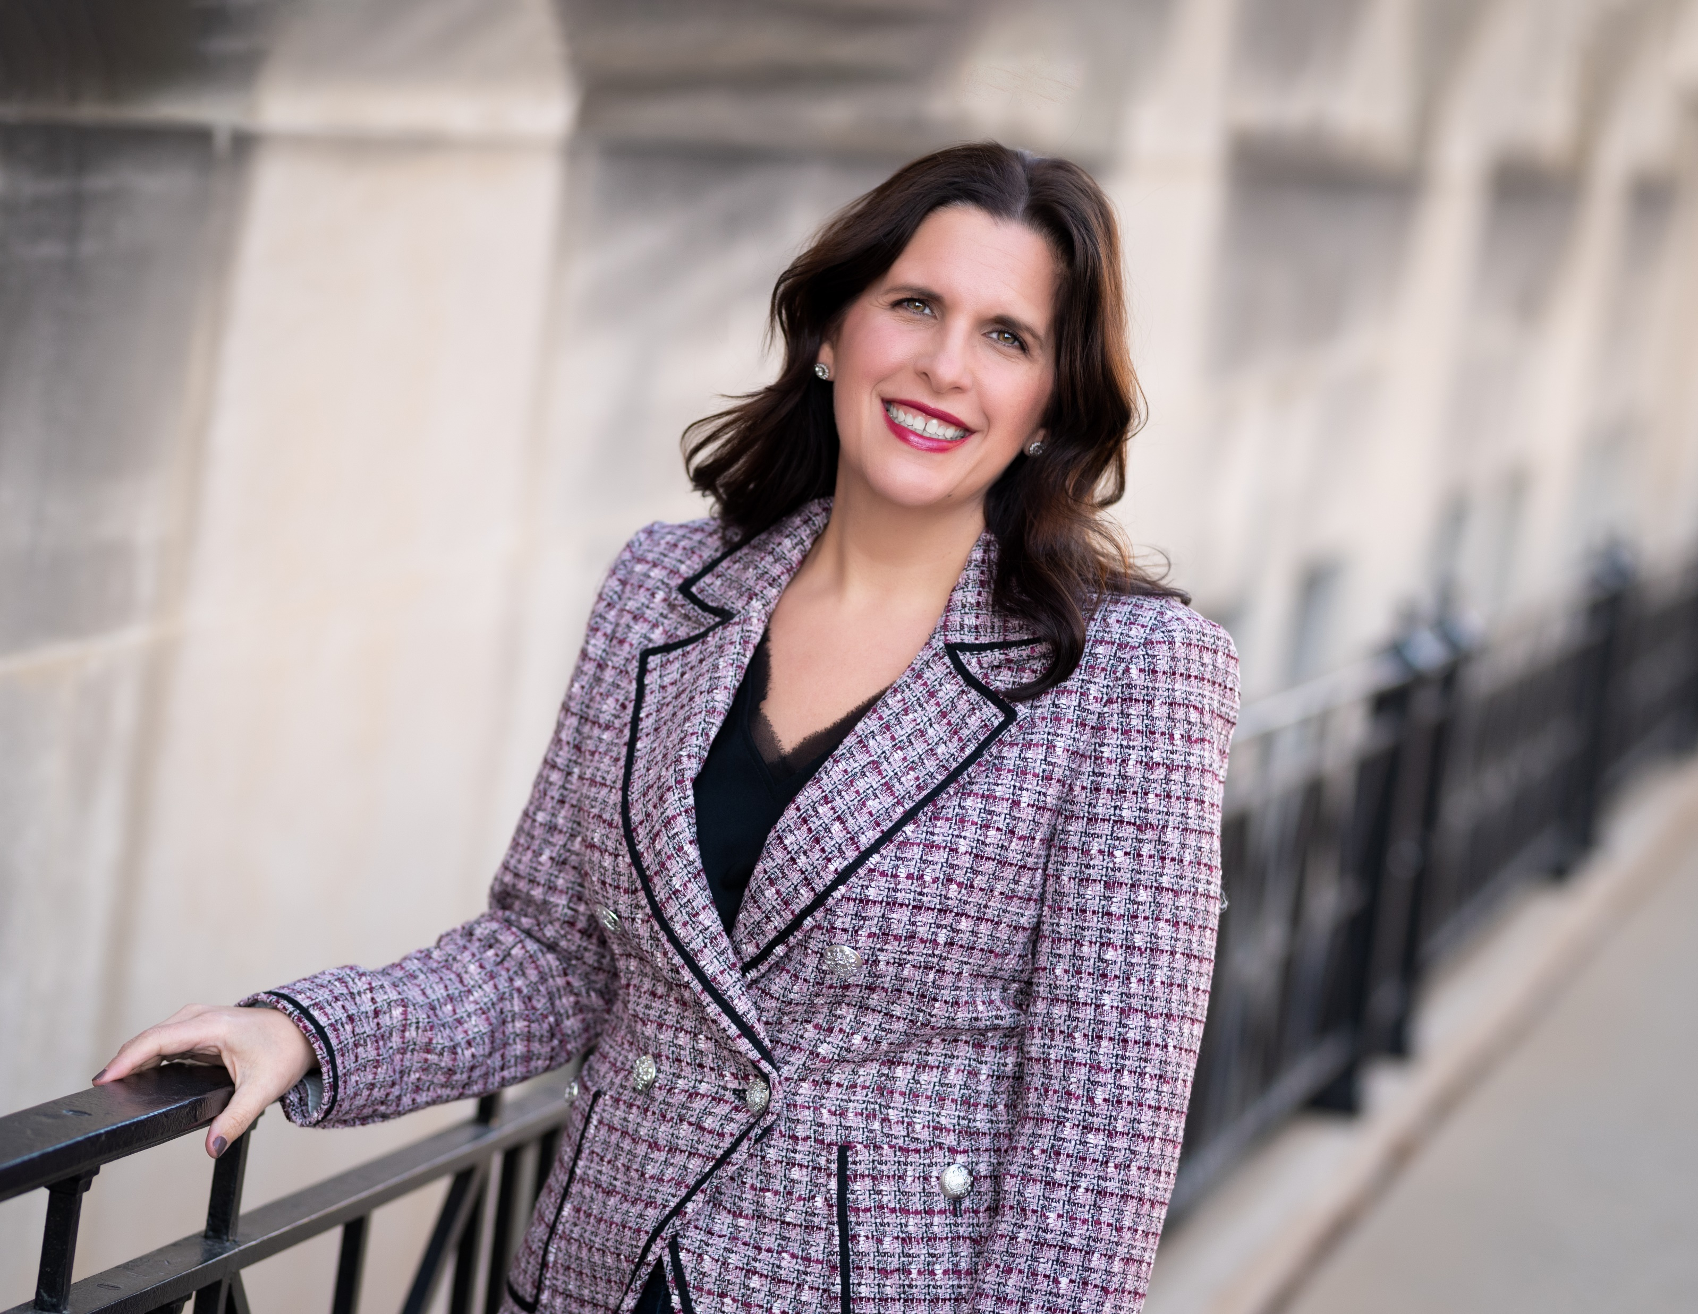
Pat O’Donnell &
Trish Reedy
Multi generational
Leadership
Bill Gardner
Public Image
Jenalea Randall
Membership
Learning from valued leaders

Slide 33
Breakout Groups
We are now going to break you into three groups, small, medium and large club leaders.
Over the next hour you will hear from Rotary leaders on three topics; Membership, Public Image, and Multi-generational Leadership.
Every 20 minutes a new topic facilitator(s) will join your group.
Should you get dropped, please log back in and you will be sent to your group.
Please use this time to learn as much as possible about each topic and to ask questions.
Mandy and DeAnn will now break you into your preassigned groups.

Slide 34
Breakout Rooms by Club Size
Room 1 – Small Clubs
Room 2 – Medium Clubs
Room 3 – Large Clubs
Ambassadors
CAAHT
Concordia
De Soto
Downs
Heart of America E-Club
Hill City
Hugoton
Johnson County
Kingman
LYONS
Marysville
Overbrook
Rotaract Club of Western Kansas City
Sharon Springs
Spring Hill
Sterling
Sublette
Valley Heights
Western Johnson County
Whirlwind Johnson KS
Wichita – Old Town
Abilene
Beloit
Colby
Dodge City
El Dorado
Garden City
Gardner
Great Bend
Guymon
Junction City
Kansas City, Kansas
Lawrence Central
Liberal
McPherson
Olathe
Ottawa
Pratt
Russell
Shawnee Mission
Village West
Washington
WSC-Sunrise
Arkansas City
Derby
East Wichita
Emporia
Hays
Hutchinson
Lawrence
Leavenworth
Leawood
Lenexa
Manhattan
Manhattan Konza
Newton
Overland Park
Overland Park South
Salina Noon
Shawnee
Topeka
Topeka South
West Wichita
Wichita Downtown
Winfield

Slide 35
Drop-in to visit with your DGE at your designated time.
This is a good opportunity to ask questions, discuss issues, and get to know other PEs leading clubs of similar size.
9:40 – 9:55 Small
9:55 – 10:10 Medium
10:10 – 10:25 Large
Please take the open time to step away from your computer, refill your glass and say hi to any two or four-legged people in your home. ☺
WE WILL ALL COME BACK AT 10:30 a.m.
BREAK & DGE ROUNDTABLES

Slide 36
Breakout Rooms by Club Size
Room 1 – Small Clubs
Room 2 – Medium Clubs
Room 3 – Large Clubs
Ambassadors
CAAHT
Concordia
De Soto
Downs
Heart of America E-Club
Hill City
Hugoton
Johnson County
Kingman
LYONS
Marysville
Overbrook
Rotaract Club of Western Kansas City
Sharon Springs
Spring Hill
Sterling
Sublette
Valley Heights
Western Johnson County
Whirlwind Johnson KS
Wichita – Old Town
Abilene
Beloit
Colby
Dodge City
El Dorado
Garden City
Gardner
Great Bend
Guymon
Junction City
Kansas City, Kansas
Lawrence Central
Liberal
McPherson
Olathe
Ottawa
Pratt
Russell
Shawnee Mission
Village West
Washington
WSC-Sunrise
Arkansas City
Derby
East Wichita
Emporia
Hays
Hutchinson
Lawrence
Leavenworth
Leawood
Lenexa
Manhattan
Manhattan Konza
Newton
Overland Park
Overland Park South
Salina Noon
Shawnee
Topeka
Topeka South
West Wichita
Wichita Downtown
Winfield

Slide 37
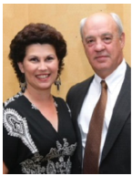
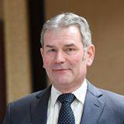
Dana Brewer
District 5680
District Governor
Faron Barr
District 5710
District Governor

Slide 38
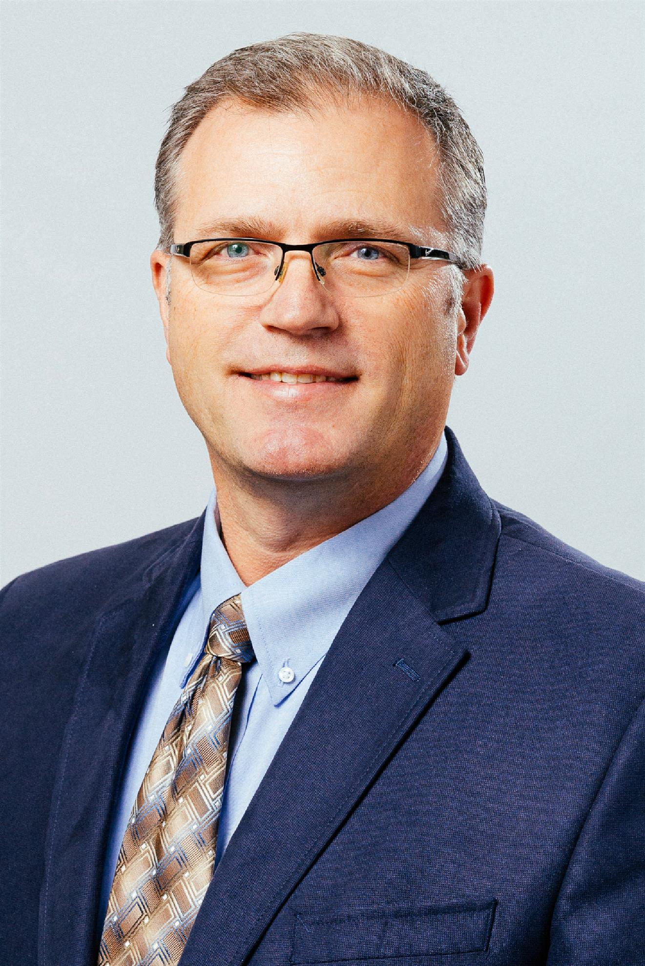
Assistant Regional
Foundation Chair,
Robert Mendoza
Our foundation provides endless possibilities

Slide 39
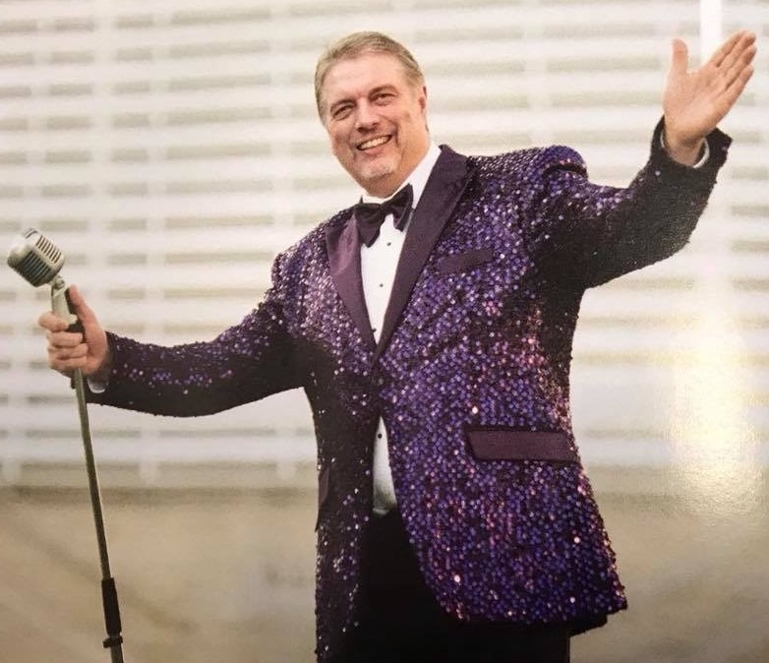
David Lewis
The new reality gives us new opportunities

Slide 40

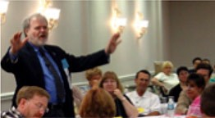
Your challenge – leadership, teams and success

Slide 41
EXERCISE
In the chat box,
write one word,
and only one word,
that best describes
your PETS experience?

Slide 42
PIECES
of
ROTARY

Slide 43
RE
SO
UR
M
CE
O
R
s
E
Rotary magazine – GREAT IDEAS!
Learning Center – WONDERFUL LEARNING MODULES FOR ALL ROTARIANS
Past Presidents – ABUNDANT CONTRIBUTIONS
District Leadership – DETAILED CURRENT INFORMATION
Fellow Rotarians – A WEALTH OF PROFESSIONAL EXPERIENCE

Slide 44

PUT THESE DATES ON YOUR CALENDAR
PROMOTE THE CONVENTION AND ENCOURAGE ATTENDANCE WITH YOUR FELLOW ROTARIANS
USE THIS OPPORUNITY TO SHARE THE BIGGER PICTURE OF ROTARY INTERNATIONAL
USE A PORTION OF THE VIRTUAL CONVENTION AS A PROGRAM FOR YOUR CLUB

Slide 45

DISTRICT CONFERENCE
Watch you
Inbox for
details
District 5710
October 22/23
Manhattan
District 5680
October 29/30
Wichita

Slide 46

DISTRICT 5680 PRESIDENTS-ELECT,
PLEASE STAY FOR A SHORT, BUT NECESSARY DISTRICT BUSINESS MEETING.
THANK YOU!

Slide 47
CLOSING CHALLENGE from
RI PRESIDENT-ELECT
SHEKHAR MEHTA
Rotary Video #2.mp4

Slide 48
Pieces of

Slide 49
SPECIAL THANKS to the speakers, facilitators, district leaders and Heartland PETS steering committee.
VIRTUAL
PETS
President-Elect Training Seminar
2021
Without the work of many Rotarians, VIRTUAL PETS 2021 would not have been a success.

Slide 50
THANK YOU
PRESIDENTS-ELECT of D5680 & D5710
VIRTUAL
PETS
President-Elect Training Seminar
2021
Vern, Fred and the leadership teams of both districts look forward to working along side you during the upcoming Rotary year.

Slide 51

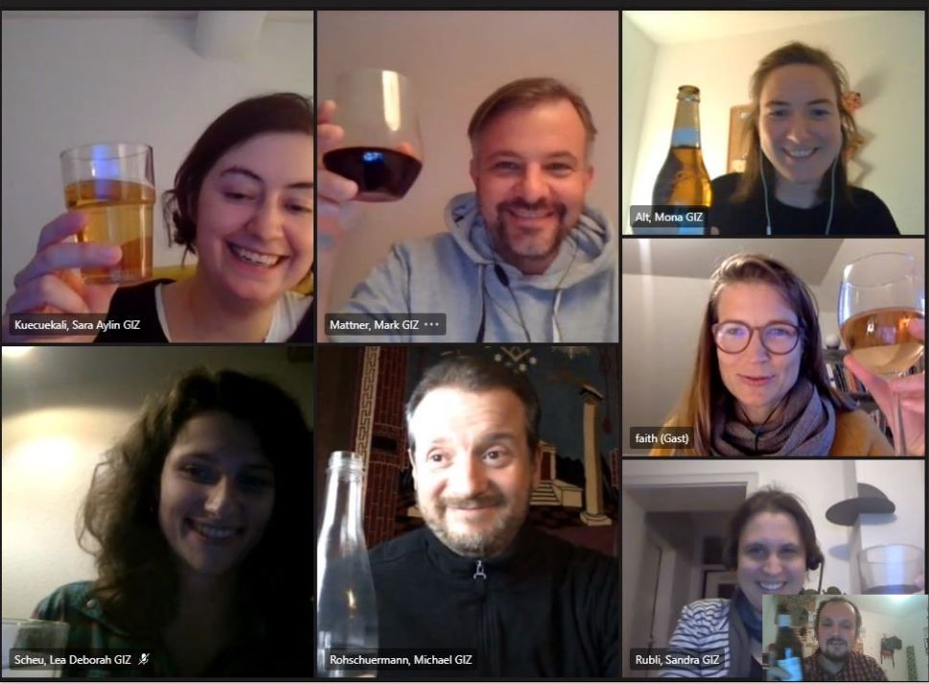


LET US
RAISE OUR GLASSES
to success as we lead our clubs,
to growth of our clubs,
to engagement by fellow Rotarians in new and exciting ways,
and to

