Slide 1

Notes:
We all have different stories about what brought us to Rotary, and what keeps us in Rotary. But we share a common bond: Individually and collectively, we are People of Action.

Slide 2
Together, we see a world where people unite and take action to create lasting change—across the globe, in our communities, and in ourselves.
Notes:
And as People of Action, we know that fulfilling a vision requires a plan. Whenever any of us faces a big challenge in our professional lives, we don’t “tackle it without first being prepared.” We’re the ones who say, “We need a plan,” and—this is equally important—we are the ones who bring everyone together to make that plan and put it into action. I’m here to talk to you about our plan for Rotary’s future. Because we know that there’s a big gap between who we are as an organization today and who we need and want to be.

Slide 3

Leading versus managing

Slide 4

THE CASE FOR CHANGE
Notes:
We began developing this plan by taking a look in the mirror, asking hard questions, and making self-assessments. We conducted focus groups and surveys and asked more than a million members, leaders, and Rotary participants across the world to share their input with us. Our goals were shaped by the feedback of those who know us best – and who already share our commitment to achieving our vision. We learned that our members thought we needed to become more nimble, more open to new ideas and faces and better about capitalizing on changing technologies and trends.

Slide 5

subhead
EXTERNAL FACTORS
Technological
Demographic
Social
Competitive
Economic
Political
Notes:
But we knew we also had to look outside of Rotary. Where is the next generation of leadership coming from? We’re in the midst of a huge demographic shift, but while the rising generations share our passion for community and for making a difference, they have plenty of other places to go to channel that passion—on their phones and in the real world.

Slide 6
subhead
Member Trends
Complexity and layers of leadership
Post Polio?
INTERNAL FACTORS
Worldwide membership numbers are stagnant and even trending down
Complex organizational structure
Lack of continuity
Preparing for a post-polio world
Notes:
As we move closer to polio eradication, we wonder: What are the new stories that will unite us, motivate us, and tell the rest of the world about our impact?

Slide 7
subhead
NORTH AMERICAN MEMBERSHIP TRENDS
Membership decline since 2005:
USA & Canada: 18.7%
Worldwide: 0.1%

Slide 8

subhead
WORLDWIDE
All-time record number of members in and out of Rotary last year

Slide 9
Worldwide Events
Depression
WWII
Hong Kong flu 1M perished
Energy crisis & recession
Black Monday & recession
Asian financial crisis & dotcom bubble
2008 recession & EU debt crisis
Membership
Giving (USD)
Notes:
What impact have worldwide events had on Membership and Giving in the past?
Membership over the years shown alongside economic & health events
Giving Amounts those years alongside economic & health events

Slide 10
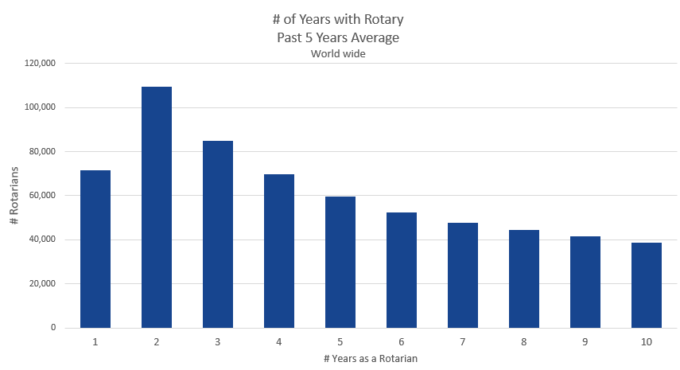
Member Longevity World Wide

Slide 11
Five
Years.
Notes:
This Action Plan is ambitious but achievable, with a five-year time frame that will push us but not exhaust us. It’s focused and to-the-point.

Slide 12
Four
Priorities.
Notes:
It has four priorities. Four. Each priority reflects the input, feedback, and hopes of current and former members, leadership, Rotaractors, alumni, Youth Exchange students, and Rotary staff. In all, we reached out to more than a million people who are connected to Rotary in some way to ensure that our Action Plan priorities are the right ones, and are authentically Rotary. The four priorities are:

Slide 13
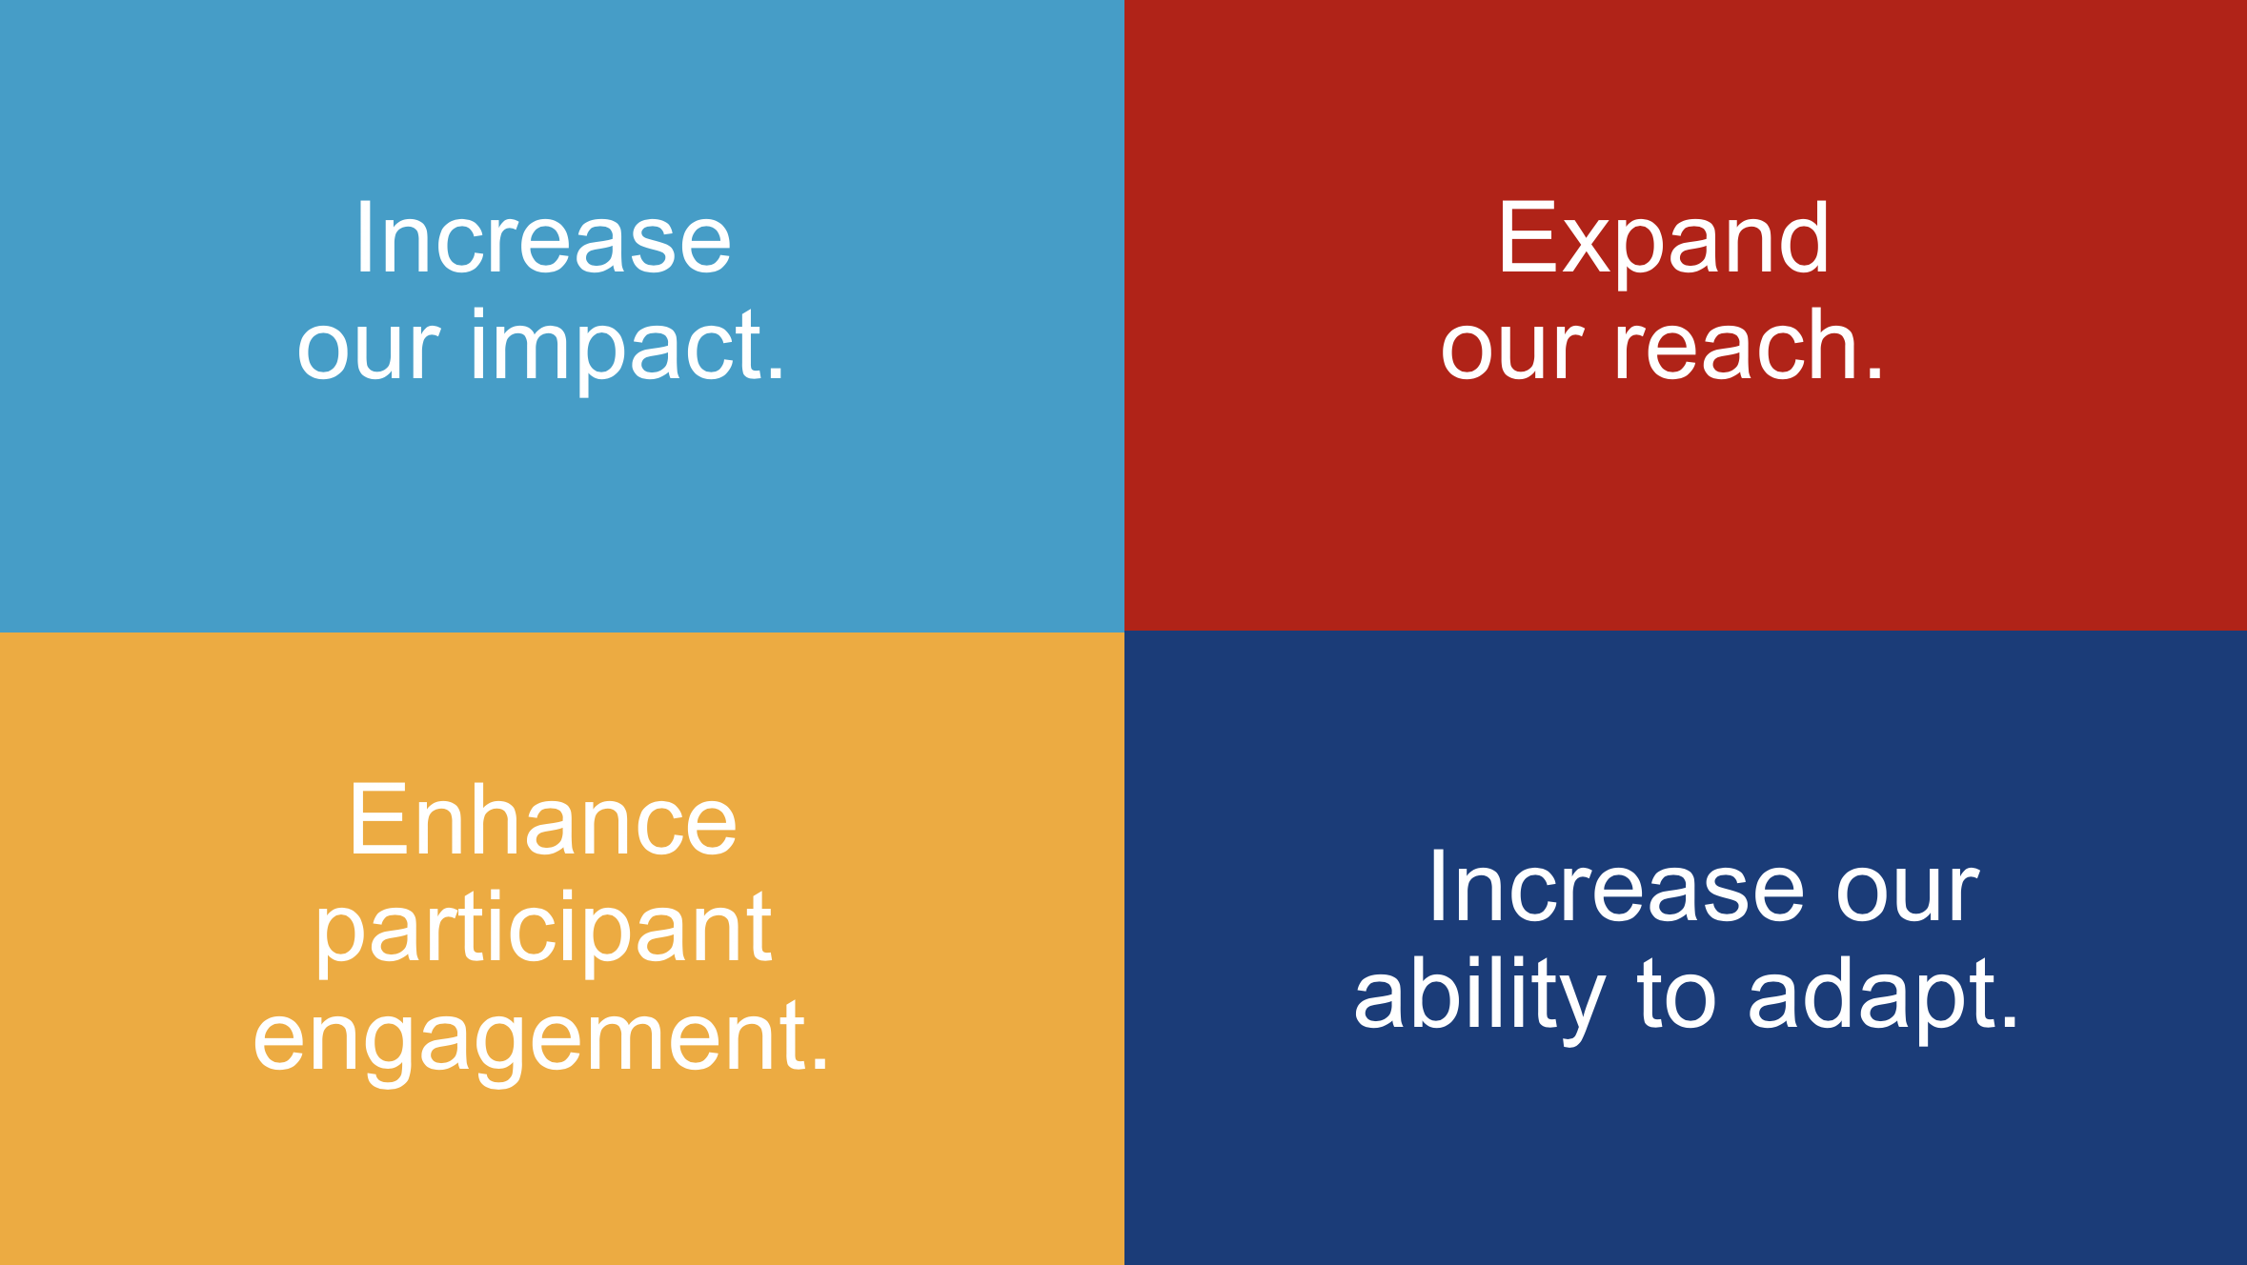
Notes:
As regional leaders, you’ve been entrusted with a pivotal role of encouraging buy-in for the plan, and helping clubs realize our priorities over the next five years . . . a tremendous legacy for the leaders and generations who will follow you.
Increase our impact;
Expand our reach;
Enhance participant engagement; and,
Increase our ability to adapt.

Slide 14
From Priority to Action.
Notes:
Now let’s look at each one in a little more detail and some of the ways we’ll turn these priorities into action.

Slide 15
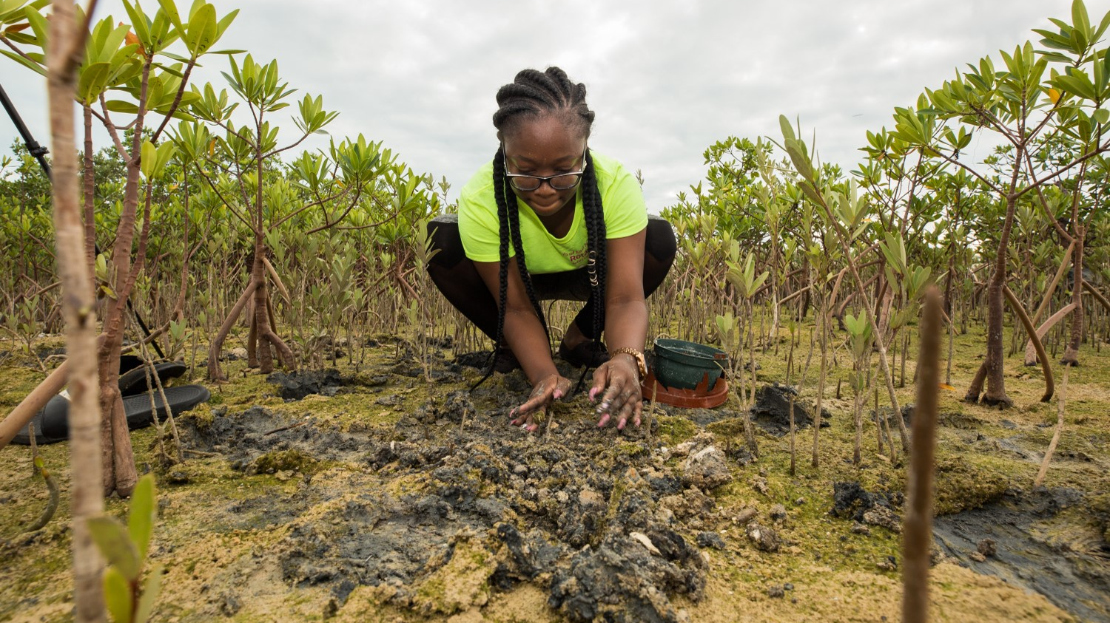
Increase our impact
Eradicate Polio and leverage the legacy
Focus our programs and offerings
Improve our ability to achieve and measure impact
Notes:
Our first Action Plan priority is to increase our impact. Our actions will answer these questions:
What will our legacy be?
How can we define and measure our impact?
How can we do more good in the world?

Slide 16
DEVELOP A STRATEGY about the importance of impactful service projects.
CONDUCT A COMMUNITY ASSESSMENT to determine which issues are top concerns in your community.
FOCUS EFFORTS so more time is spent on activities that make a real impact.
CELEBRATE THE LONG-TERM SUCCESSES but be open to new opportunities to prove your impact has only just begun.
Challenge Your club to:
Increase Its Impact
Notes:
There’s a lot we can do at the club level. We’re going to encourage a greater sense of focus—instead of clubs trying to do too many things and getting only halfway there. We’re going to help clubs collect more information on community impact and do pre- and post-activity evaluations, so they can tell compelling stories about the impact they are making.

Slide 17

EXPAND OUR REACH
Grow and diversify our membership and participation
Create new channels into Rotary
Increase Rotary’s openness and appeal
Build awareness of our impact and brand
Notes:
Our second Action Plan priority is to expand our reach so that we can grow our capacity to make an impact. People of Action activate, inspire and give others hope that they can be part of the change that makes the world better. Together, we must answer these questions:
How can we share our values with new audiences?
How can we inspire more people to take action?
What new models can we test that bring people together to experience the power of Rotary?

Slide 18
SET A GOAL to collaborate with new groups in the community.
USE ROTARY’S MEMBERSHIP TOOLS AND RESOURCES to learn how to make your club more diverse, open and attractive.
TELL COMPELLING STORIES about how Rotary is making a difference.
Challenge Your club to:
Expand Its Reach
Notes:
At the club level, we need to actively invest in bringing in more people from different backgrounds. There are so many ways to create new channels into Rotary—bringing family members to events, involving local Rotaractors, updating clubs’ websites and social media pages. There are all kinds of leaders in communities, and we want those leaders connected to Rotary. So let’s open up our thinking about who a leader can be, and then reach out to these new people: start a dialogue about how we can mutually benefit from their participation in our activities and events.

Slide 19
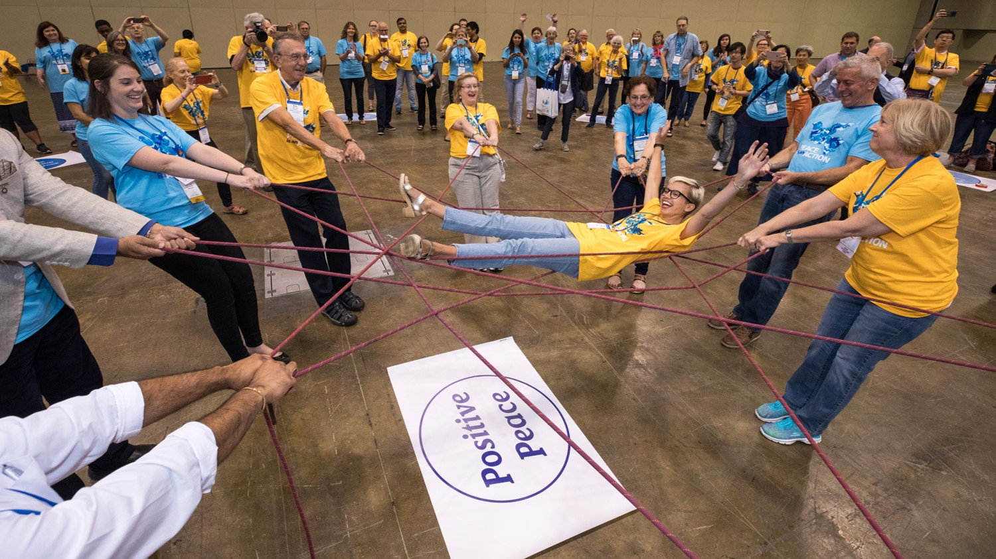
Enhance participant engagement
Support clubs to better engage their members
Develop a participant-centered approach to deliver value
Offer new opportunities for personal and professional connection
Provide leadership development and skills training
Notes:
Our third Action Plan priority is to enhance participant engagement. Our actions will answer these questions:
How can we make sure Rotarians find long-term value in their membership?
What would improve the Rotary experience?
What skills could people learn through Rotary?
How can we better develop our leaders?

Slide 20

What is a participant?

Slide 21
SHIFT FOCUS FROM GAINING NEW MEMBERS TO DELIVERING VALUE and engaging members.
BUILD CONNECTIONS with everyone who encounters Rotary as a participant and invite them to share their ideas and thoughts.
USE ROTARY’S LEARNING CENTER to develop leadership and other skills in participants.
Challenge your club to:
Enhance Its Participant Engagement
Notes:
We want to improve the overall Rotary experience for anyone who affiliates with us. And we should take nothing for granted. We need to look at every encounter as an opportunity to show our people what Rotary can do for them—as individuals and as members of our communities. Let’s create the space for members, participants, and the community at large to provide regular feedback on their experiences and needs. Let’s not wait for a community need to present itself to us: let’s be proactive and become known as the people who spot opportunities for positive change that no one else sees.

Slide 22
Service in the context of COVID-19
SHIFT EMPHASIS TO ENGAGEMENT as a critical step to keep members
Support and encourage ONLINE MEETINGS
Target new members including those in their 2ND OR 3RD YEAR
Taking care of current members
Minimizing Departures
Notes:
Vision on service in the context of COVID-19
Quickly assessing local needs and acting now – needs are shifting rapidly
Unified effort – local focus, global effort
What are we really good at – advocacy and pulling players together
Recovery and rebuilding – preparing for 12-18 months from now (grants)
Highlight our efforts
Shift from Membership to Engagement is critical
Retain members – back to basic values of connections and service
Care of members – buddy system
Focus on delivering value
Tremendously important to continue to meet – supporting/encouraging online meetings

Slide 23
PRIORITY 3 IN ACTION:
Service in the context of COVID-19
and
Shifting emphasis to engagement

Slide 24
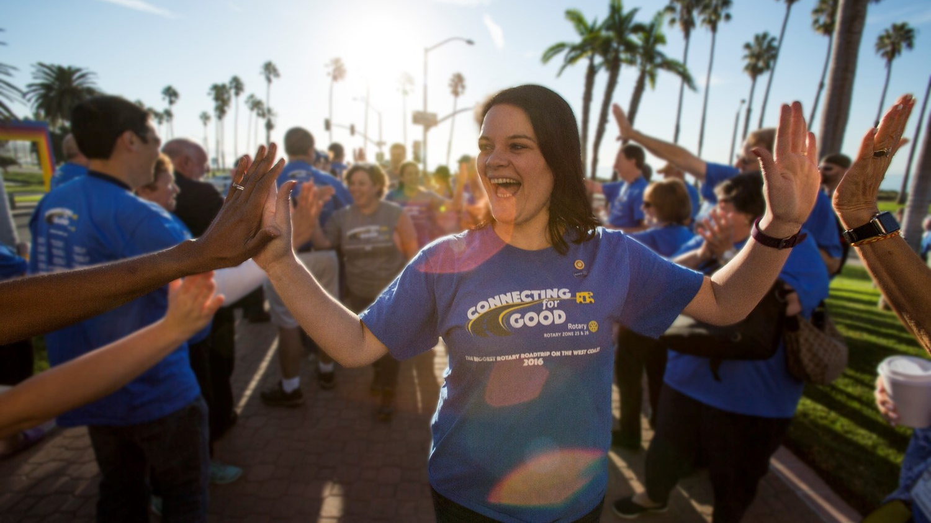
INCREASE OUR ABILITY TO ADAPT
Build a culture of research, innovation, and willingness to take risks
Streamline governance, structure, and processes
Review governance to foster more diverse perspectives in
decision-making
Notes:
Our fourth Action Plan priority is to increase our ability to adapt. Our actions will answer these questions:
How can we adapt faster to a changing world?
How can new perspectives strengthen Rotary?
What new ideas could create lasting change?

Slide 25
HOLD INNOVATION FORUMS AND BRAINSTORMING SESSIONS with members and other participants to gather ideas.
SET ASIDE A SMALL FUND to try new ideas and stay ahead of change.
REVIEW CLUB ROLES, PROCESSES, AND TASKS and look for ways to be more efficient.
ESTABLISH A CONTINUITY PLAN so that efforts become cohesive, and all leaders become invested in a joint success.
Challenge your club to:
Increase Its Ability to Adapt
Notes:
We are inventive, entrepreneurial, and resilient. That’s why we’re People of Action. And because we share those qualities, new approaches to our organizing principles won’t threaten our sense of who we are. It’s time for us to seek out fresh opportunities, to embrace innovative ideas and take calculated risks. We must create more paths to leadership, welcome new voices, and simplify how we operate.
We should also encourage our clubs to take a fresh look at club governance and look at ways to streamline it. They can create a fund to take some risks and try out new activity ideas. They can host the club meeting in a new location and at a new time. They can involve non-Rotarian advisors in club board meetings to gain new and different perspectives and ideas.

Slide 26
“Innovation distinguishes between a leader and a follower.”
Steve Jobs

Slide 27
LEARN MORE
Visit rotary.org/actionplan
Take the strategic planning course
Download the strategic planning guide
Update or create a new strategic plan for your club
Think about how you can bring Rotary’s Action Plan to life
Notes:
If you have any questions about the Action Plan or how you can get involved, or to stay updated on our progress, go to our website: rotary.org/strategicplan.

