Slide 1
We will begin this session in a few minutes Please write your name, title, club and district in your screen name. such as Jane Jones, PE, Anytown, 0000
“Leadership is the process of influencing the activities of an individual or a group in efforts toward goal achievement in a given situation.”
- Hersey & Blanchard (1988)

Slide 2
We’re Rotary, There’s No Limit To What We Can Do.
We're Rotary - There's No Limit To What We Can Do - Bing video

Slide 3
WELCOME PRESIDENTS-ELECT of D5680 & D5710
VIRTUAL
PETS
President-Elect Training Seminar
2021
Pre-PETS session #3
Sunday, March 21
7:00 p.m. – 8:30 p.m.

Slide 4
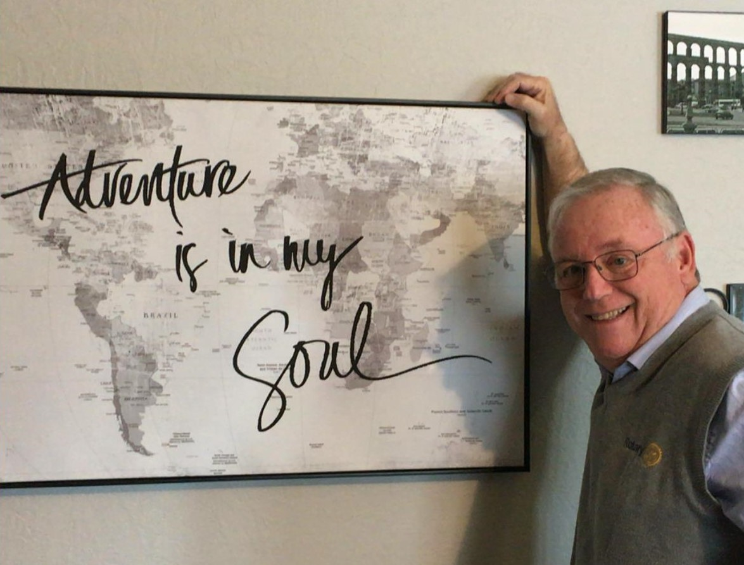
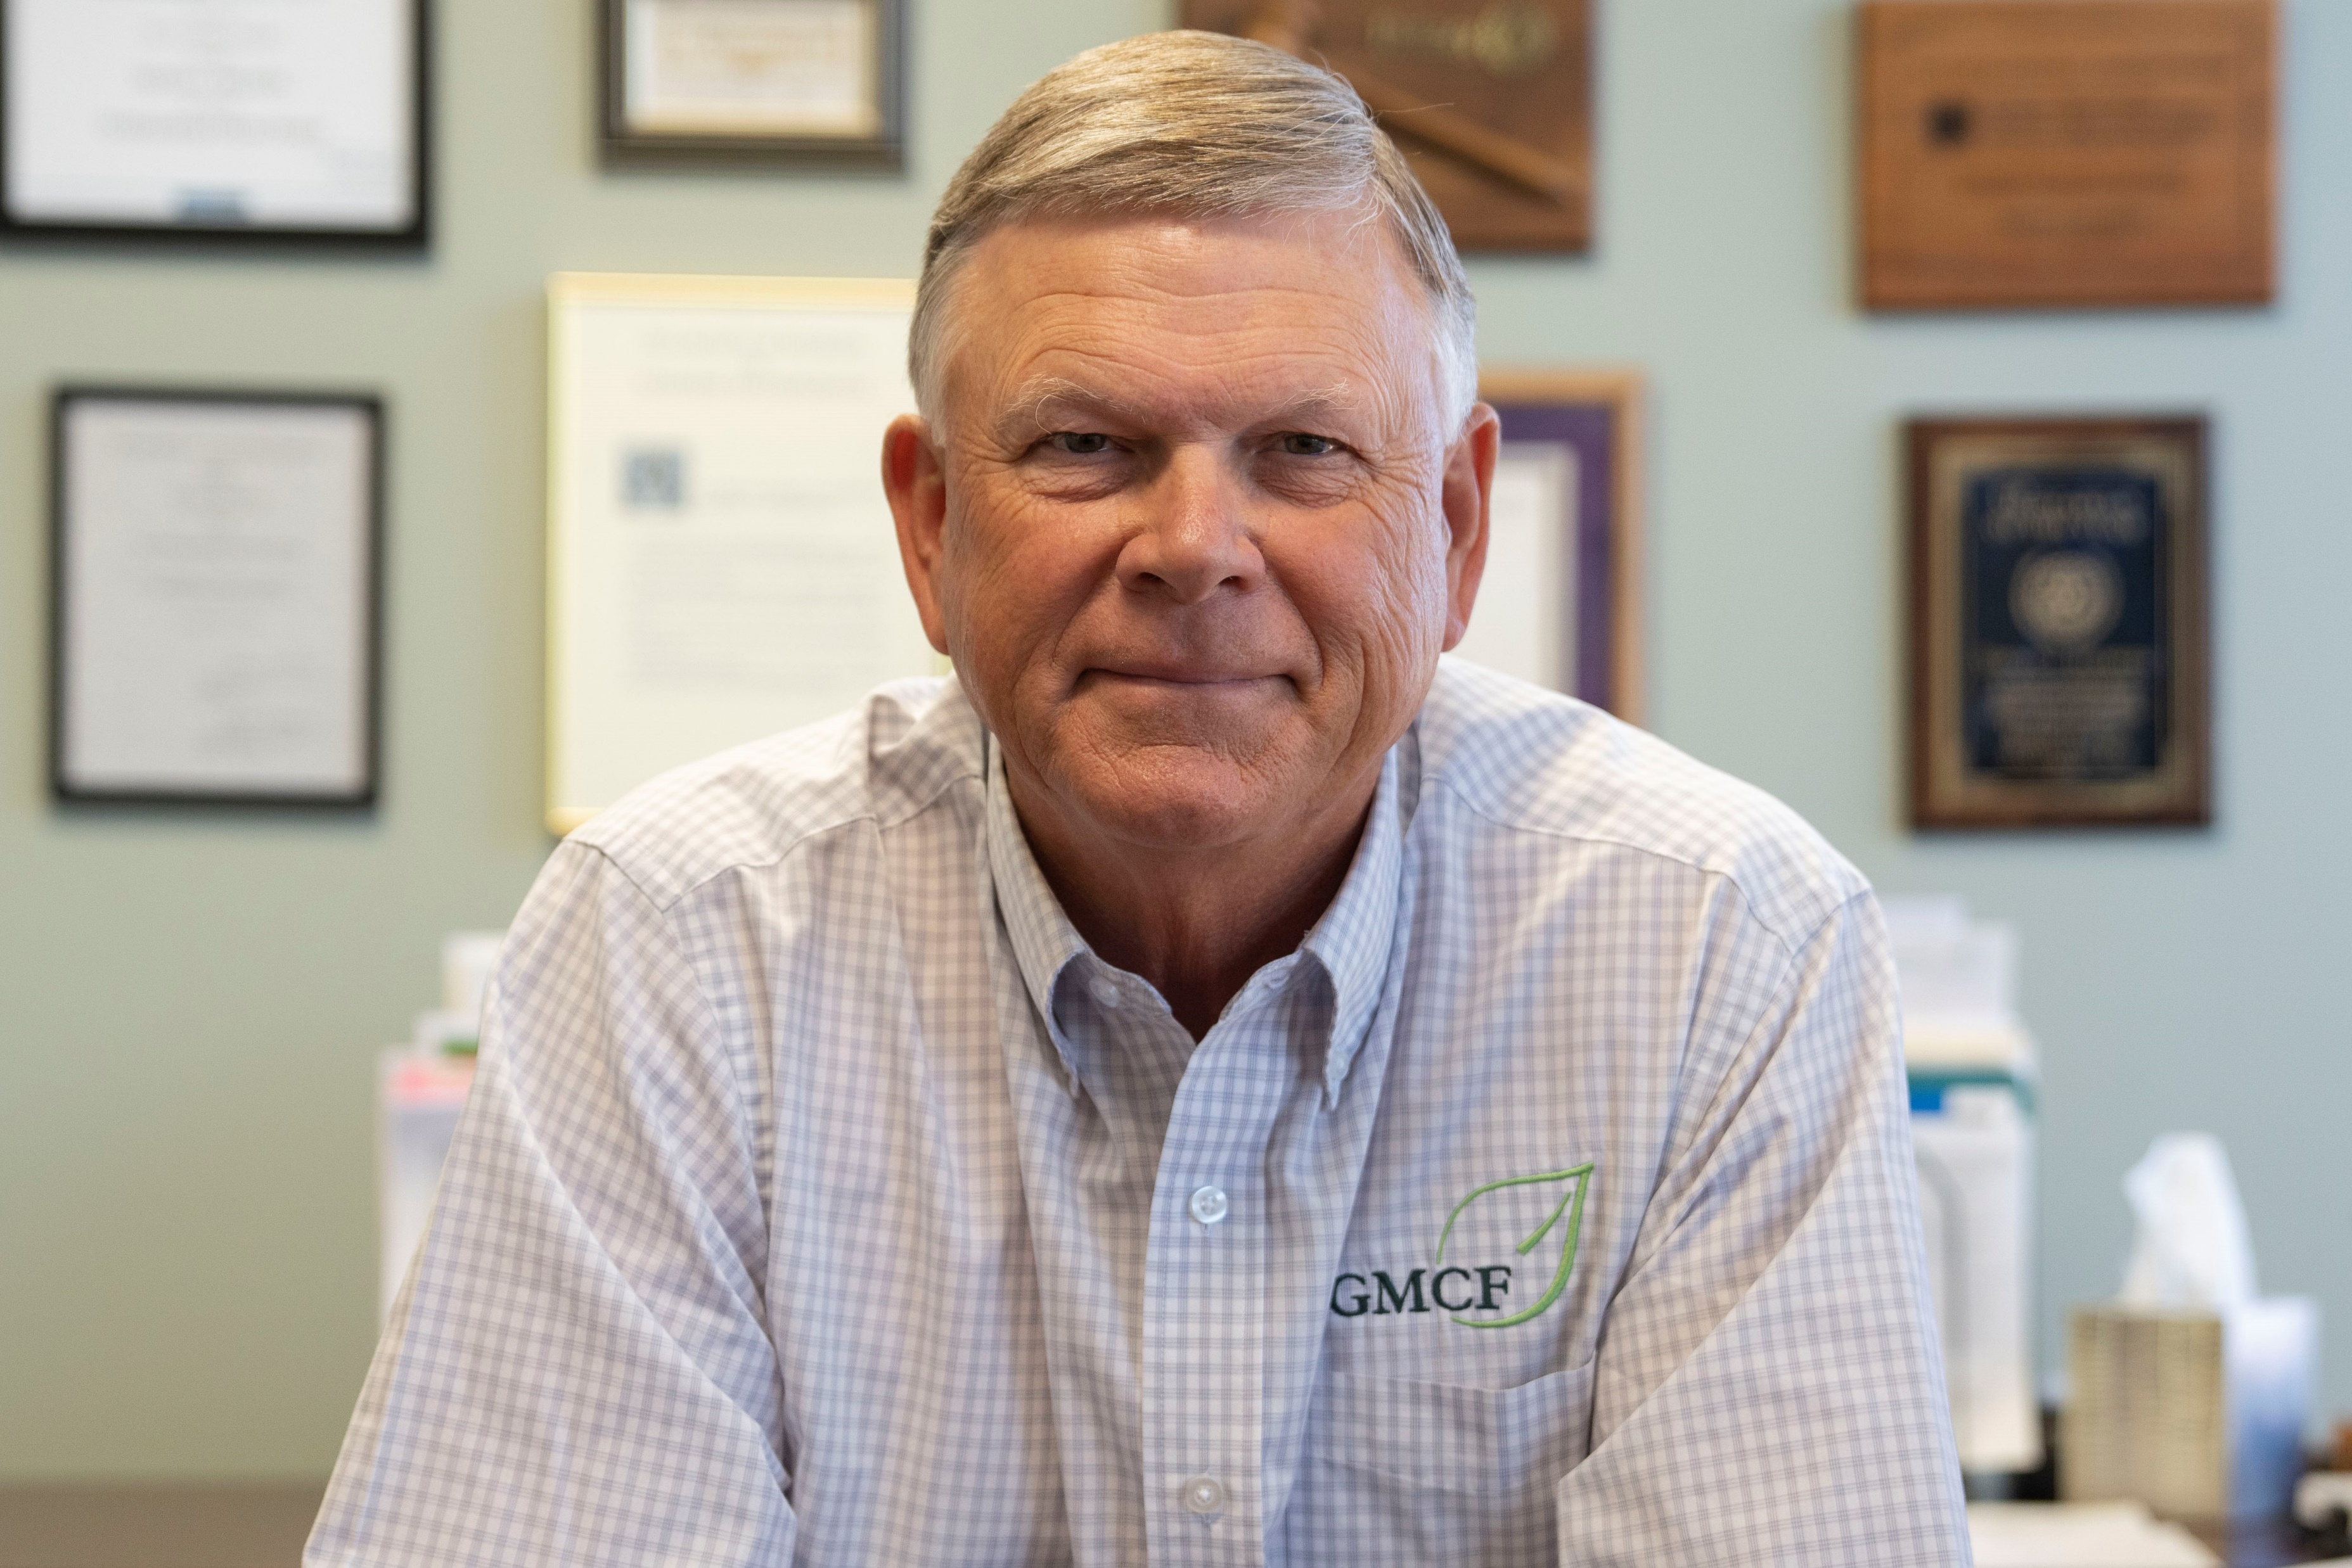
Fred Heismeyer
District 5680
Governor - elect
Vern Henricks
District 5710
Governor - elect

Slide 5
Before We Start
Rename yourself
with first and last name,
title, Club
Please MUTE when
not talking
Turn your
camera on
Use the chat to communicate
questions and comments
Raise hand to contribute
or comment

Slide 6
We continue to ask you this question: ARE YOU READY to Make a World of Difference and

Slide 7
EXERCISE
Poll Question:
Why did you choose to lead your club?
For fame and popularity
To benefit my community
To increase my leadership abilities
No one else was willing to be president
To better our club & fellow Rotarians
I really don’t know!

Slide 8
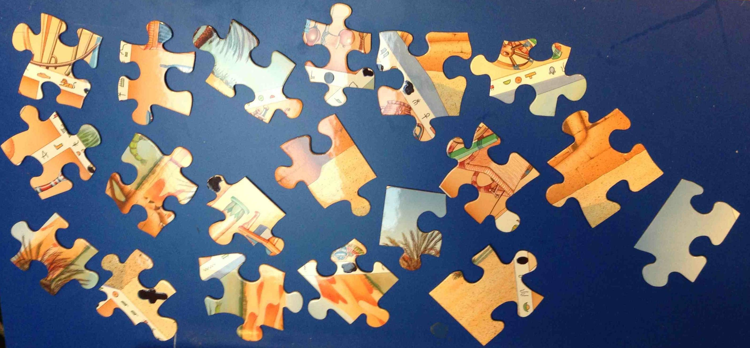
Pieces of

Slide 9
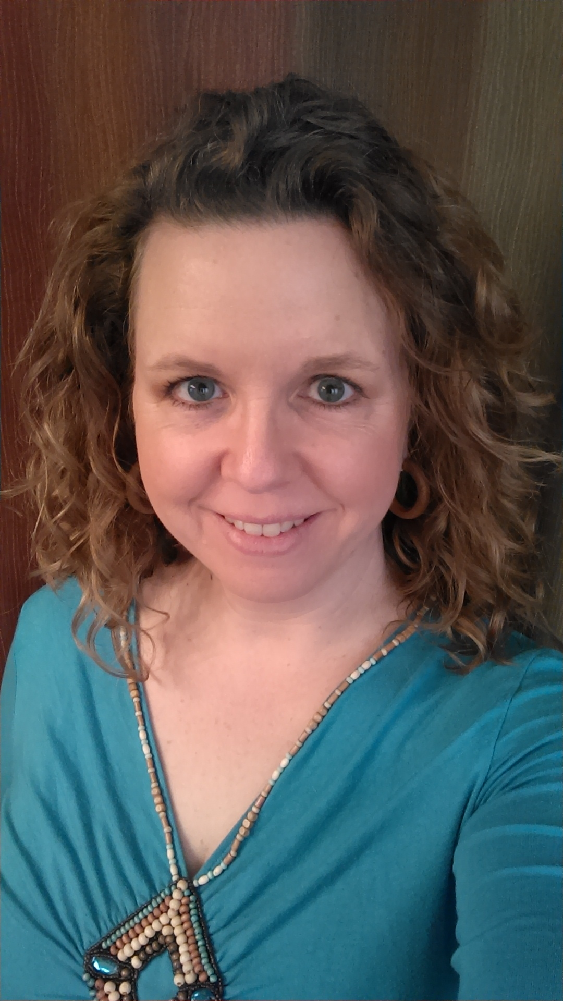
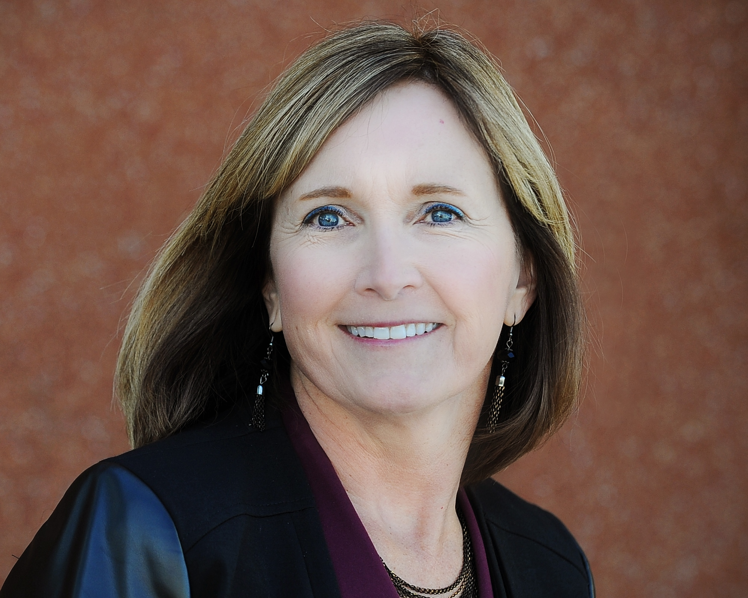
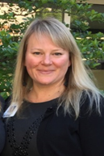
Our panel of past presidents
Amy Lash Esau
Rotary Club of Old Town
Patti Mellard
Rotary Club of Human Trafficking
Crystal Bryant-Kearns
Rotary Club of Konza

Slide 10
HELPFUL HINTS FROM OUR PANEL
Be sure to transition with your predecessor
Get community input
PLAN
“failure to plan is to plan failure”
Recruit an engaged leadership team
Be flexible, nimble, and prepare for change

Slide 11
HELPFUL HINTS FROM OUR PANEL
Read your club’s bylaws
Know Rotary acronyms and explain if needed
Be willing to ask non-performers to step down from position
Set club goals and expectations
Challenge your fellow Rotarians
Be prepared

Slide 12
HELPFUL HINTS FROM OUR PANEL
most important
HAVE
FUN!

Slide 13
EXERCISE
In the chat box,
write one word,
and only one word,
that best describes
your club’ culture?

Slide 14
PIECES
of
ROTARY

Slide 15
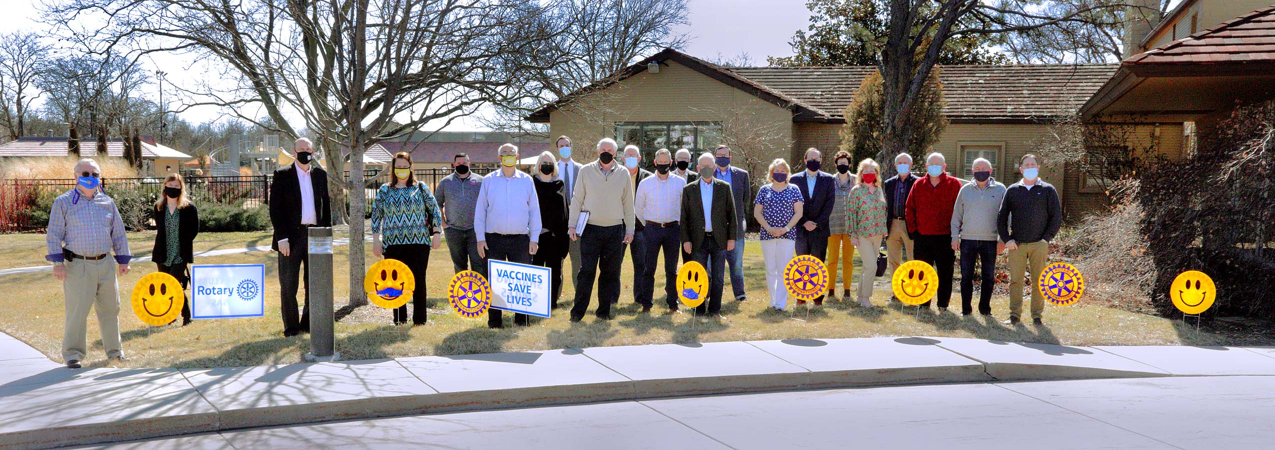
#Rotarysharingsmiles
Make sure your club is using the smile kits
Use the hashtag to spread the word
Take pictures and share them with both districts
Like and share on your personal social media sites

Slide 16
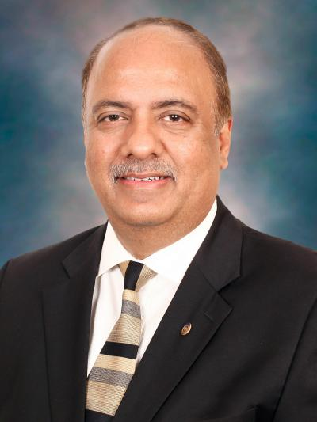
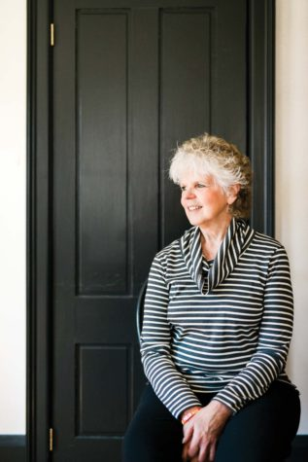
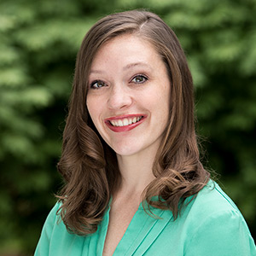
Friday evening
a mix of inspirational messages and Rotary virtual fellowship
RI President-Elect
Shekhar Mehta
Ann Lee Hussey
Sarah Wine
4:30 – 5:00 p.m. SOCIAL
5:00 - 6:30 p.m. GREAT SPEAKERS
6:30 – 6:45 p.m. ENTERTAINMENT
6:45 – 7:00 p.m. CLOSING

Slide 17
RE
SO
UR
CE
s
District 5680 website – www.rotary5680.org
District 5710 website – www.rotary5710.org
D5680 RYLA –
Campus Activities - Leadership - Southwestern College (sckans.edu)
RI website – www.Rotary.org
Heartland PETS – www.heartlandpets.org
My Rotary Log-in:
Learning Center Individual Profile
Giving History Rotary Club Central

Slide 18
Attention: D5680 PEs
LEARNING OPPORTUNITIES
for your club’s officers and chairs
Zoom meeting: Saturday, April 3
10:30 a.m. – 12:00 p.m.
OPEN TO ALL ROTARIANS
LEARN DETAILS ABOUT
District Grant Process: 10:30 a.m. – 11:00 a.m.
Youth Programs: 11:00 a.m. – 11:30 a.m.
Strategic Engagement: 11:30 a.m. – 12:00 p.m.
INVITE YOUR 2021-22 CLUB OFFICERS/CHAIRS

Slide 19
Pieces of

Slide 20
THANK YOU PRESIDENTS-ELECT of D5680 & D5710
VIRTUAL
PETS
President-Elect Training Seminar
2021
See you again at the next PETS session
Friday, March 26
4:30 p.m. – 7:00 p.m.

